Slide 1
Why this film called True Cost?

Slide 2
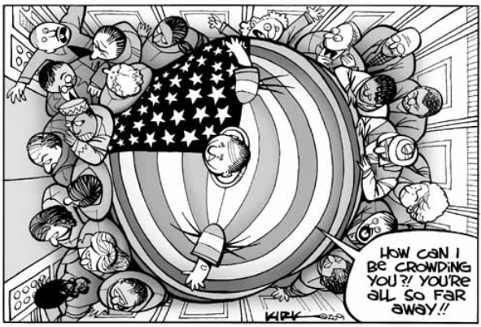

Slide 3
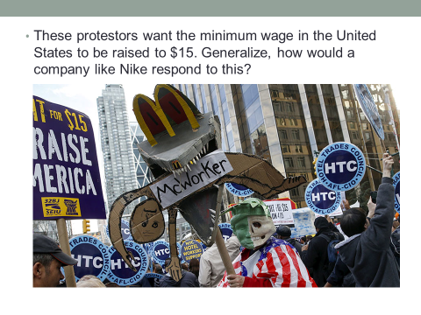
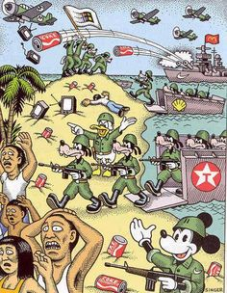
What job are the people protesting?
Discussion about how service makes up most of money, transition into economies
Why doesn’t McDonalds send its jobs overseas?

Slide 4
Weebly
Create an account on the website Weebly.
Register with your school email.
Your website should have the following pages:
Homepage
Human Rights Violation #1
Human Rights Violation #2
Human Rights Violation #3
When you click publish, there is blue link. Copy and paste that link to a page OneNote.
Figure out how to add pictures, videos, and change your sites header.

Slide 5
Identifying Human Rights…
What is happening?
What rights are involved?
In your opinion, what should be done about it?
Video, Banksy protest…

