Slide 1
The Blind Men and the Elephant

Slide 2
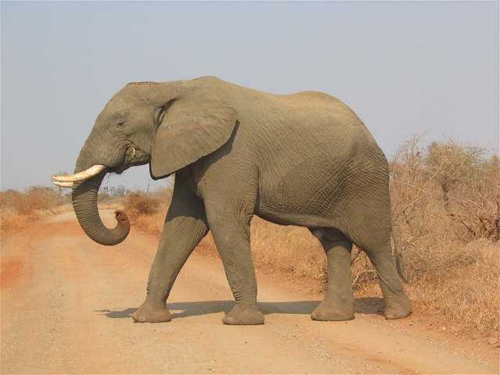
It was six men of Indostan
To learning much inclined,
Who went to see the Elephant~(Though all of them were blind),
That each by observation~Might satisfy his mind.

Slide 3
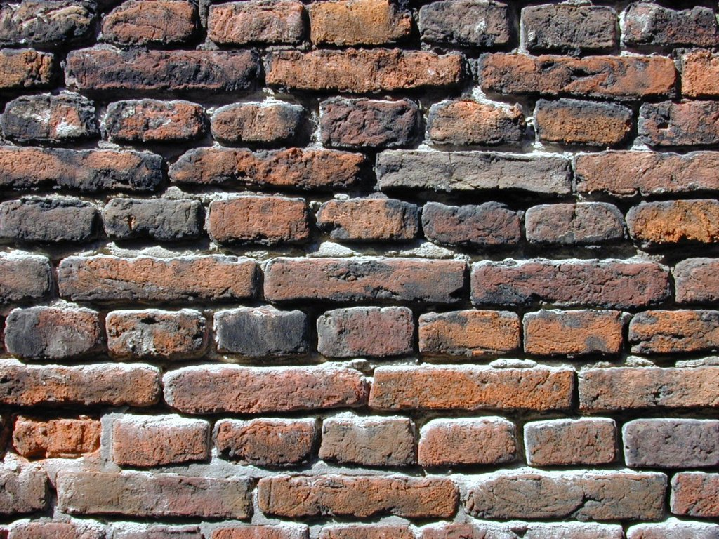
The First approached the Elephant,
And happening to fall
Against his broad and sturdy side, ~ At once began to bawl:
"God bless me! but the Elephant ~ Is very like a wall!"

Slide 4
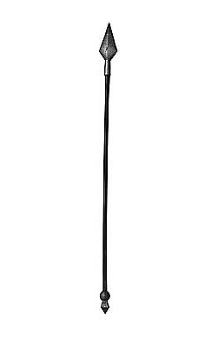
The Second, feeling of the tusk,
Cried, "Ho! what have we here?
So very round and smooth and sharp? ~ To me 'tis mighty clear
This wonder of an Elephant ~ Is very like a spear!"

Slide 5
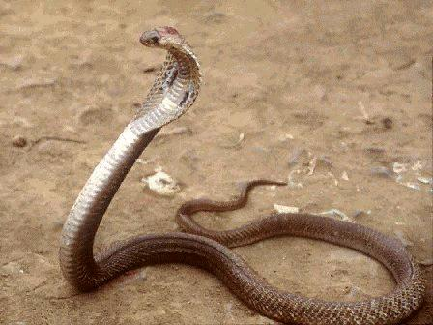
The Third approached the animal,
And happening to take
The squirming trunk within his hands, ~ Thus boldly up and spake:
"I see," quoth he, "the Elephant ~ Is very like a snake!"

Slide 6
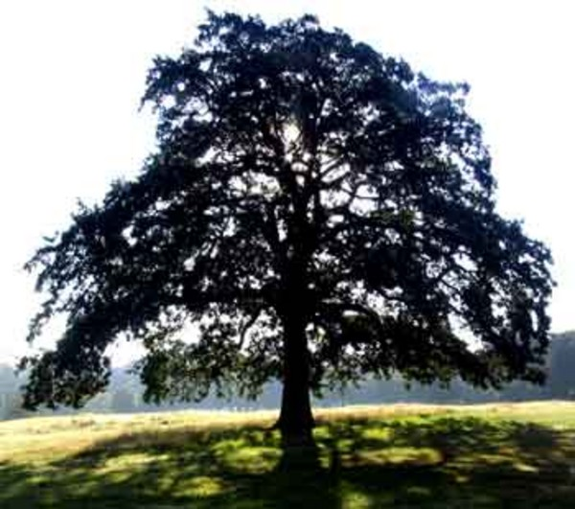
The Fourth reached out an eager hand,
And felt about the knee.
"What most this wondrous beast is like ~ Is mighty plain," quoth he;
"'Tis clear enough the Elephant ~ Is very like a tree!"

Slide 7

The Fifth who chanced to touch the ear,
Said: "E'en the blindest man
can tell what this resembles most;
Deny the fact who can,
This marvel of an Elephant ~ Is very like a fan!"

Slide 8

The Sixth no sooner had begun
About the beast to grope,
Than, seizing on the swinging tail ~ That fell within his scope,
"I see," quoth he, "the Elephant ~ Is very like a rope!

Slide 9
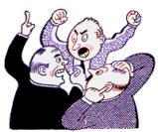
And so these men of Indostan
Disputed loud and long,
Each in his own opinion ~ Exceeding stiff and strong,
Though each was partly in the right ~ And all were in the wrong!

Slide 10
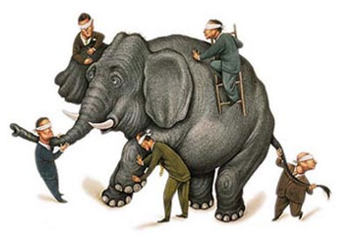
Moral
So oft in theologic wars,
The disputants, I ween,
Rail on in utter ignorance
Of what each other mean,
And prate about an Elephant
Not one of them has seen!
-John Godfrey Saxe

Slide 11
Why do the blind men reach the conclusions they do? Give examples from the poem.
Why don't the blind men "look" further for the whole truth?
What is the point of the poem?
Explain why the message is more interesting and clearer when told through a story than if the poet said it more directly
Describe a time when you jumped to a conclusion about something and later found out you only had part of the story or truth.
In the last stanza, the poet compares the elephant to God. What is he saying about people's perspectives of God?

