Slide 1
Sub. Africa Vocab
Patterson

Slide 2
Vocabulary
On each of the following slides there is a picture and a vocabulary word. When called upon, your job is to guess what the word or phrase means based upon the picture.

Slide 3
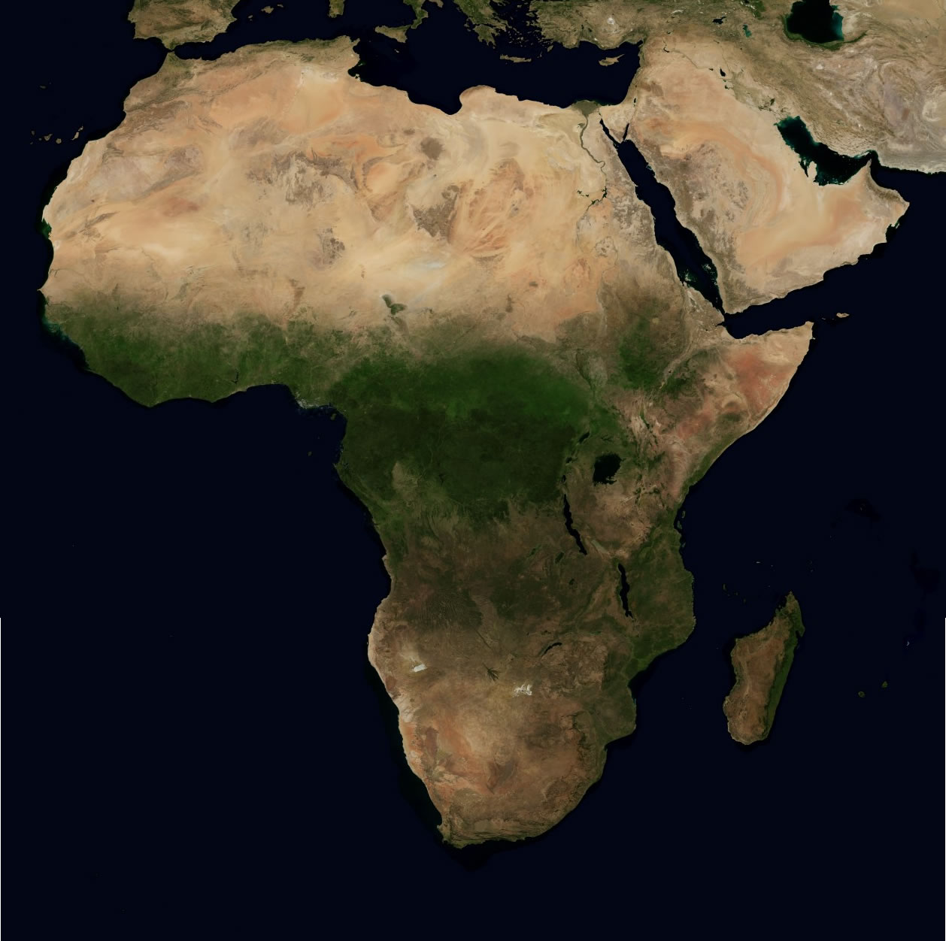
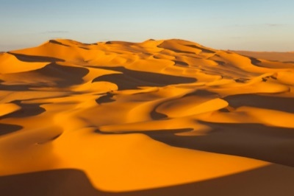


Sub-Saharan Africa

Slide 4
Sub-Saharan Africa
the region below the Sahara Desert, which is considered African rather than Arab.
Sub-Saharan African is mostly Christian. North Africa is mostly Muslim.

Slide 5
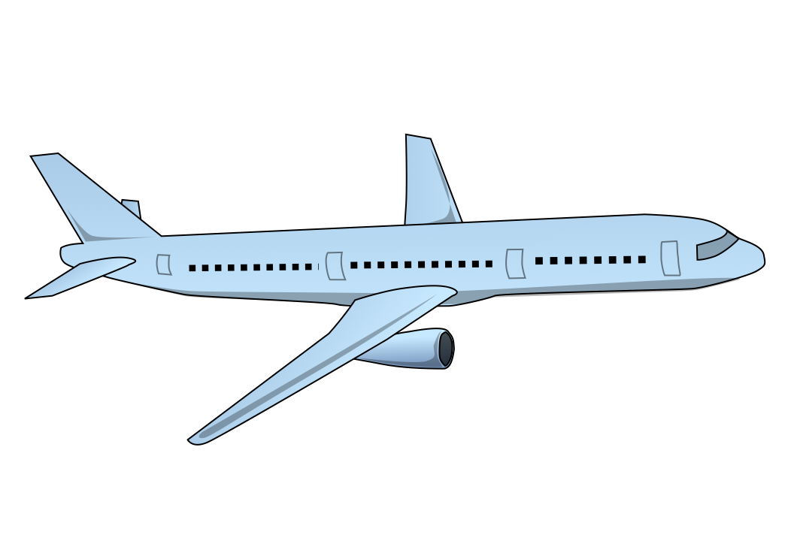


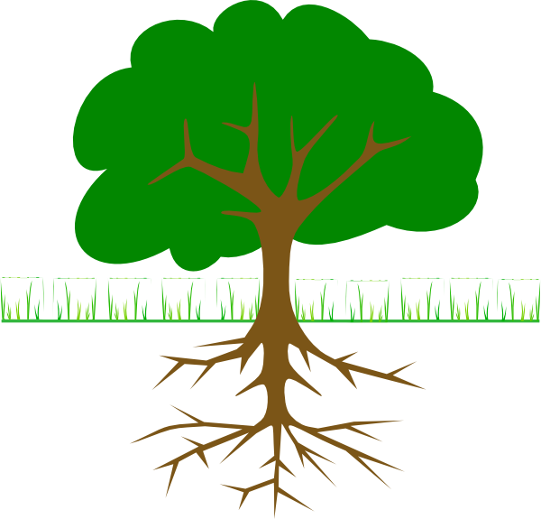
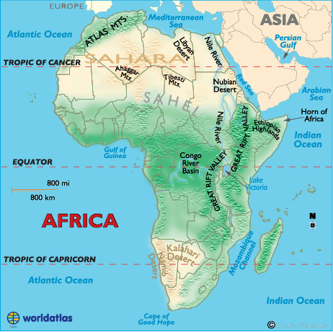

Physical Map

Slide 6
Physical Maps
show what a region looks like by showing things such as deserts, plains, and mountains.

Slide 7

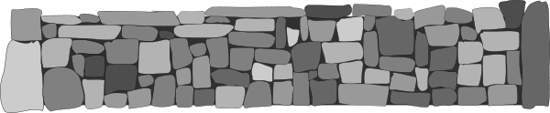
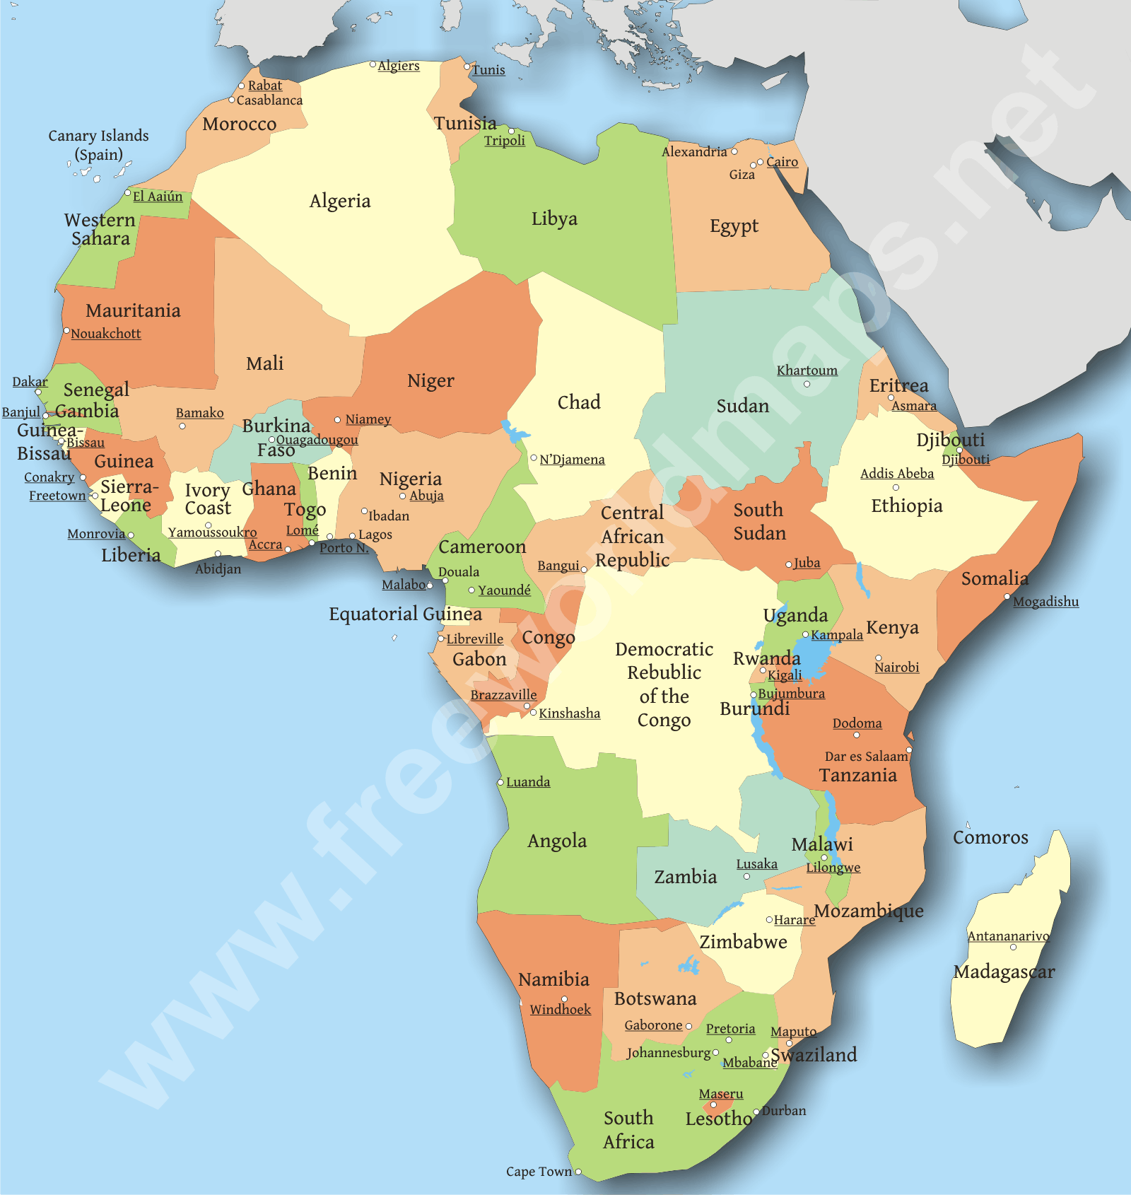

Political Map

Slide 8
Political Maps
show continents, countries, and divisions within countries.

Slide 9
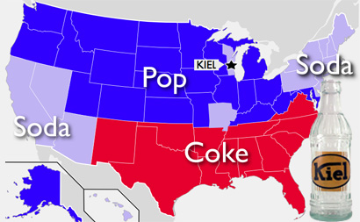
Thematic Map
Potential Topics
Oil Location
Birth Rates
Crime Rate
Land Use
Education Rates
Etc….

Slide 10
Thematic Map
are special issue maps, showing things like: land use, language, and population.

Slide 11


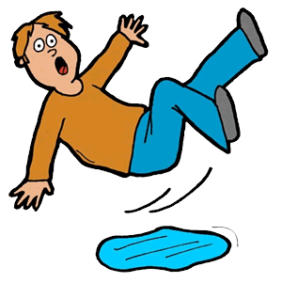
Primary Source
Kathryn!!!!

Slide 12
Primary Resource
a document or physical object which was written or created during the time under study.

Slide 13
Secondary Source
Kathryn!!!!

Slide 14
Secondary Resource
a document or physical object which was written or after the time under study.

Slide 15




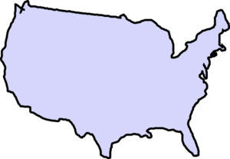
Colonize

Slide 16
Colonize
to settle in an area and take control of its government.

Slide 17
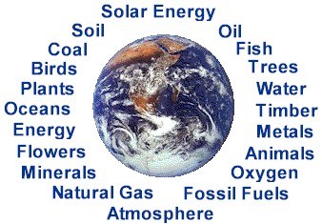
Natural Resources
=

Slide 18
Natural Resources
A supply of materials produced by the Earth that are valuable to human society (usually for natural resources).

Slide 19


Cultural Diffusion

Slide 20
Cultural Diffusion
the spread of customs and ideas from one culture to another.

Slide 21
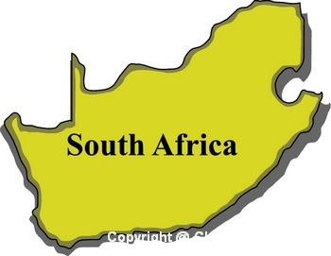
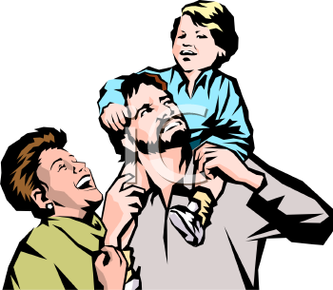
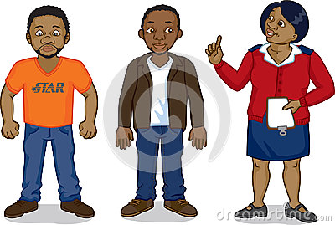
Apartheid

Slide 22
Apartheid
A series of racist laws that prevented people of color from becoming powerful and wealthy.

Slide 23


Nationalism

Slide 24

Nationalism
a feeling of pride in one’s homeland; a group’s identity as members of a nation.

Slide 26

Word Wall
Study Help!!!
Computer
https://quizlet.com/_u0we0
Phone
1. Open Up Quizlet App
2. Search for Pattea42
3. Click on Sub-Saharan Africa

Slide 27
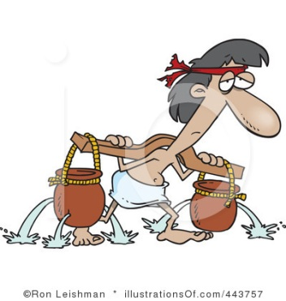

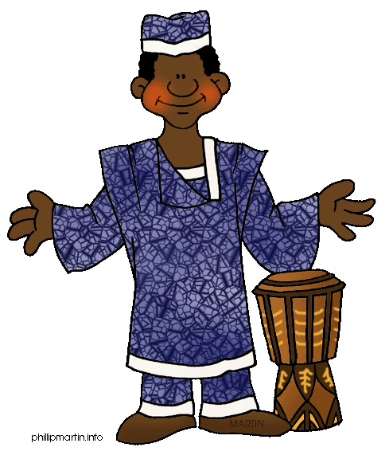
Slave Trade

Slide 28
Slave Trade
The transporting of humans as slaves, with a focus on Africa to the Americas.

Slide 29
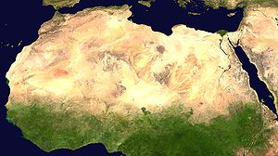
Sahel

Slide 30
Sahel (Shore)
area between the Sahara desert and the rest of Africa

Slide 31
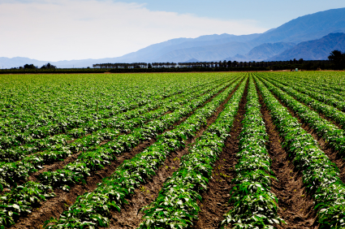
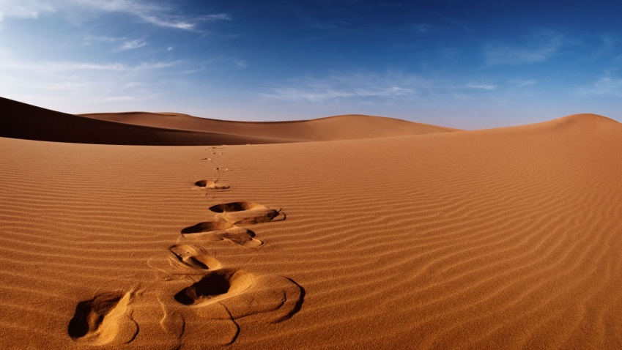
Desertification

Slide 32
Desertification
the process by which farmland becomes too dry or damaged to support life.

Slide 33
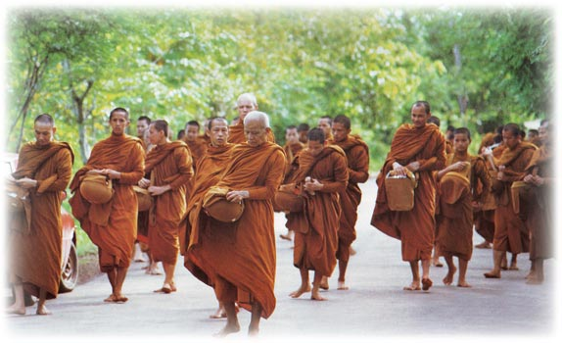


Culture

Slide 34
Culture
A group of people’s way of life, who share customs and beliefs.

