Slide 1
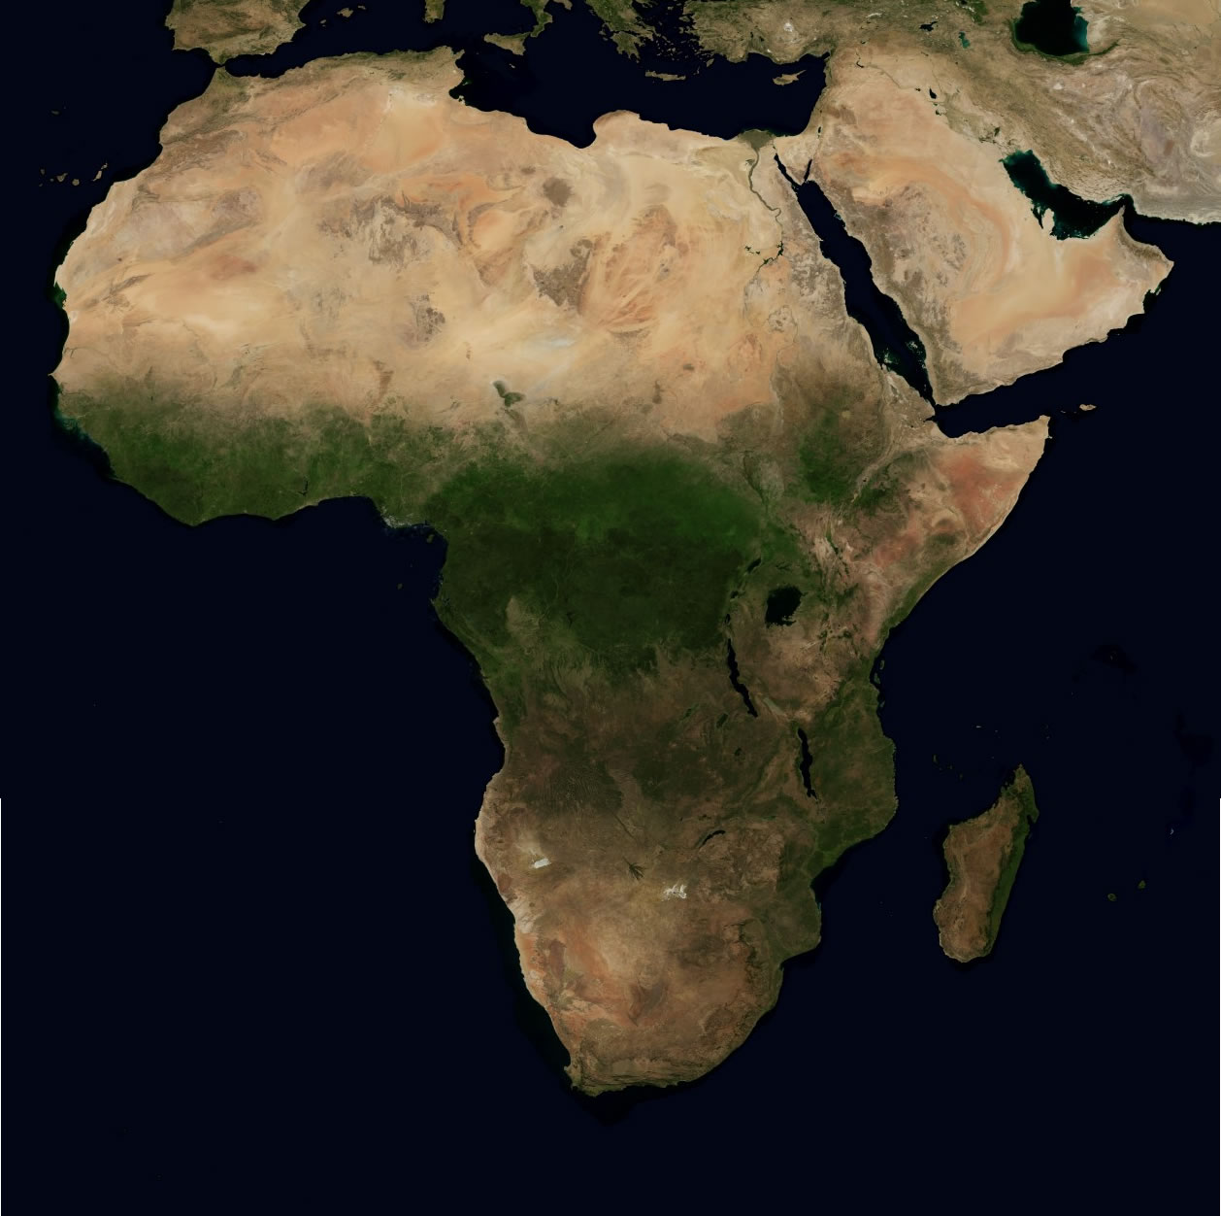
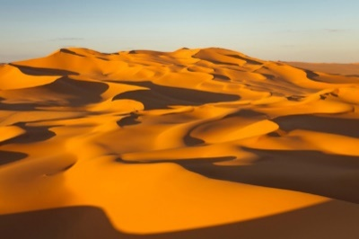


Sub-Saharan Africa
the region below the Sahara Desert, which is considered African rather than Arab.

Slide 2





Physical Map
show what a region looks like by showing things such as deserts, plains, and mountains.

Slide 3



Political Maps
Show continents, countries, and divisions within countries.

Slide 4
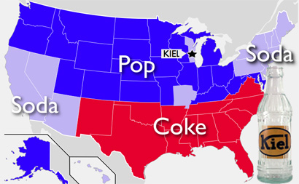
Thematic Map
Are issue maps, showing things like: land use, language, and population in an area.

Slide 5



Primary Source
a document or physical object which was written or created during the time under study.
Kathryn!!!!

Slide 6
Secondary Source
a document or physical object which was written or after the time under study.
Kathryn!!!!

Slide 7



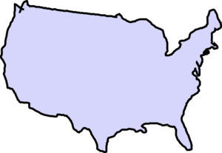

Colonize
to settle in an area and take control of its government (usually for natural resources).

Slide 8
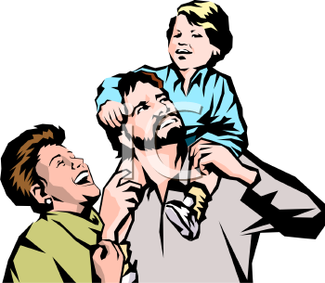
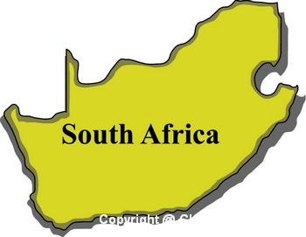
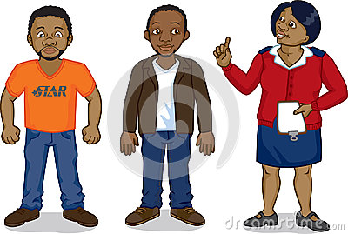
Apartheid
A series of racist laws that prevented people of color from becoming powerful and wealthy.

Slide 9
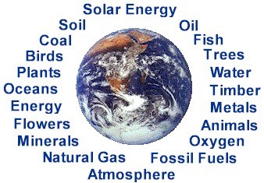
Natural Resources
A supply of materials produced by the Earth that are valuable to human society.
=

Slide 10


Cultural Diffusion
the spread of customs and ideas from one culture to another.

Slide 11


Nationalism
Is a feeling of pride in one’s country or group.

