Slide 1
South Asia
Patterson

Slide 2
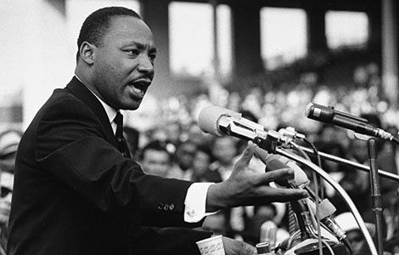
Gandhi vs. Great Britain

Slide 3
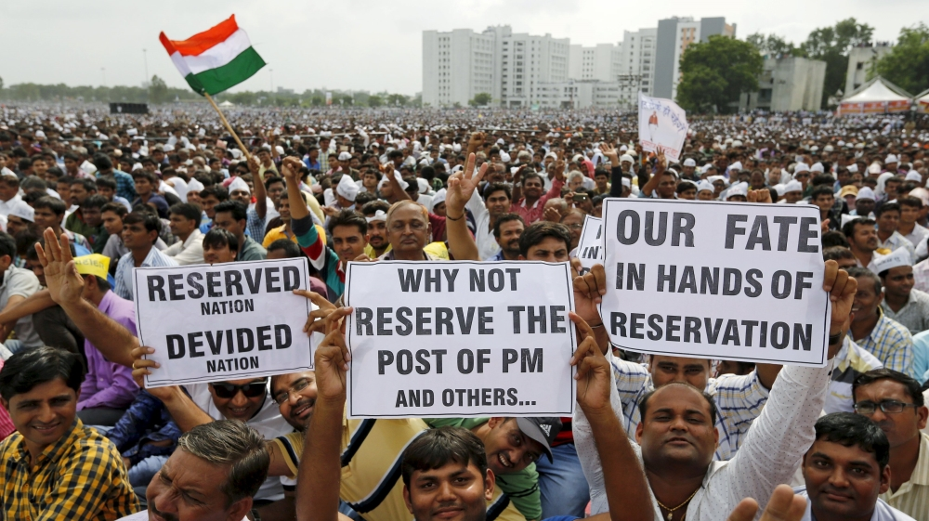
Caste System and the Case for Affirmative Action

Slide 4
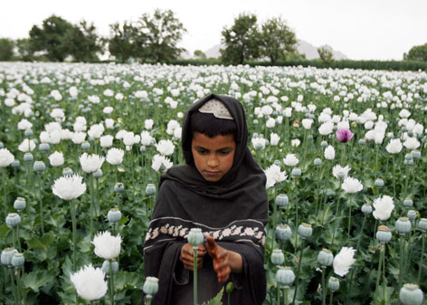
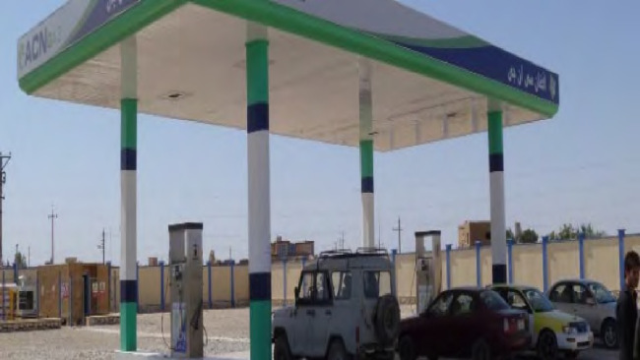
Opium in Afghanistan

Slide 5
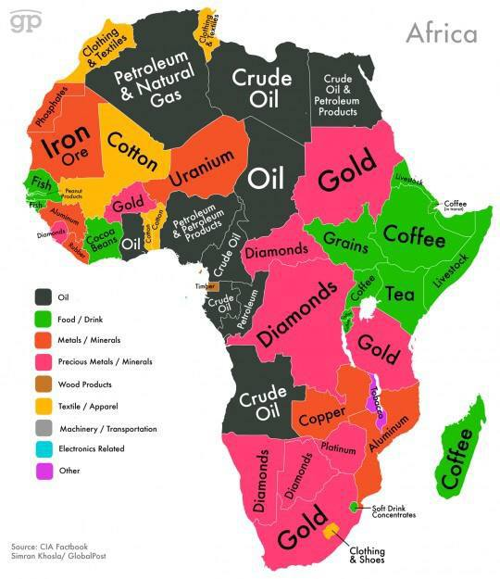
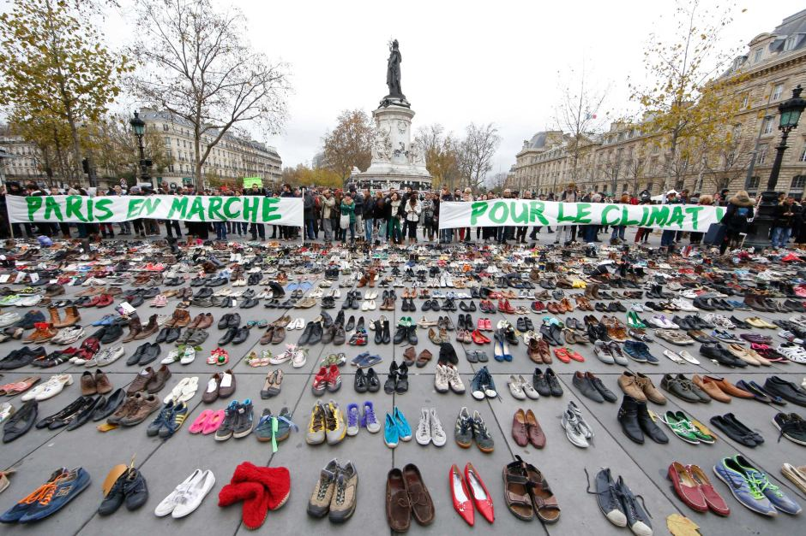
Developing Countries

Slide 6
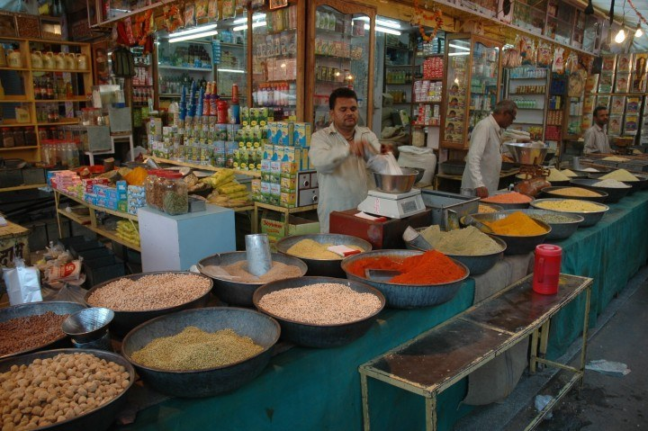
Other Topics

Slide 7
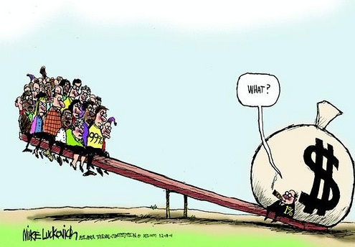
Inequality
Power
Resources
Opportunities

Slide 8
Inequality
Imbalance of what you’re measuring (power, resources, etc..)

Slide 9
Scarcity
Resources
Demand
Demand
Demand
Demand
Demand

Slide 10
Scarcity
There is never enough resources to satisfy all demands.

Slide 12
Warm Up – 7 minutes
Before you grab a computer, you need to have done the following:
Popsicle stick in cup
Grabbed calendar
Have something to write with
To Do List
Grab a computer and log in
Identify/write learning target
Answer warm up
Directions are on your blue piece of paper.
Confused? Ask Mr. Patterson for the instructions.

Slide 13
Silent Work Time – 15 minutes
Silently work on your strand.
If you need something, raise your hand.
All assessments need to be taken/started during this time.
Lights will be off.
Jazz/Classical or no music

Slide 14
Collaboration Time – 20 minutes
Students to work with/problem solve with other students.
Continue working on your strand.
Lights will be on.
Appropriate music is okay.
Constructive conversation is encouraged.

Slide 15
Exit Slip – 7 minutes
Log off computer and plug it in.
Complete exit slip
Turn in your warm up in the folder
Confused? Ask Mr. Patterson for the instructions.

