Slide 1
Southeast Asia
Patterson
Callanan Middle School

Slide 2
Vocabulary
Over the next three weeks we will be learning about Southeast Asia. This region is affected by several complex and thought provoking issues. To help us understand the issues you will need to become familiar with the unit vocabulary.
On each slide there is a picture and a vocabulary word. When called upon, your job is to guess what the word or phrase means.

Slide 3
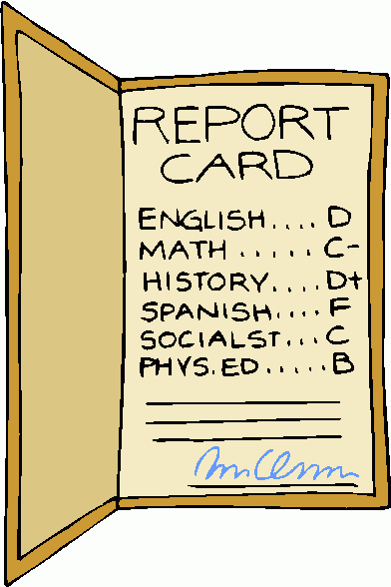
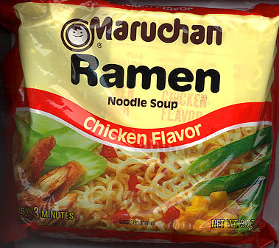
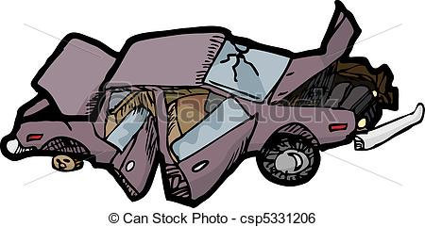
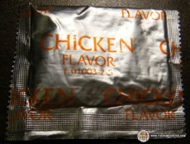
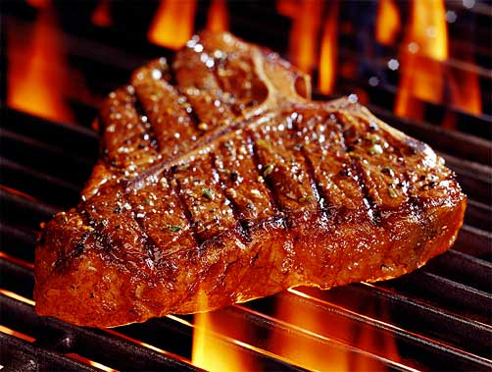
Standard of Living
High
A
Low

Slide 4
Standard of Living
the average quality of life for a person living in a community.
4 left…

Slide 5
Human Rights

Slide 6
Human Rights
Basic rights and freedoms to which all humans should have
3 left…

Slide 7
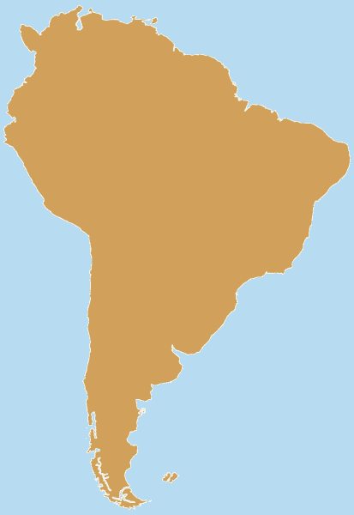
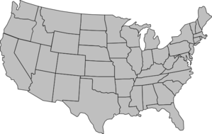
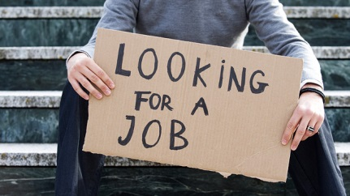
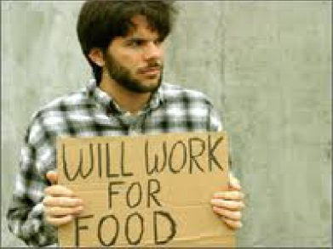
Outsourcing

Slide 8
Outsourcing
Sending jobs to other countries for cheaper labor (workers).
2 left…

Slide 9
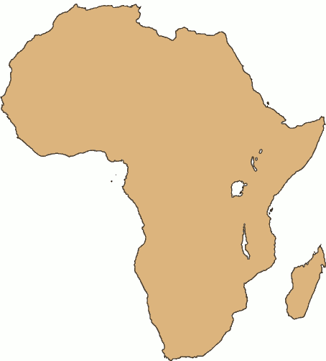
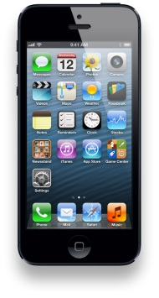
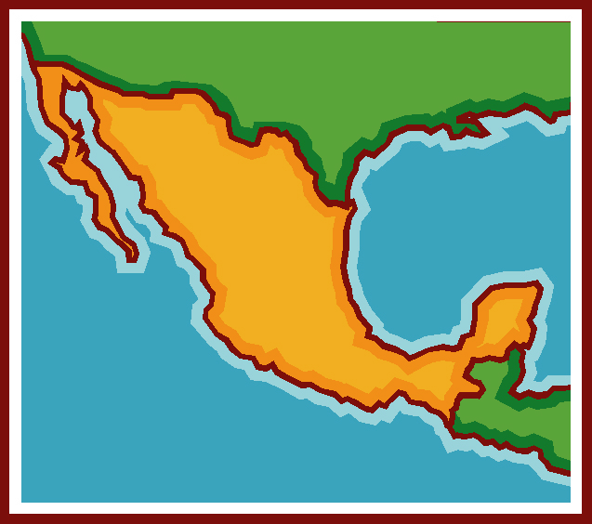
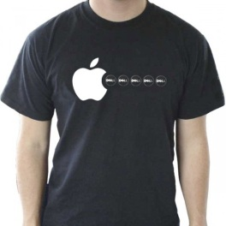
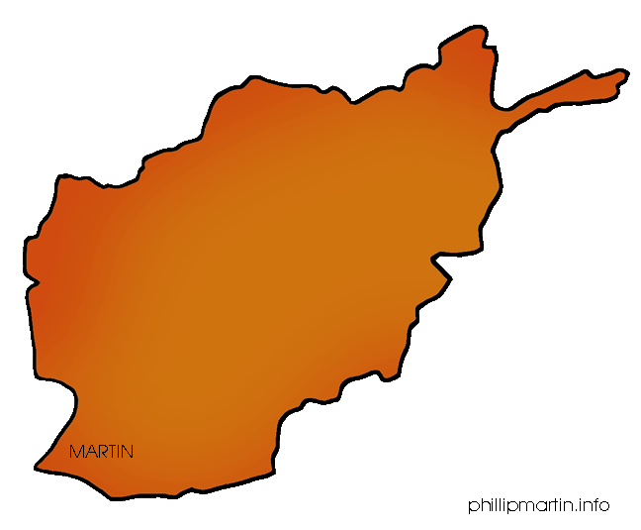
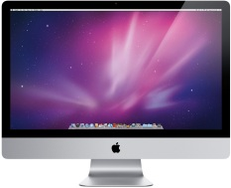
Multinational Corporation

Slide 10
Multinational Corporation
A business that has offices in multiple countries.
1 left…

Slide 11
Globalization

Slide 12
Globalization
Countries working together to buy and sell products and exchange ideas
0 left…

Slide 13
Word Wall
1. Vocabulary Word
2. Definition
3. A picture showing the meaning of the word
Study Help!!!
http://quizlet.com/_nuocp

Slide 14
Old Slides

Slide 15
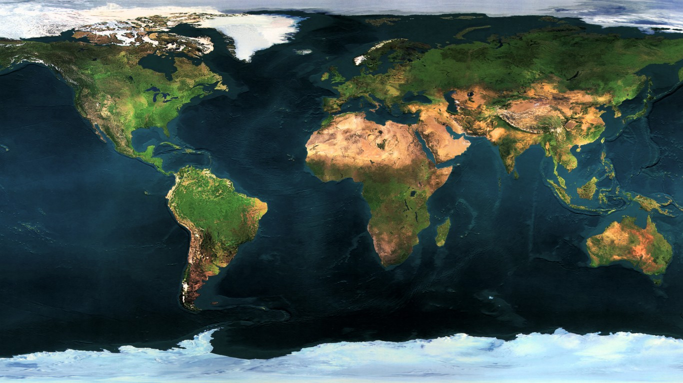
Where is this region?
5
3
2
4
6
1

Slide 16
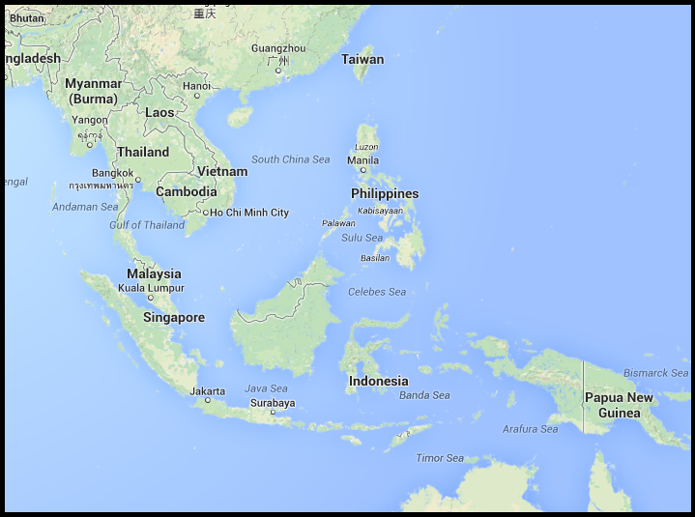
Region Map

Slide 17
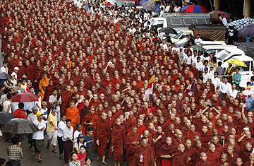
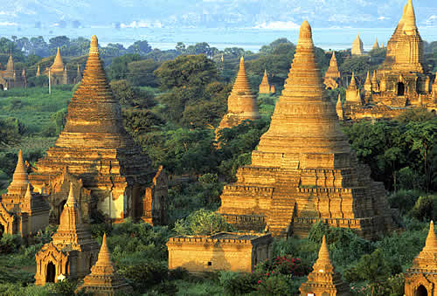
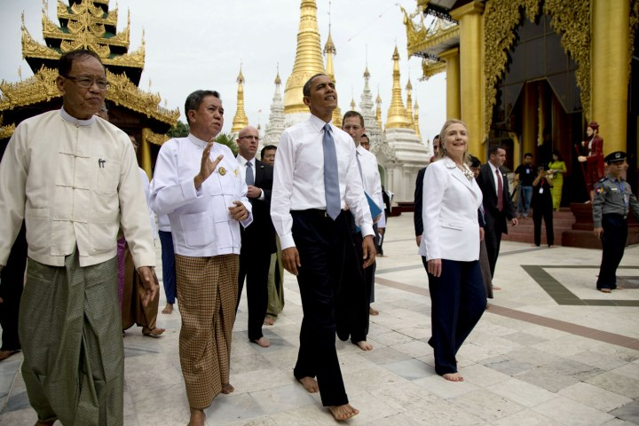
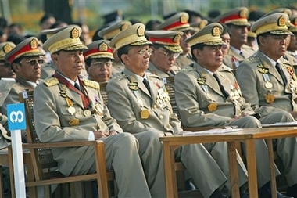
Issues (Myanmar)

Slide 18
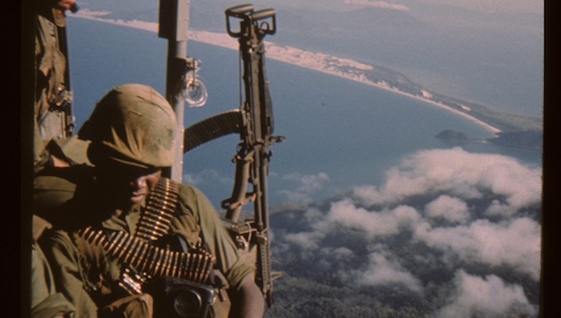
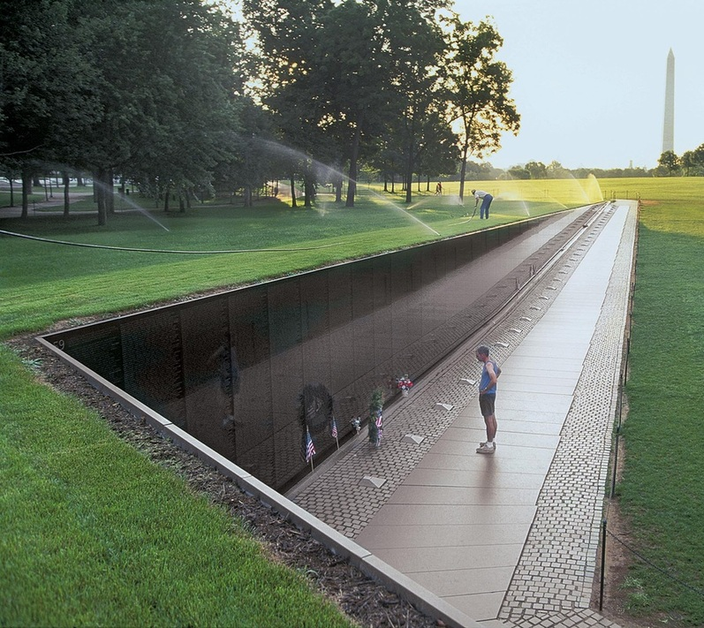
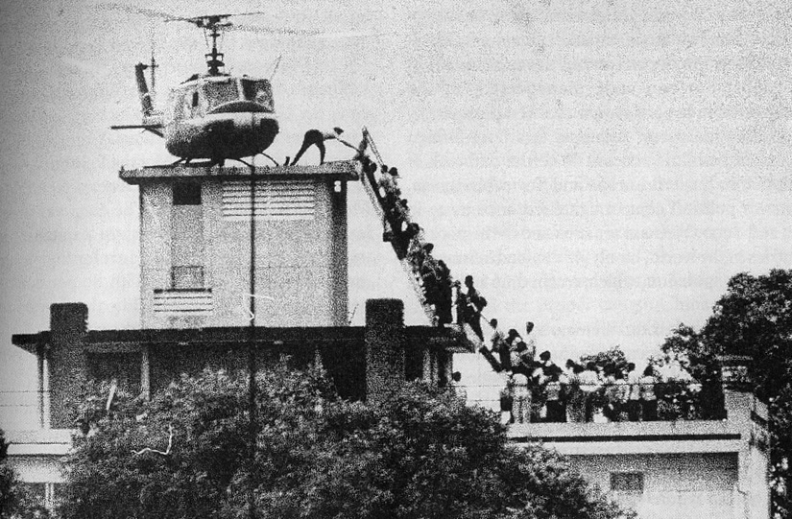
Issues (Vietnam War)

Slide 19
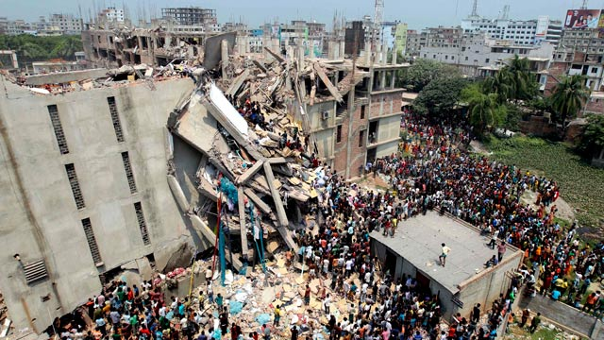
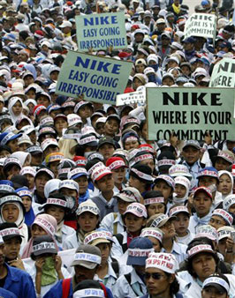
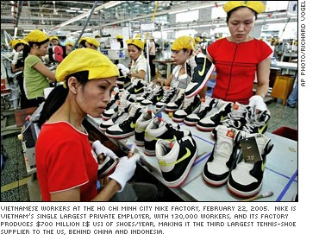
Essential Question
What is the real price of your t-shirt?

Slide 20
Globalization
Countries working together to buy and sell products and exchange ideas

Slide 21
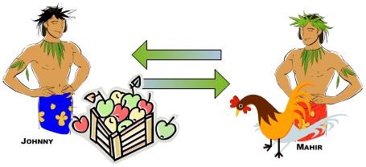
World Trade Organization (WTO)

Slide 22
World Trade Organization (WTO)
The group responsible for making sure companies and countries don’t break rules when they trade.

