Slide 1
Southeast Asia & (Oceania)
Patterson/Smith
Callanan Middle School

Slide 2
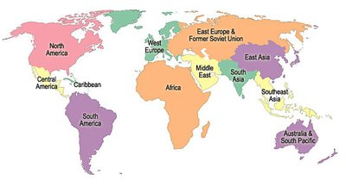
Southeast Asia
Where is this region?

Slide 3
Southeast Asia
Over the next five weeks we will be focusing on the countries that make up Indochina.
Trivia question: What countries make up Indochina?

Slide 4
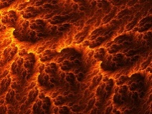
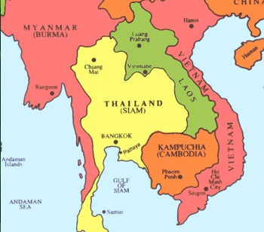
Indochina
Lava

Slide 5
Southeast Asia (Indochina)
Result
Poverty
Imbalance
(Power & Money)
Rich Culture
Recent Events
Colonialism
War
Human Rights Abuse

Slide 6
1940’s on….
U.S.
Your great grandparents were being born. The minimum wage was 43 cents. 55% of houses had toilets in there house.
Britain
Britain’s Empire was slowly deteriorating. The country began the long process of rebuilding after WWII.
India
Gandhi was leading the his civil disobedience movement.

Slide 7
Meanwhile in Indochina
Growing sense of nationalism
General anger/resentment at foreigners
In 1945 France tried to take over Indochina. What started was a war that lasted until 1975, killing 58,000 Americans and millions of Southeast Asians.

Slide 8
Southeast Asia
Pg. 124-127
Questions:
1. European brining Christianity to Southeast Asia is an example of what?
2. What did Southeast Asians want after WWII? Why was this a problem?
3. Describe the how Vietnam gained its independence. How did this affect Laos and Cambodia?

