Slide 1
Plate Tectonics

Slide 2
Warm Up 1-22-13 Ending Date: 1-25-13
Write down everything you know about tectonic plates.

Slide 3
Think, Pair Share
THINK: Think about what you believe plate tectonics are.
PAIR: Turn to your partner. Discuss what you believe plate tectonics are. Try to come up with a common understanding. Be prepared to share it with the class.
SHARE: When called on, come up to the board and write what you think plate tectonics are.

Slide 4
PLATE TECTONICS

Slide 5
Looking at Maps…
http://www.teachersdomain.org/asset/ess05_int_tectonic/
Take a sheet of paper out. Write your name in the top right hand corner.

Slide 6
Quick Write #1
Where are most of the earthquakes located?
What can we conclude by looking at this map?
Think—Write down your thoughts
Pair—30 seconds after Mrs. Smith says to
Share—Quick Whip

Slide 7
Quick Write #2
What do you notice about the locations of volcanoes?
What do their locations have in common with the earthquakes?
What is a possible explanation of this pattern?
Think—Write down your thoughts
Pair—30 seconds after Mrs. Smith says to
Share—Quick Whip

Slide 8
Quick Write #3
What do plate tectonics have in common with volcanoes and earthquakes?
What can you predict about plate tectonics?
Think—Write down your thoughts
Pair—30 seconds after Mrs. Smith says to
Share—Quick Whip

Slide 9
Video Clip
On your sheet of paper, number 1-5
Take at least 5 notes over the video

Slide 10
Warm Up 1-23-13
What are plate tectonics? How do they impact geographical features?
Geographical features: Mountains, volcanoes, etc.

Slide 11
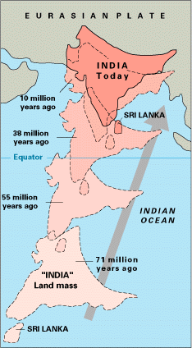
Where was India 71 million years ago?
How has plate tectonics changed India’s location over time?

Slide 12
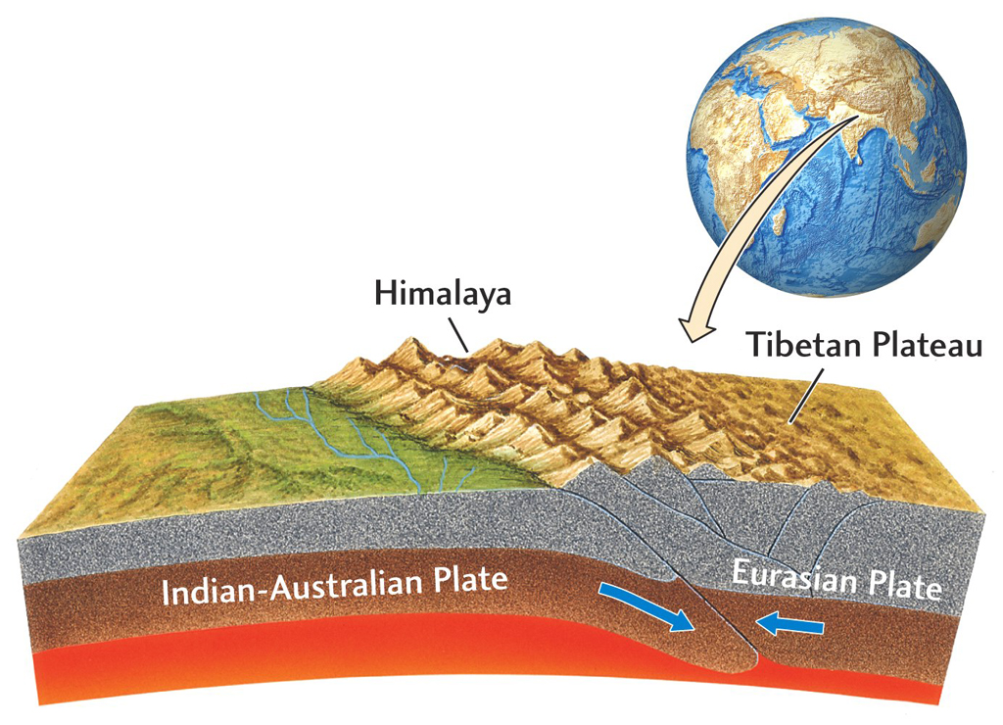

Slide 13
60 MILLION YEARS AGO…

Slide 14
40 MILLION YEARS AGO

Slide 15
20 MILLION YEARS AGO

Slide 16
TODAY

Slide 17
10 MILLION YEARS FROM NOW…

Slide 18
A look through time…ACTION!
http://www.pbs.org/wgbh/nova/everest/earth/shock.html

