Slide 1
Opium & Afghanistan
Mr. Patterson

Slide 2
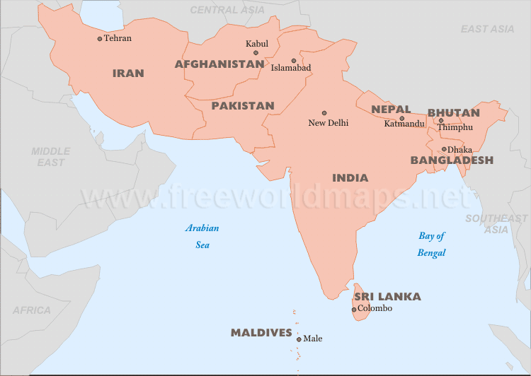
Afghanistan

Slide 3
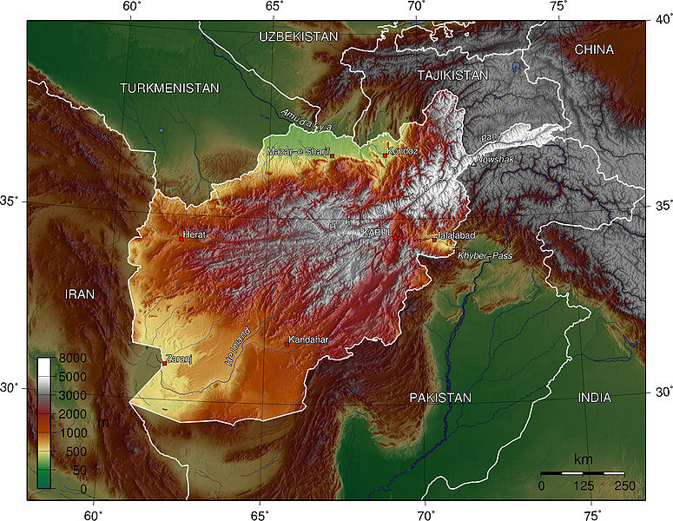

Slide 4
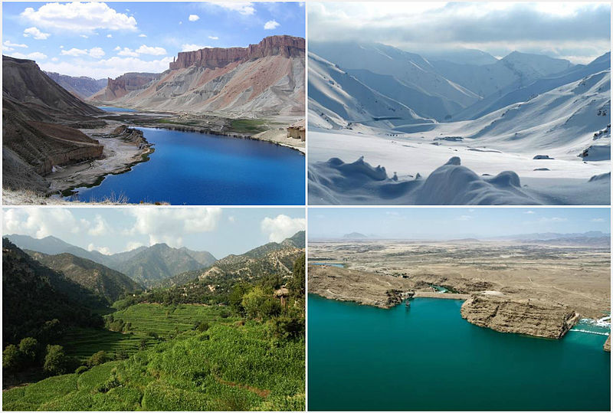

Slide 5
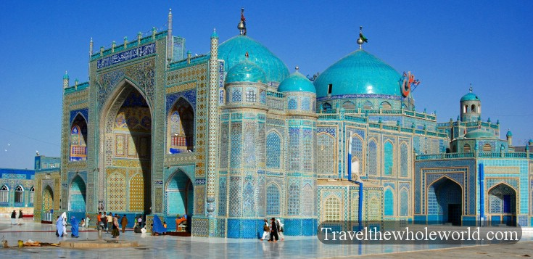
Afghanistan
Population
32 million
Size
Slightly larger than
Texas
Religion
Muslim
Language
Over 30+ languages
Natural Resources
$900 billion to $3 trillion dollars in value

Slide 6
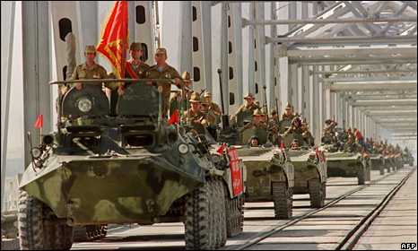
History
Britain tried to colonize
1842-1933
Coups de tat’s/Kings 1933-1977
Soviet Union invaded
1978-1989
Coup de tat’s/Civil Wars
1989-1996
Until the Taliban…

Slide 7
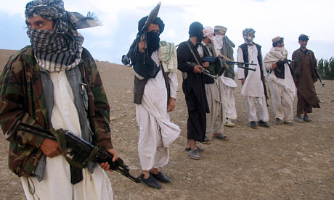
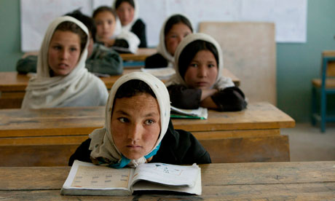
Taliban
Goals
Create a fundamental Islamic country
Strengths
Willing to do anything to carry reach their goal
Blend in with the population
Weaknesses
Limited access to training and money

Slide 8
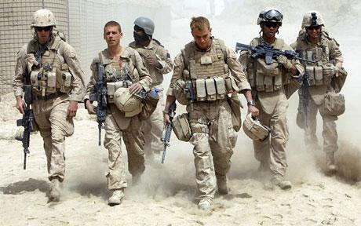
ISAF (USA)
Goals
Make sure that Afghanistan is not a safe place for terrorist
Strengths
Best military in the world
Weaknesses
Will only be in the country for a limited time

Slide 9
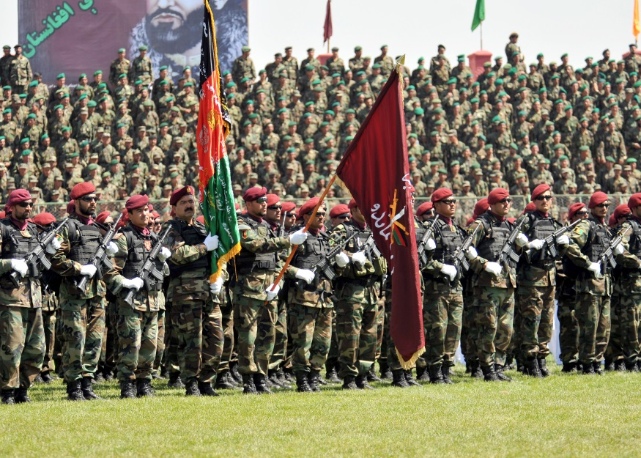
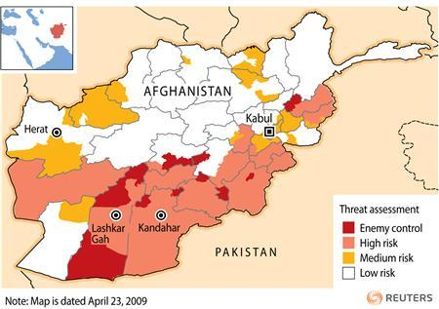
Afghanistan Government
Goals
Maintain/get more power as the Taliban and Americans fight
Strengths
To some extent they have control over the population
Weaknesses
Corruption
United States will eventually leave

Slide 10
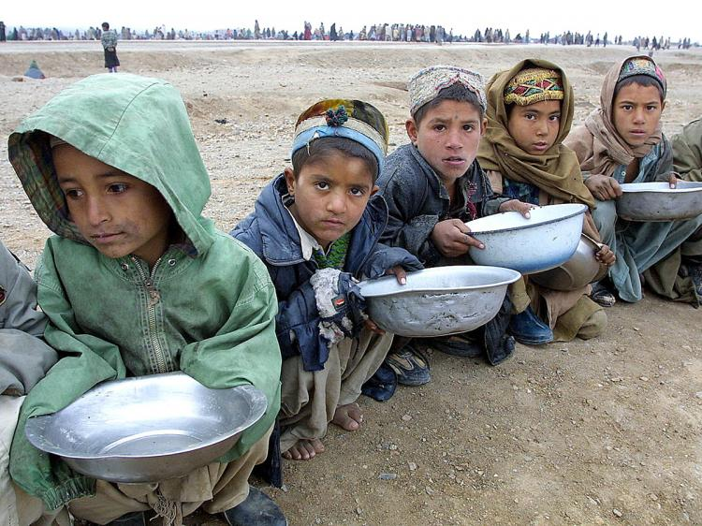
Standard of Living
Average Lifetime
48 years
Average Income
$1,100
Literacy Rate
28%

Slide 11
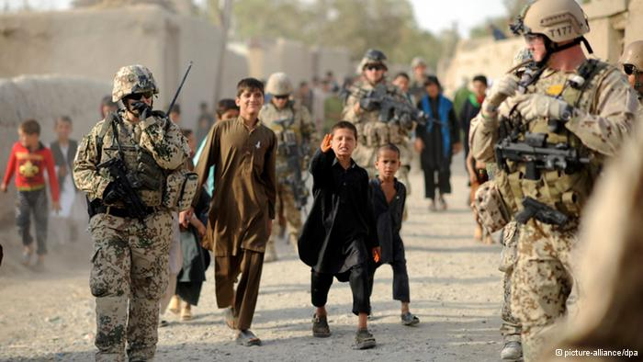
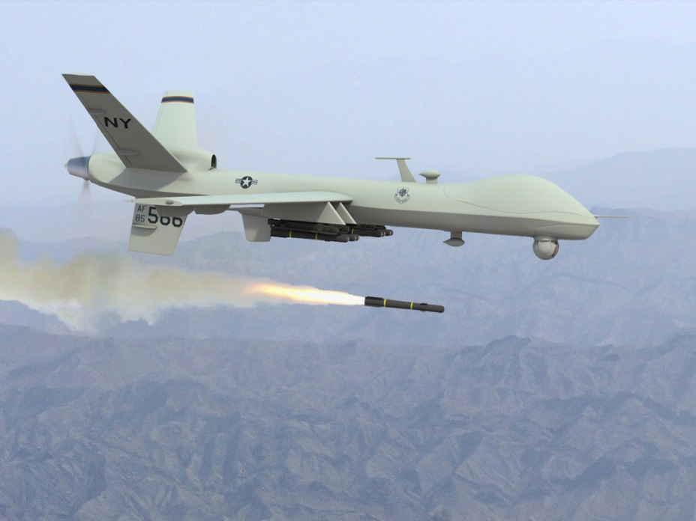
Violence
As the Taliban and ISAF forces fight each other innocent people get killed or become refugees
Estimated Civilians Killed
20,000

Slide 12
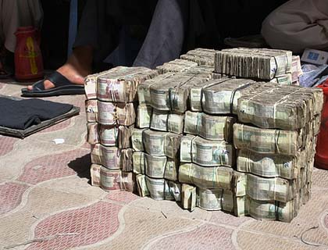
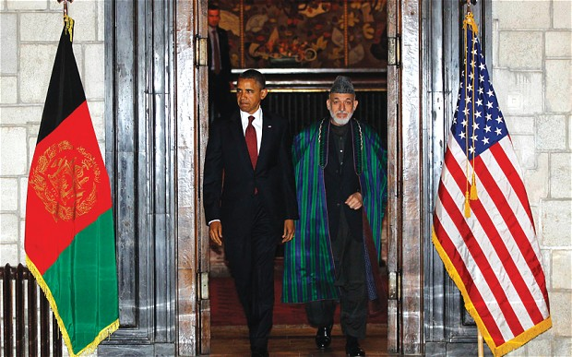
Corruption
Money that is supposed to help raise the standard of living for the average Afghan is being stolen

Slide 13
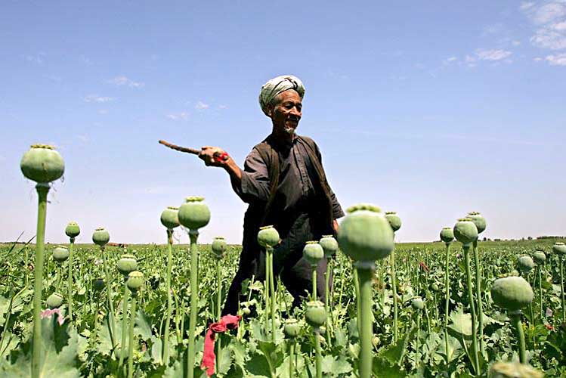
Role of Opium
Much of the fighting and corruption in Afghanistan is centered around opium…

