Slide 1
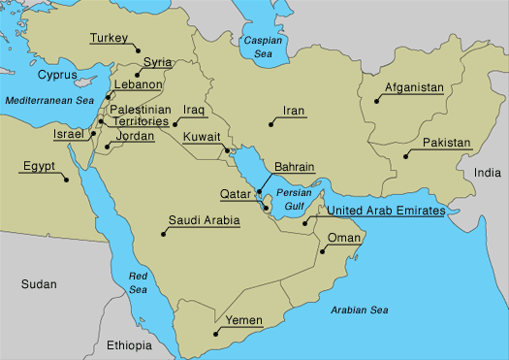
Inequality…

Slide 2
Standard of Living…
Yemen
Average Income
$2,500
Life Expectancy
64 years
Qatar
Average Income
$102,100
Life Expectancy
79 years

Slide 3
Brief History of OPEC - TV
Do not write in complete sentences.
Have text evidence
Use evidence from all documents
The reading is posted in OneNote so you can just click on the links instead of typing them out.
If you want to use your phone, scan the QR codes.
When done, go to OneNote and look in Today’s Task for BLANK VIDEO.

Slide 4
Citations
Where did you get your information from?
According to Document A, Mr. Patterson can…
Mr. Patterson can dunk a basketball (Doc. O).
Steal a phrase from the reading and mark it with “”.
Mr. Patterson can “dunk a basketball.”
Don’t just write: I got all of this information from Document A.
Text Evidence

Slide 5
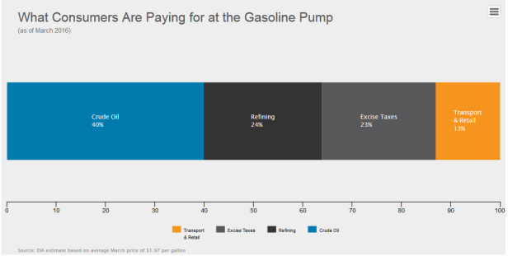
Chart showing crude oil from onenote

Slide 6
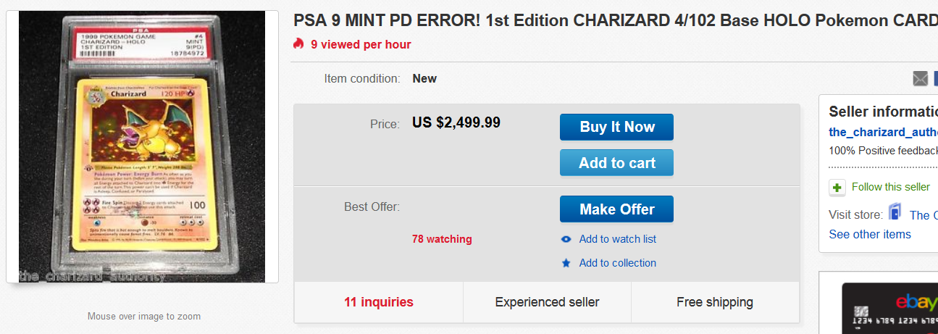
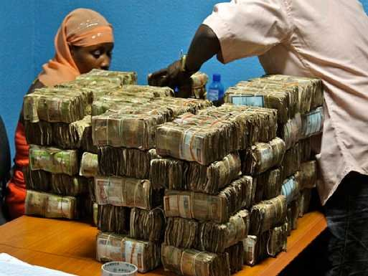
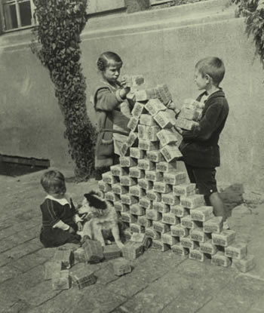
For warm ups, possibly talk about debeers

