Slide 1
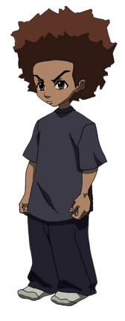
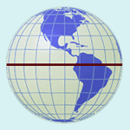
Equator
A line that cuts the Earth into exactly two even parts horizontally, at the “waist.”

Slide 2
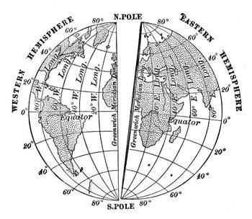
Prime Meridian
A line that cuts the Earth into exactly two even parts vertically, from “head to toe.”

Slide 3
Prime Meridian
Equator
Name,
Block,
Teacher

