Slide 1
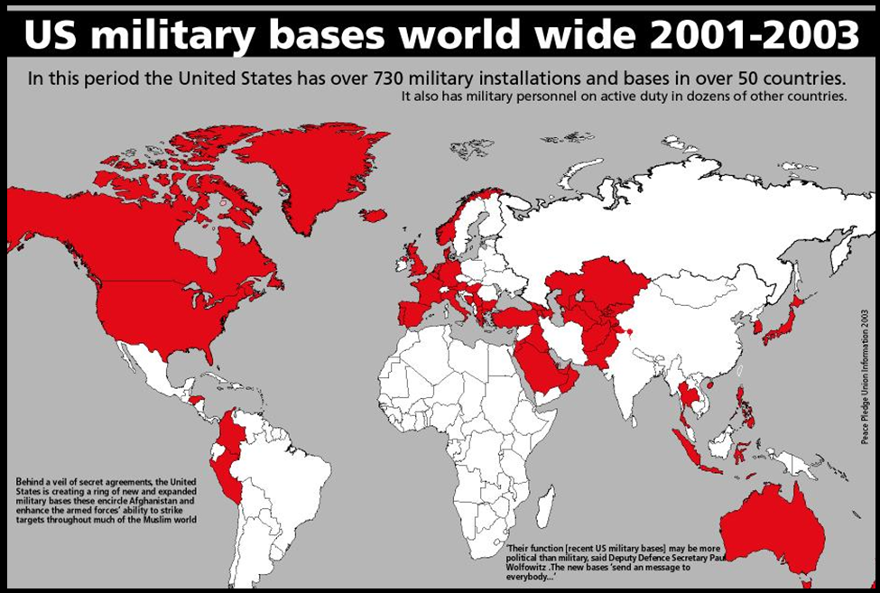
Notes:
Warm Up Question- 1. Why would a country put a military base in another country? 2. What does map mean/show you about U.S. interests? Do we care about this region more than North Africa and Sub-Saharan Africa?

Slide 2
Middle East vocabulary
Patterson

Slide 3
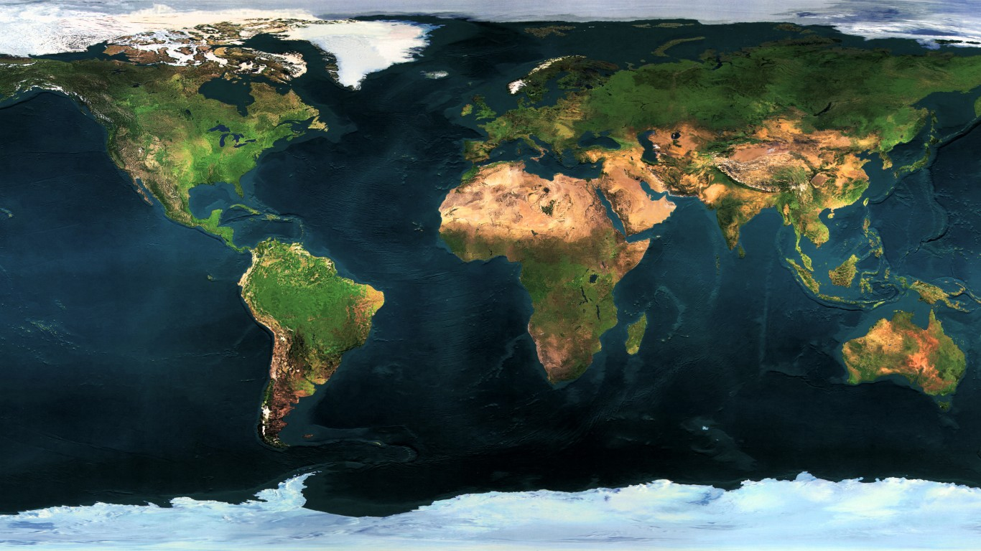
Where is this region?
3
2
1

Slide 4
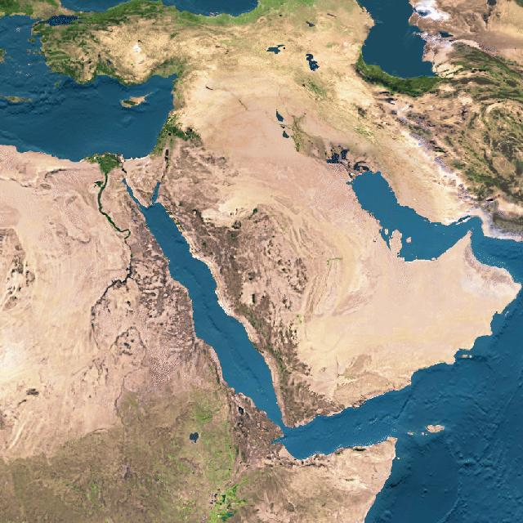
Middle East
Based on this physical map, what can you infer about the climate in the Middle East?
3
2

Slide 5
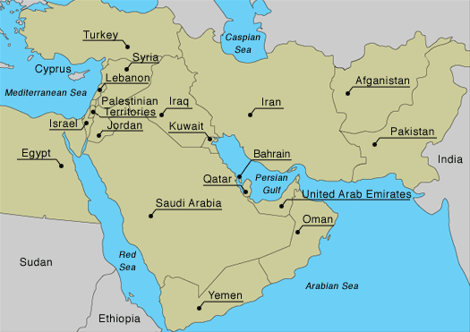
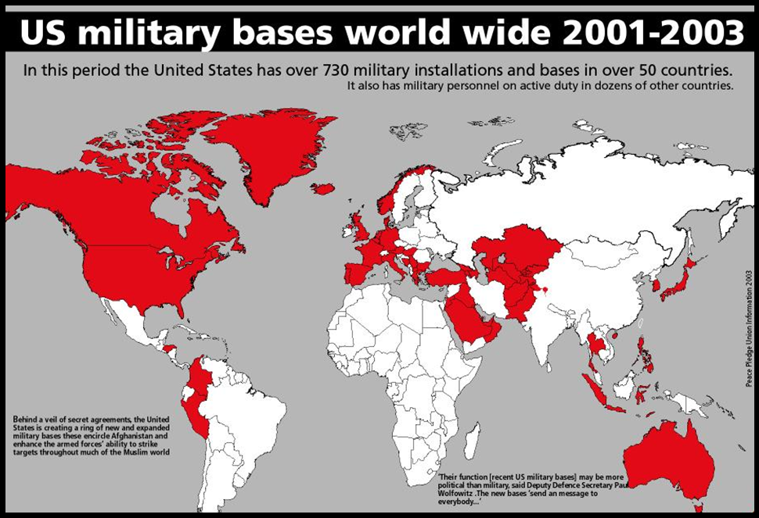
Why should we care?
Middle East is an interesting region to study.
Strengths and Weaknesses

Slide 6
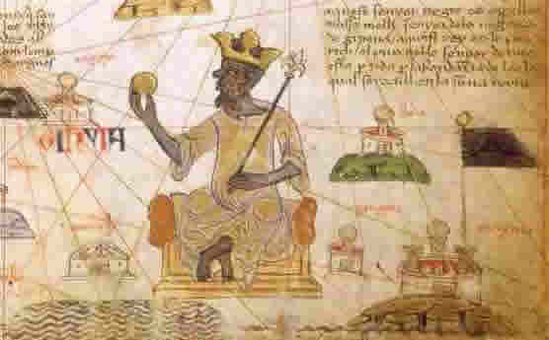
Thinking back to Sub-Saharan Africa…
Strength
Rich heritage
Weakness
Colonization leading to Apartheid

Slide 7
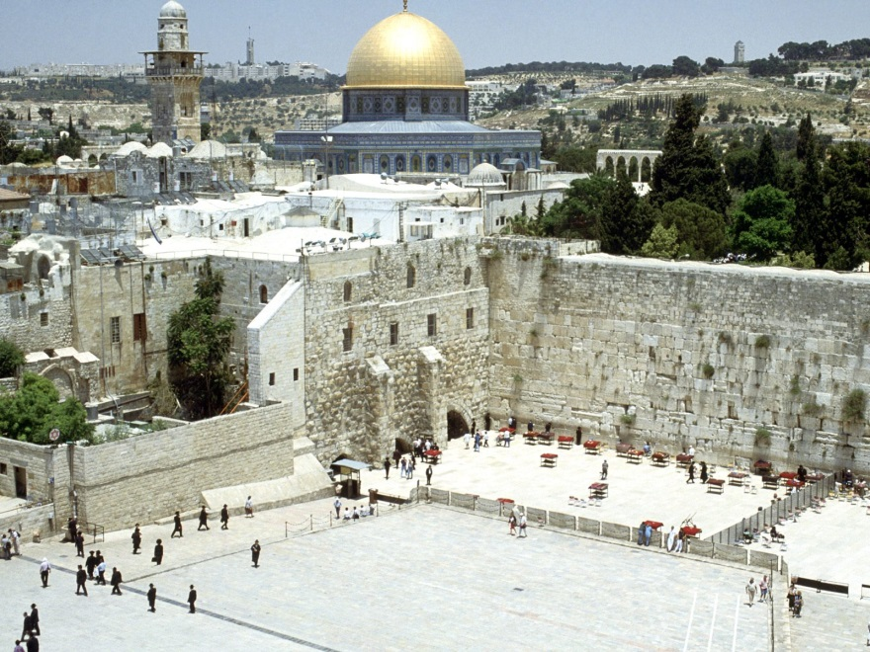
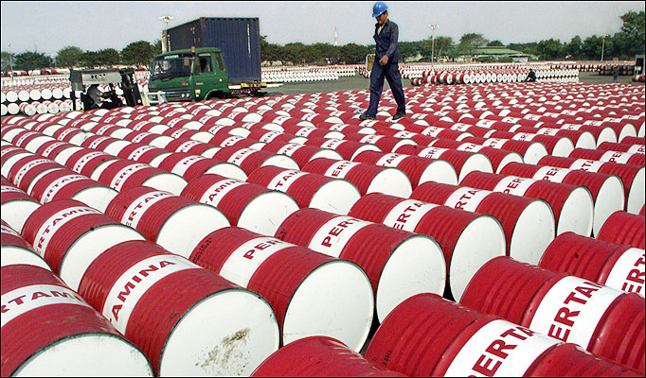
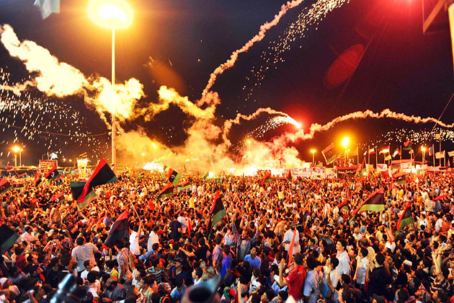
Middle East
Strengths
Religion
Resources
Revolution

Slide 8
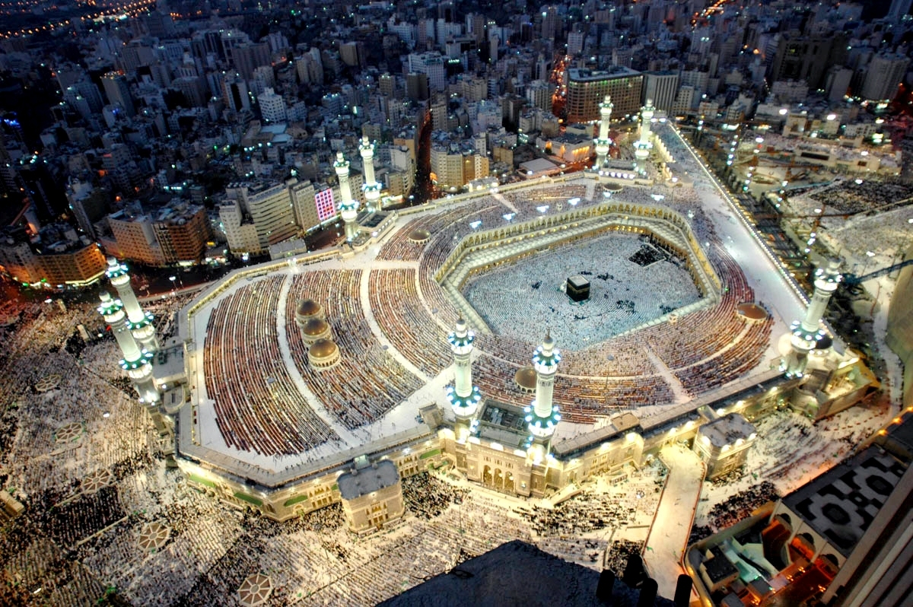

Slide 9
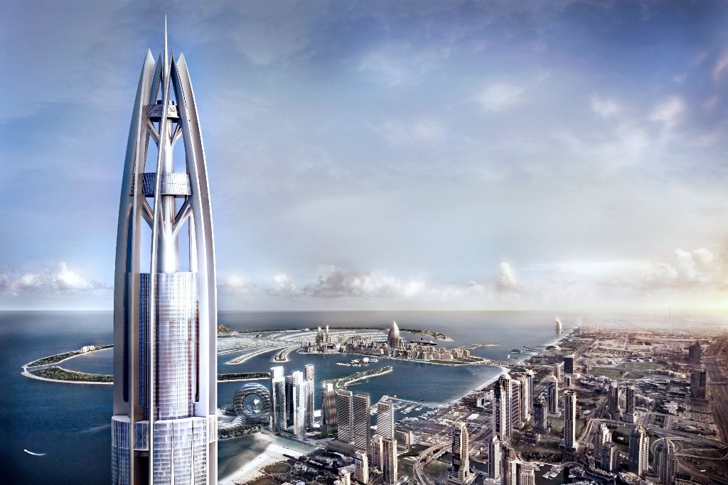

Slide 10
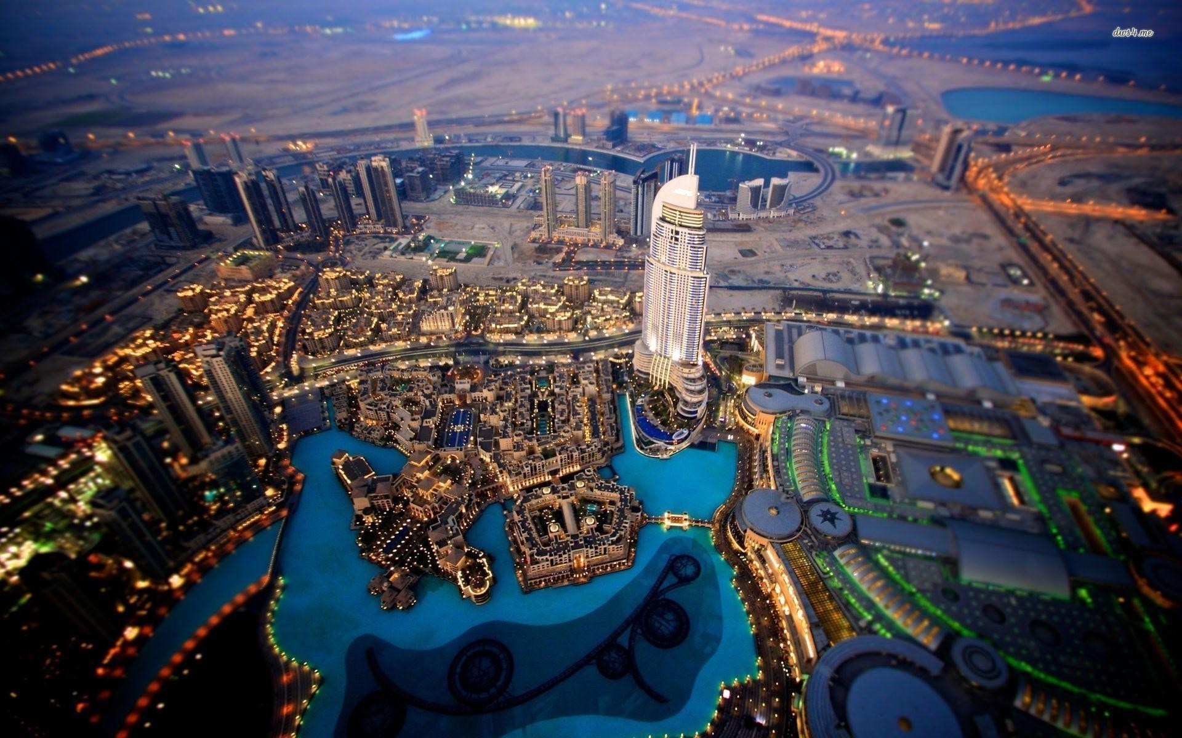

Slide 11
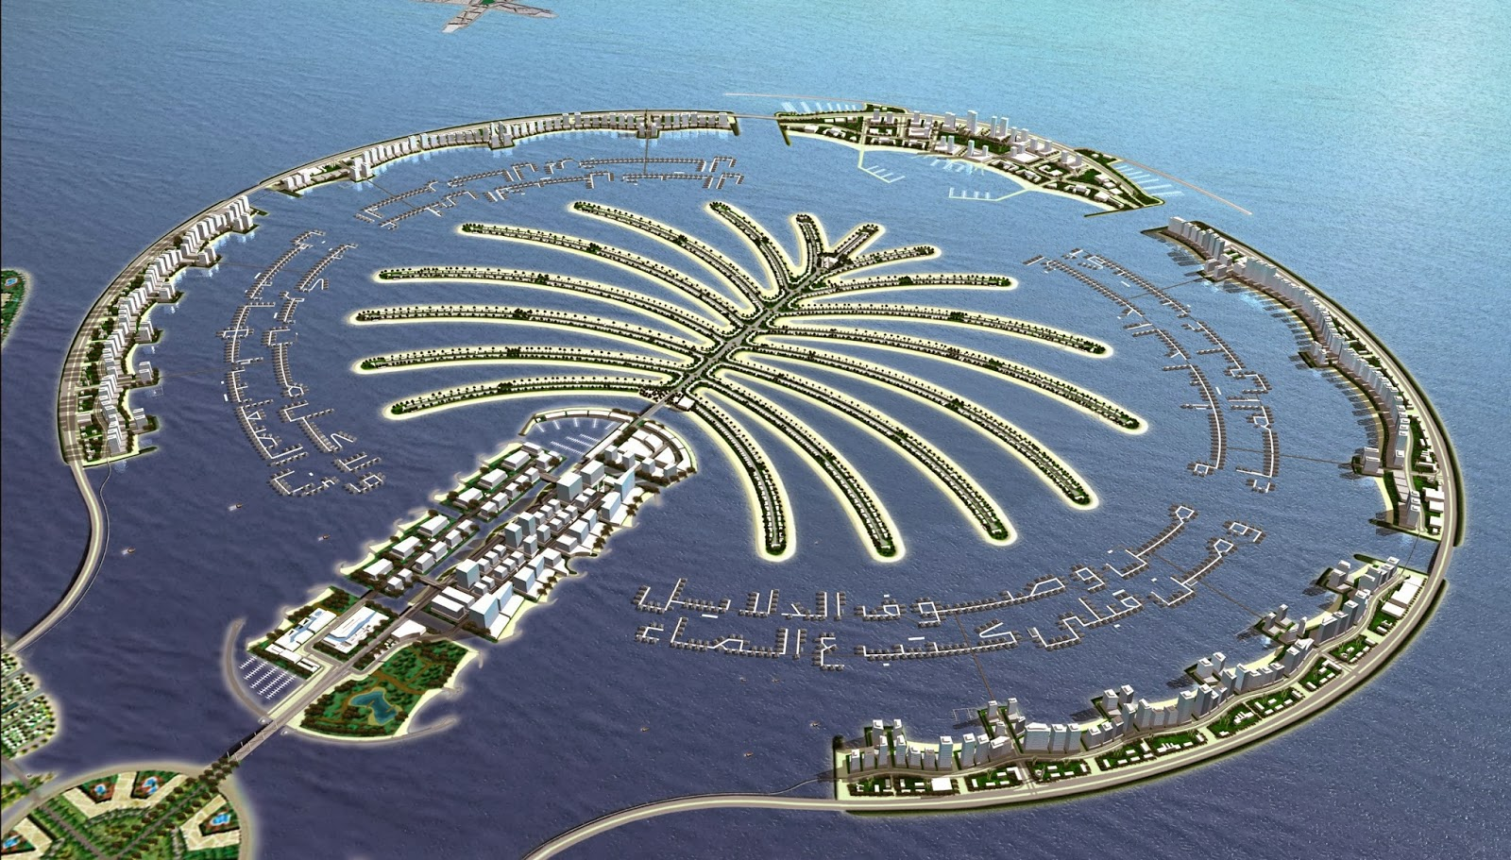

Slide 12
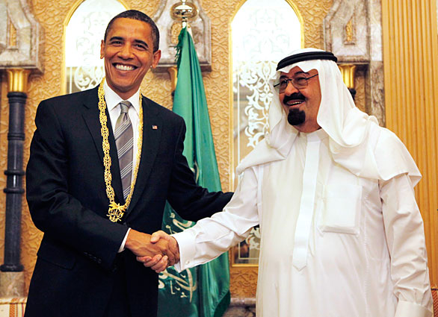
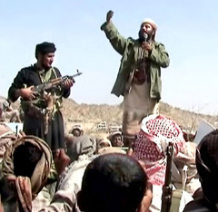
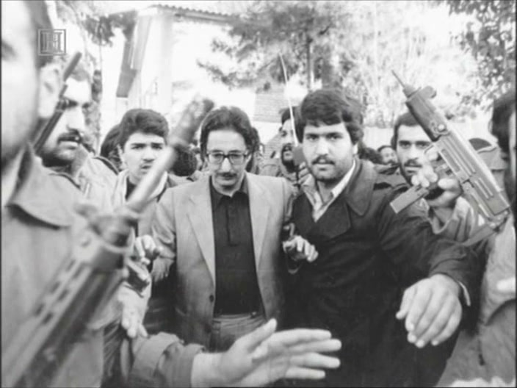
Middle East
Weaknesses
Conflict between religions
History of dictatorship
Standard of Living

Slide 13
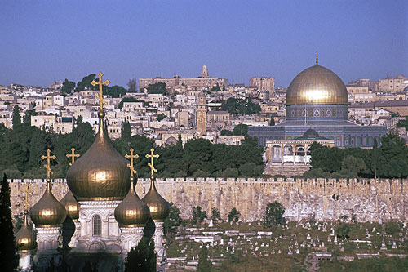
Middle East - Link
3
1
2

Slide 14
Inequality…

Slide 15
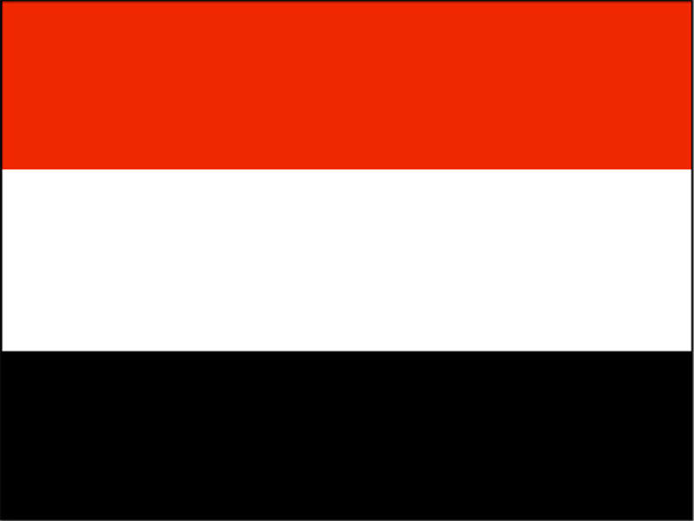
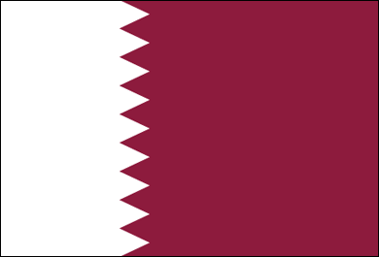
Standard of Living…
Yemen
Average Income
$2,500
Life Expectancy
64 years
Qatar
Average Income
$102,100
Life Expectancy
79 years

Slide 16
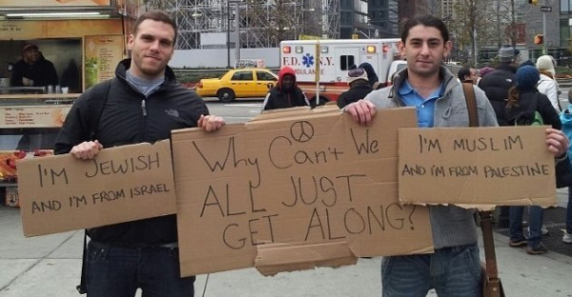
Can there be peace in the Middle East?

Slide 17
Vocabulary
Over the next six weeks we will be studying the region of Southwest Asia. This region is incredibly rich in both history and culture. For us to fully appreciate what we are going to study we must become familiar with the following vocabulary terms.
On each of the following slides there is a picture and a vocabulary word. When called upon your job is to guess what the word or phrase means based upon the picture.

Slide 18
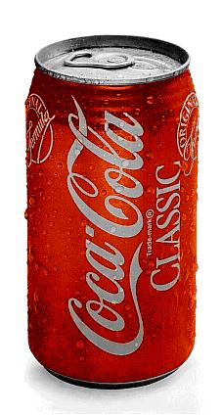
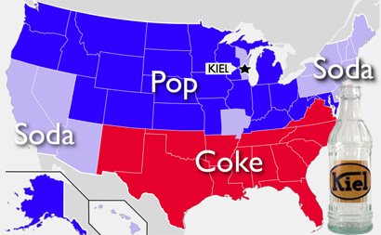
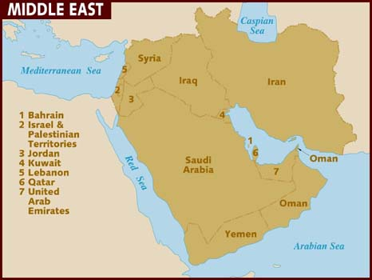
Middle East
Southwest Asia
Or
Middle East

Slide 19
Middle East
Southwest Asia and Middle East refer to the same region, they are nicknames.
9 left…

Slide 20
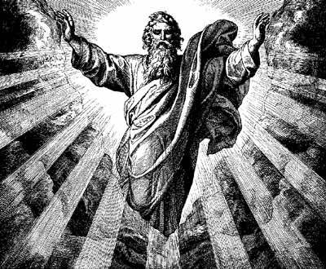
Religion

Slide 21
Religion
the belief in and worship of a superhuman controlling power, especially a personal God or gods.
8 left…

Slide 22
Monotheism

Slide 23
Monotheism
The belief that there is only one God.
7 left…

Slide 24
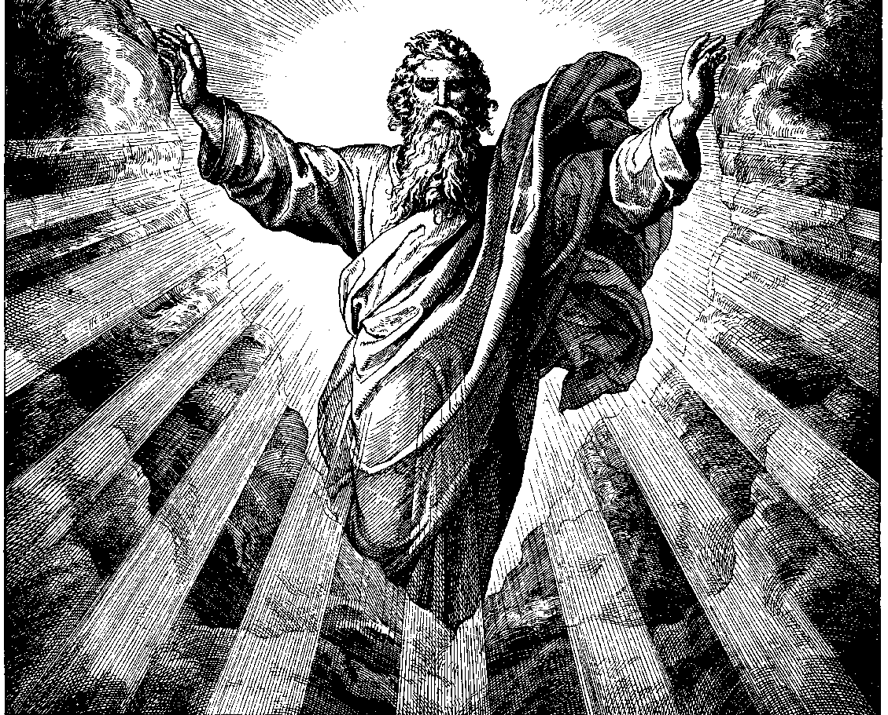
Prophet

Slide 25
Prophet
Teacher inspired by god.
6 left…

Slide 26
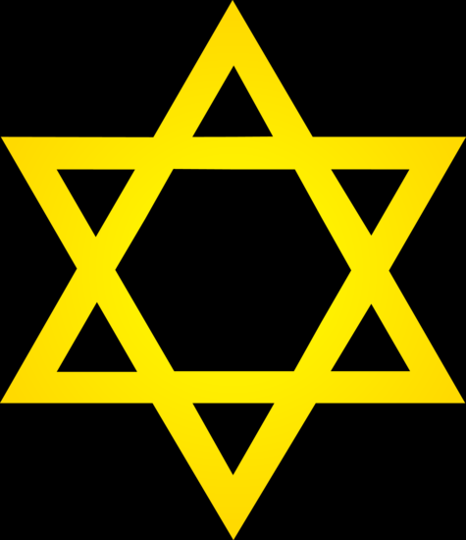
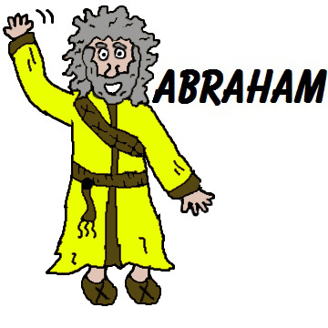
Judaism
+ Torah +

Slide 27
Judaism
A monotheistic religion with Abraham as the main prophet and the Torah as the holy book.
5 left…

Slide 28
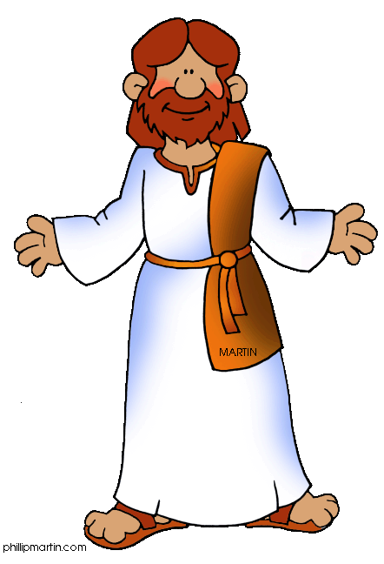
Christianity
+ Bible +

Slide 29
Christianity
A monotheistic religion with Jesus as the main prophet and the Bible as the holy book.
4 left…

Slide 30
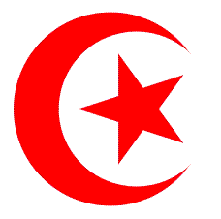
Islam
+ Quran + Muhammad

Slide 31
Islam
A monotheistic religion with Muhammad as the main prophet and the Quran as its holy book.
3 left…

Slide 32
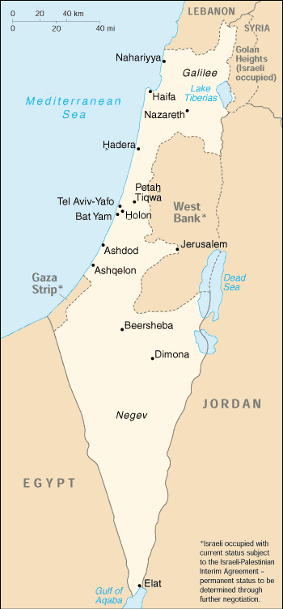
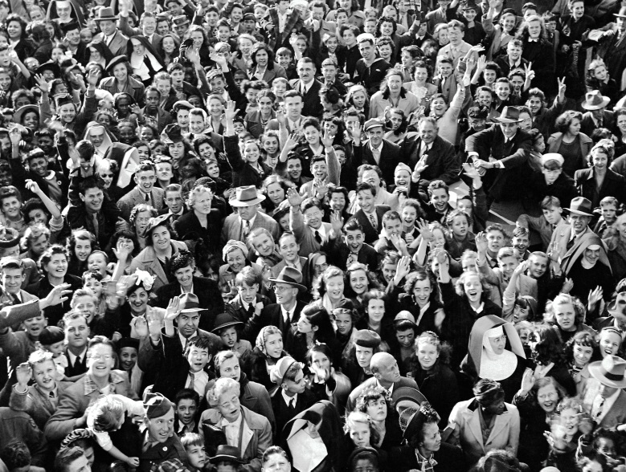
Israel

Slide 33
Israel
Is a country in the Middle East where most of its citizens are Jewish.
2 left…

Slide 34
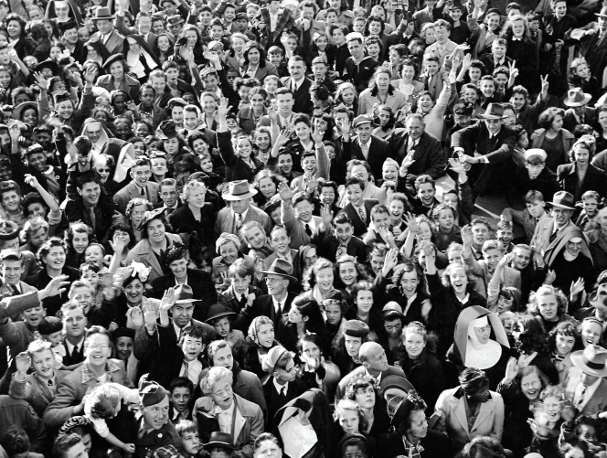
Palestinians

Slide 35
Palestinians
Are a group of Muslims who used to live where Israel exists today.
1 left…

Slide 36
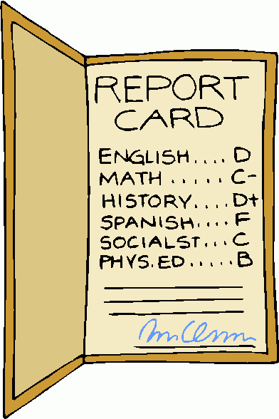
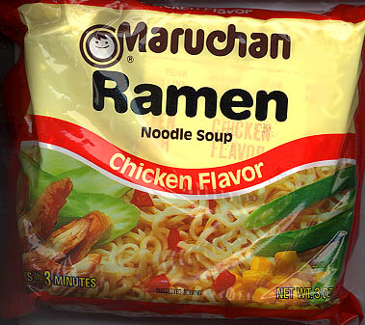
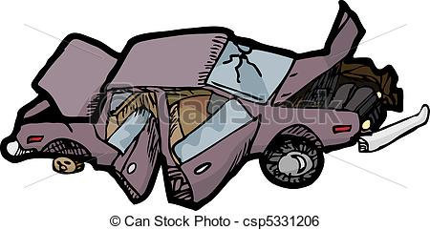
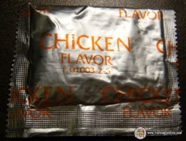
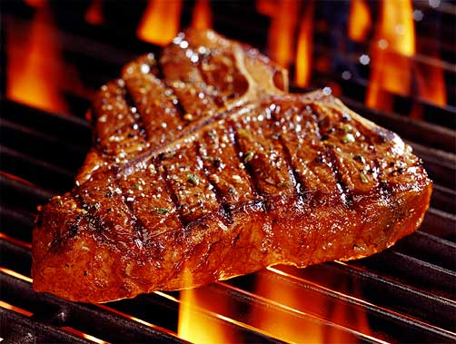
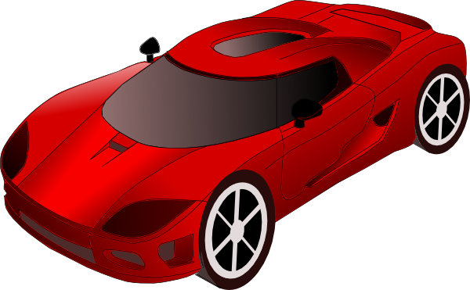
Standard of Living
D
A

Slide 37
Standard of Living
the average quality of life for a person living in a community.
0 left…

Slide 38
Word Wall
1. Vocabulary Word
2. Definition
3. A picture showing the meaning of the word
Study Help!!!
http://quizlet.com/_125fv1

Slide 39
Old Vocabulary Words

Slide 40
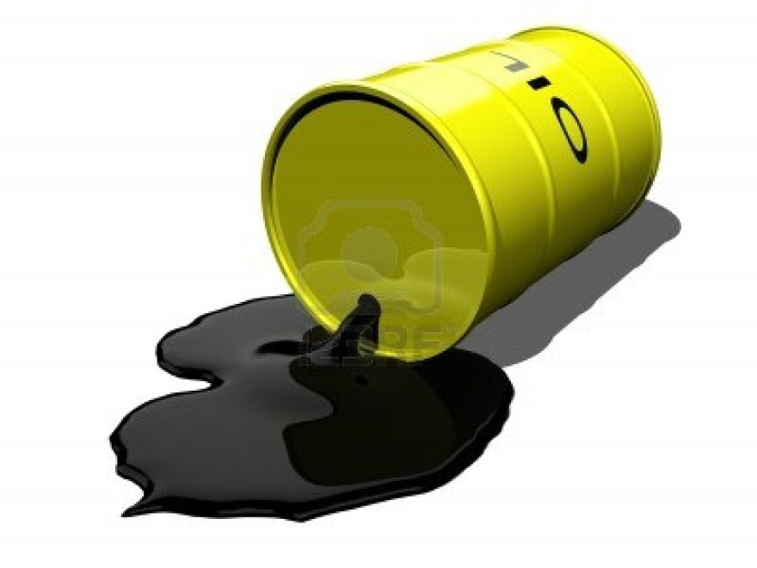
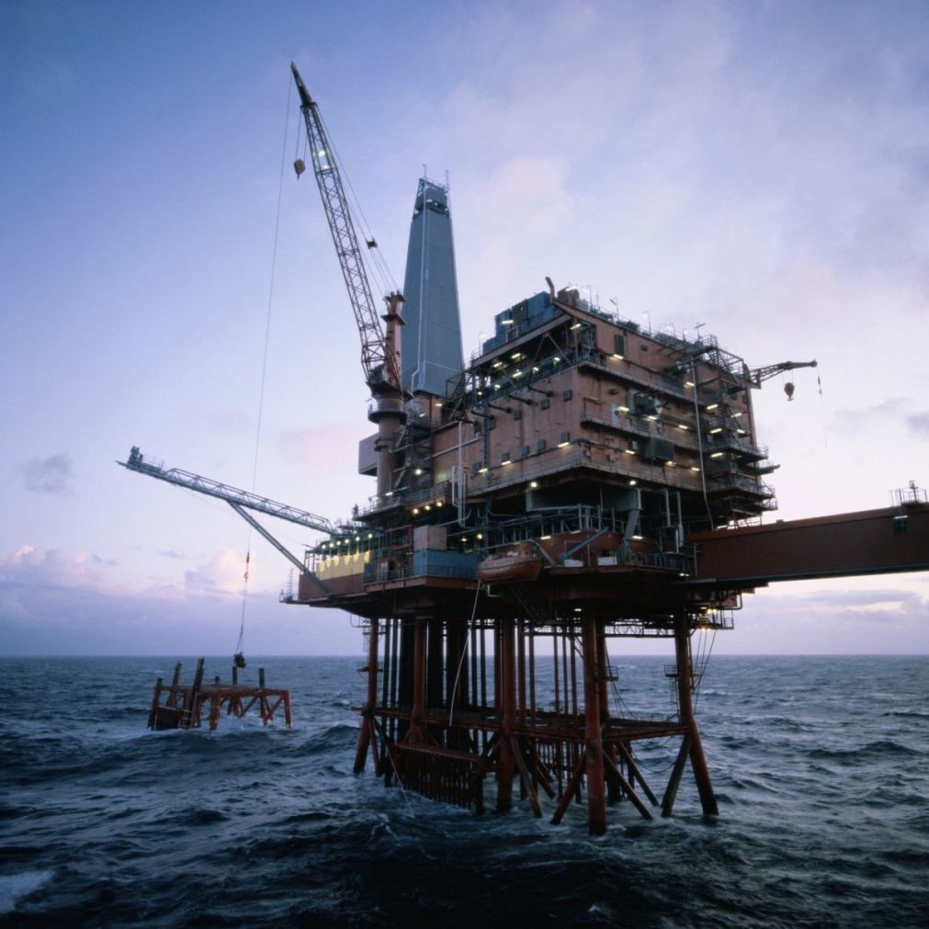
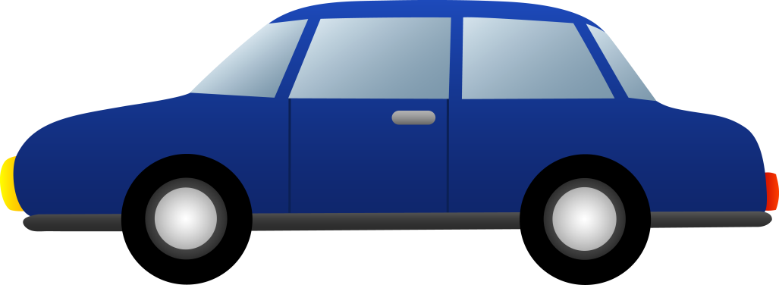
Petroleum

Slide 41
Petroleum
The name for the natural resource that powers cars. Synonym for oil or fossil fields.

Slide 42
Settlement
The building of a town or community in an area previously empty.

Slide 43
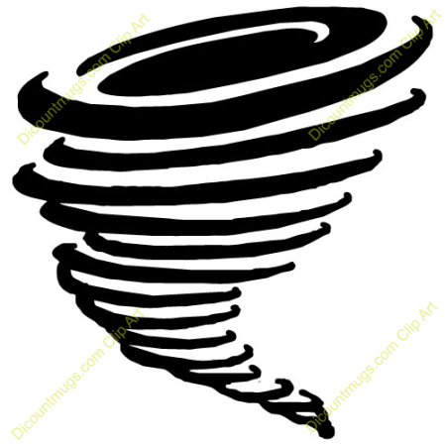
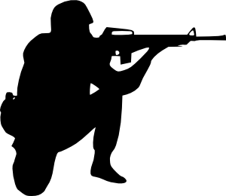
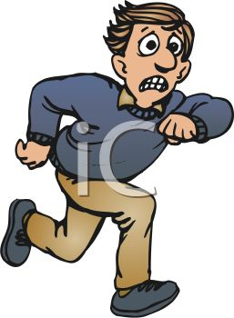
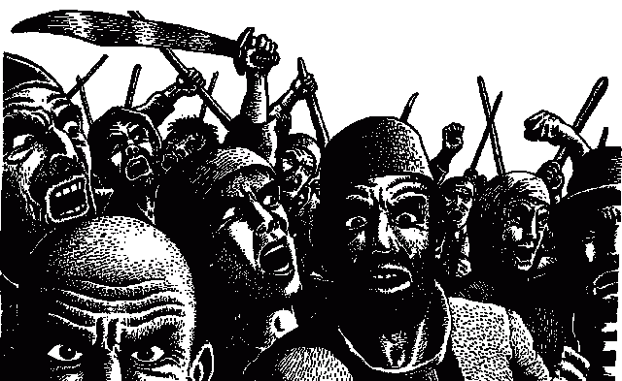
Refugee

Slide 44
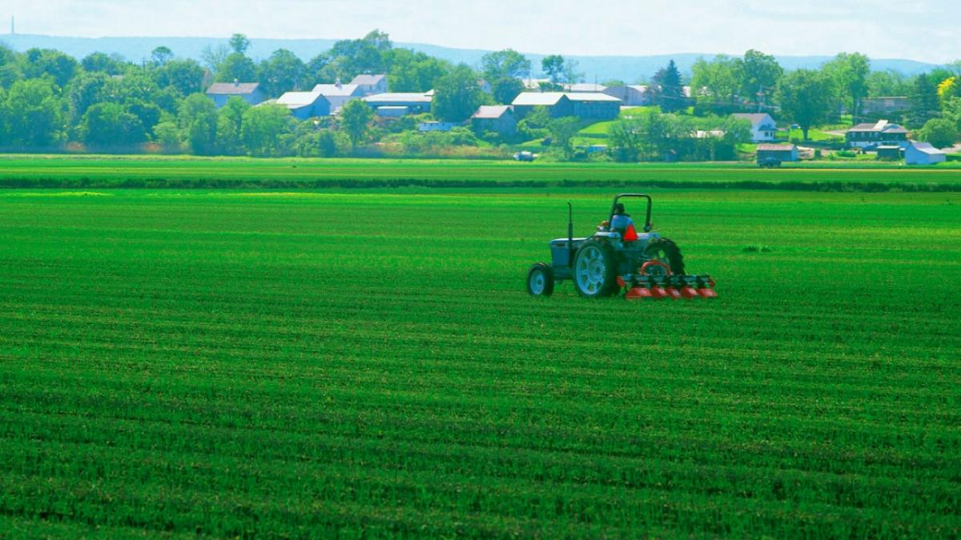
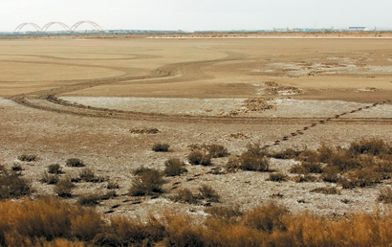
Arable Land

Slide 45
Arable Land
Land that can grow crops

Slide 46
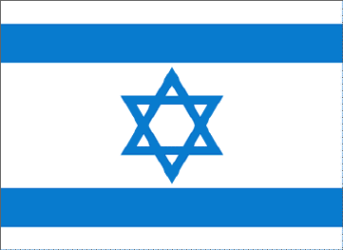
Settlement
1.
2.

Slide 47
Refugee
a person who has been forced to leave their country in order to escape war, persecution, or natural disaster.

Slide 48
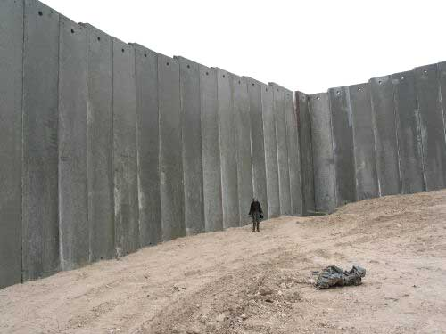
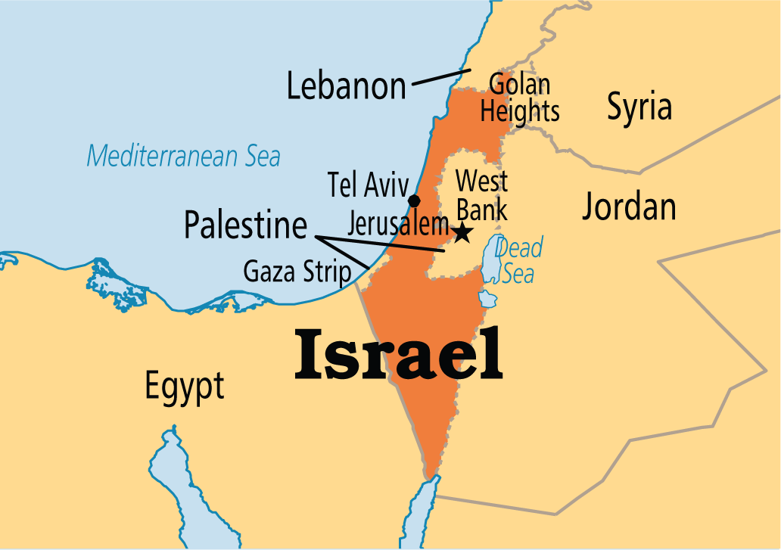
1. Israel

Slide 49
2. Saudi Arabia

Slide 50
Iraq

Slide 51
4. Euphrates and 3. Tigris Rivers

Slide 52
5. Syria

Slide 53
6. Iran

Slide 54
7. Yemen

