Slide 1
Simla Conference
Mr. Patterson

Slide 2
Key Vocabulary
Colonization- taking over or controlling another country.
Nationalism- feeling of pride in your country.
Civil Disobedience- nonviolent protests such as marches, sit ins, and boycotts.

Slide 3
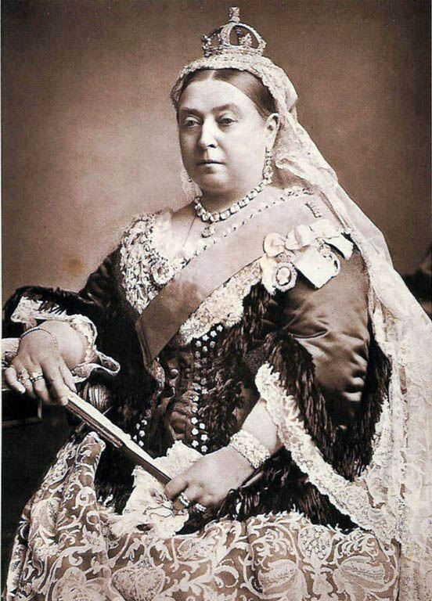
Queen Victoria & Colonization
Began the movement in the 1850s to colonize several countries to gain their natural resources
WHY?
In theory, it made goods cheaper for the British—this was eventually overturned after a century of spending $$ in other countries…

Slide 4
Horrible Histories Video
Watch the video and write down goods they mention

Slide 5
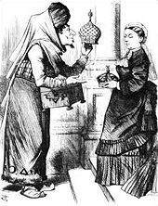
Quick Write #1
Who is in the cartoon?
What do you think is happening in the cartoon?

Slide 6
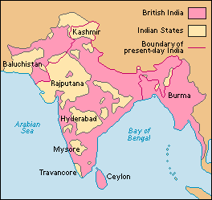
Quick Write #2—India in 1858
Look at the map to answer the questions.
How much of India did the British control?
How do you think this shaped India’s culture?

Slide 7
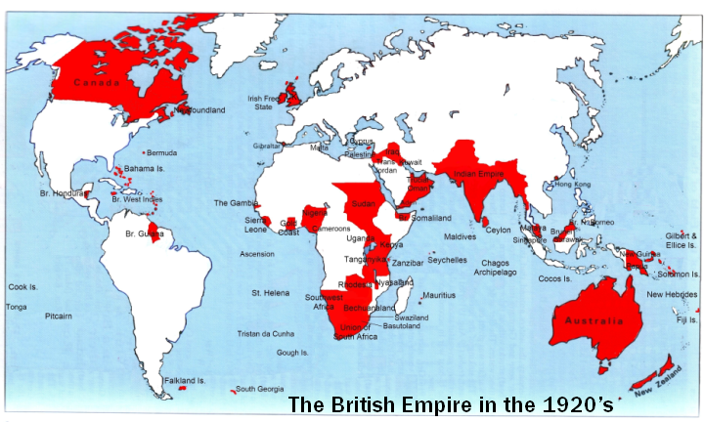
British Empire – 1920s
Turn to your partner and try to name a few countries in the red that the British controlled.—30 seconds

Slide 8
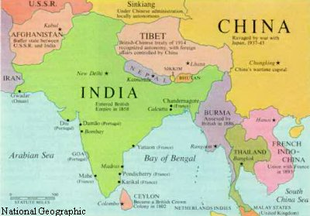
India - 1945

Slide 9
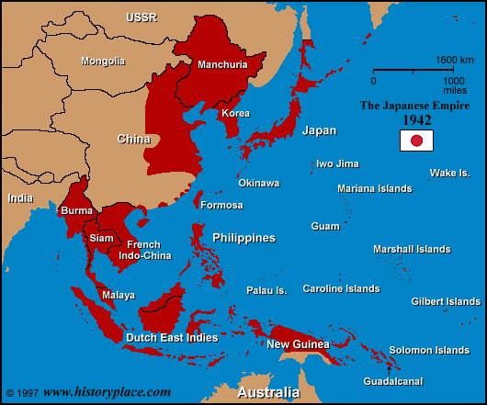
Fighting In Pacific

Slide 10
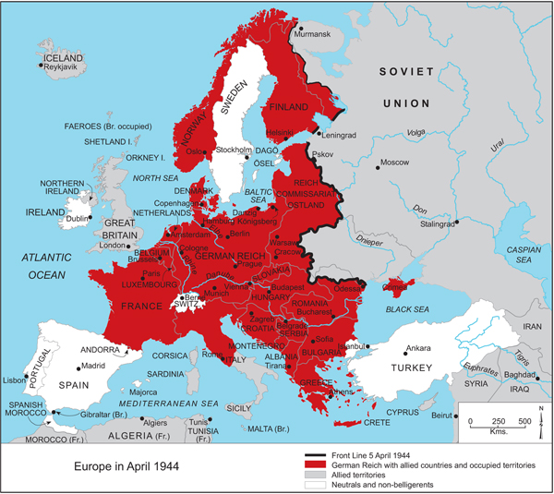
Meanwhile in Europe…

Slide 11
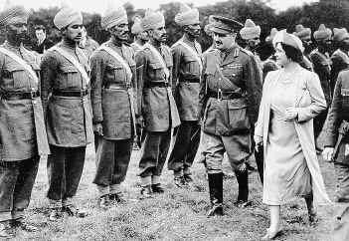
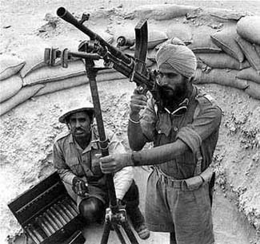
Indian earns its independence
200,000 volunteers for Britain
Video
0:00-7:00
England’s Promise
Video
30:00-37:35 min

Slide 12
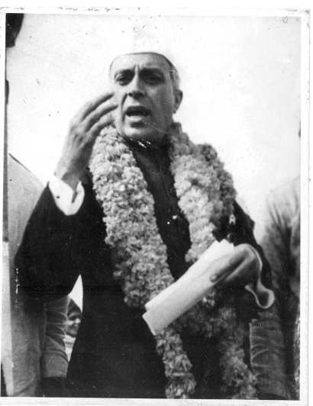
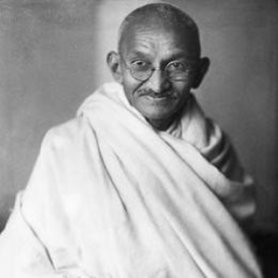
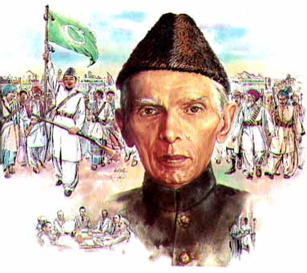
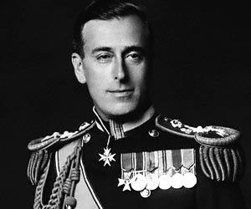
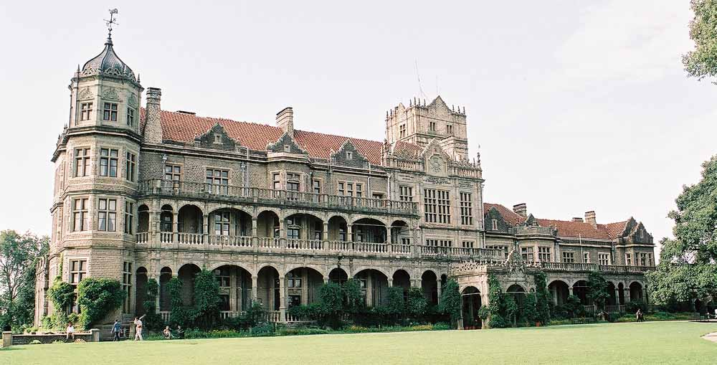
Simla Conference…

