Slide 1
Sub-Saharan Africa
Patterson

Slide 2
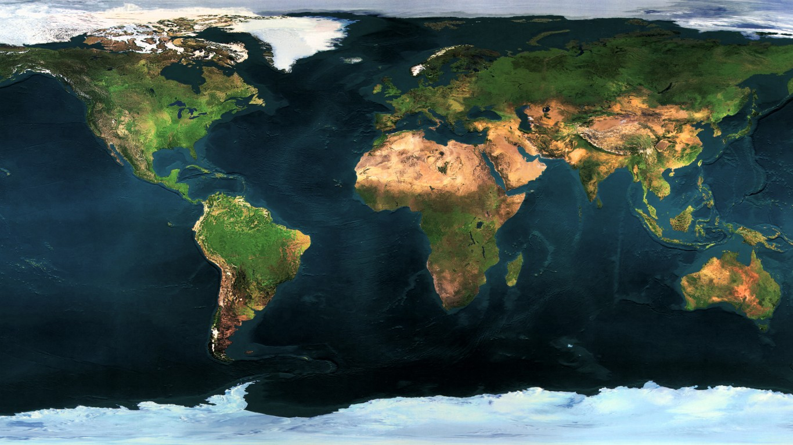
Where is this region?
5
3
2
4
6
1

Slide 3
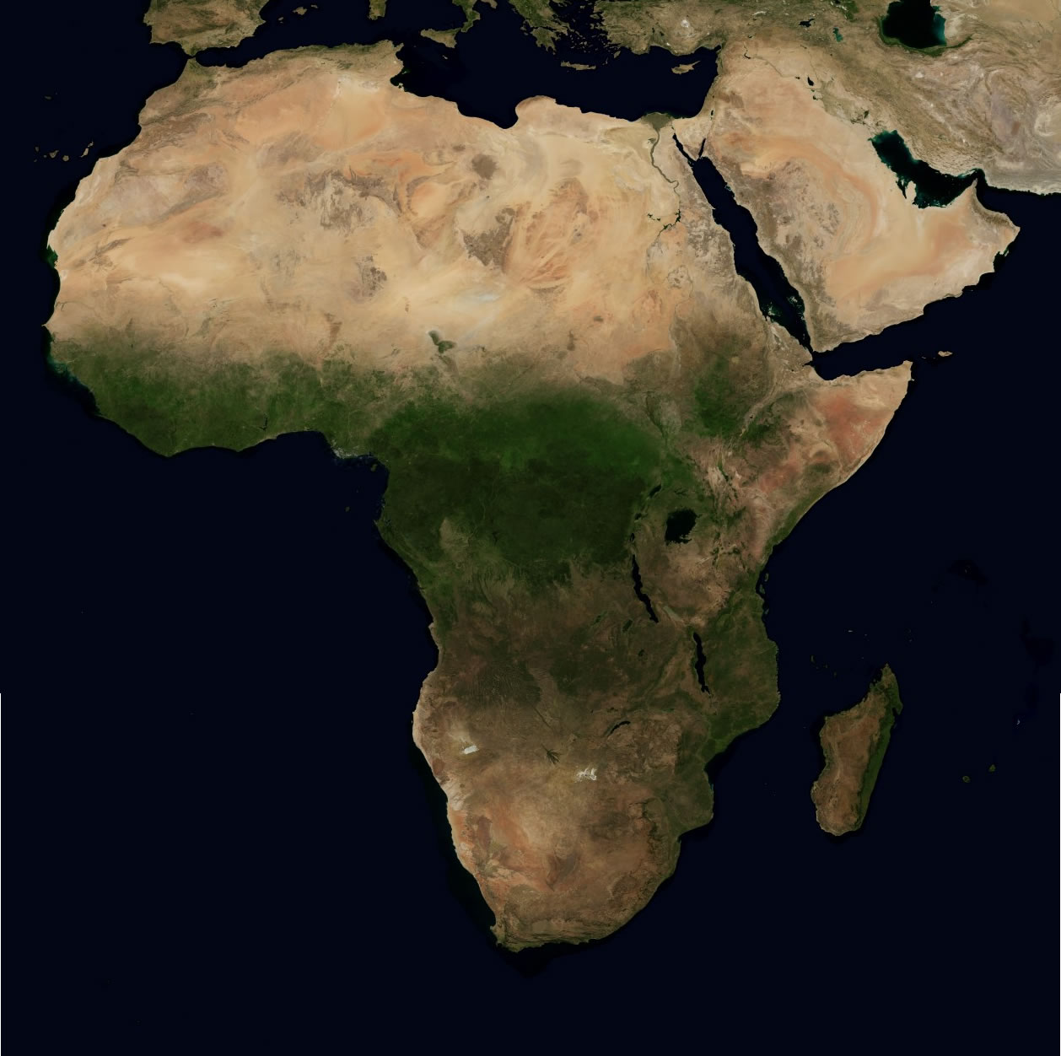
Sub-Saharan Africa

Slide 4
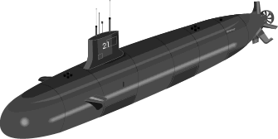
Sub-Saharan Africa
Sub means “below” Sahara is a desert

Slide 5
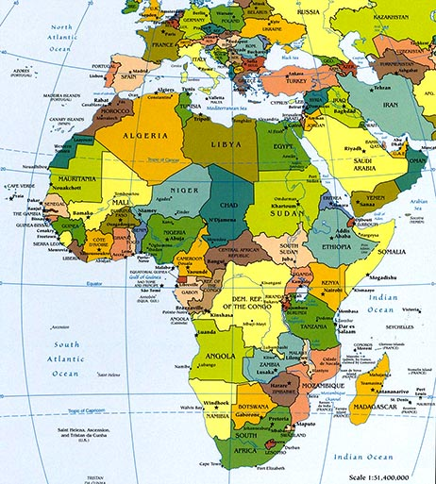
Why should we care?
Africa is an interesting region to study. It’s a tale of two halves, one of a rich heritage and the other of a struggle to develop.
The origins of the struggle largely center on Africa being on the wrong end of guns, germs, and steel.

Slide 6
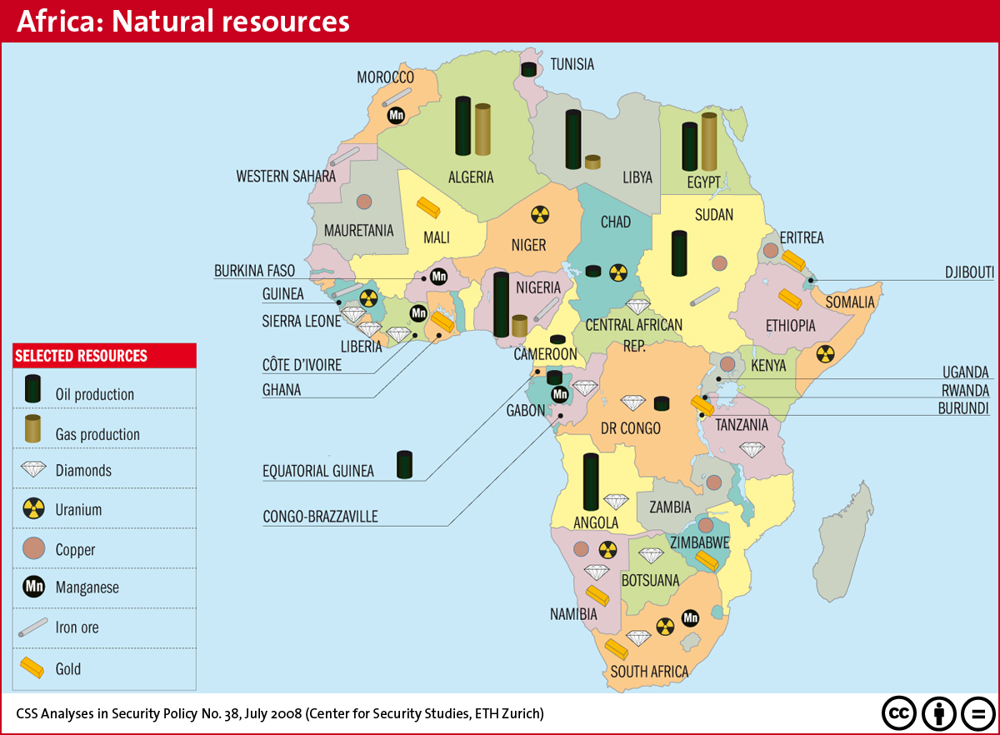
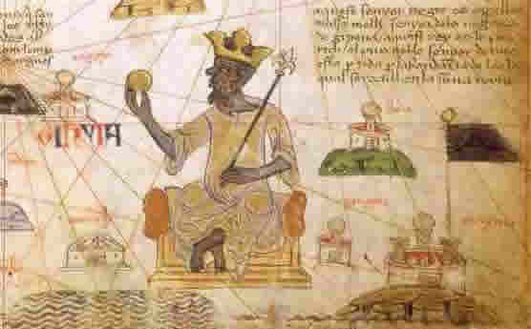
Sub-Saharan Africa
Strengths
Resources
Rich heritage

Slide 7
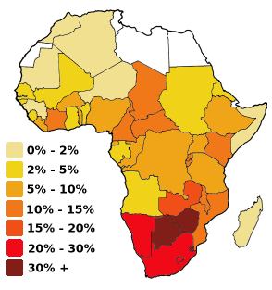
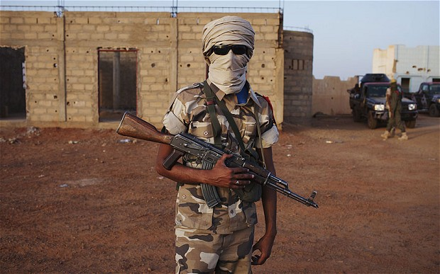
Sub-Saharan Africa
Areas for Improvement
Lack of development
Turmoil/conflict
Climate change
HIV/Ebola

Slide 8
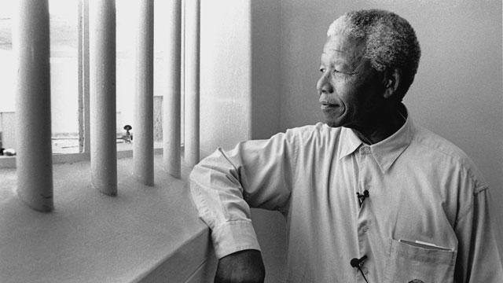
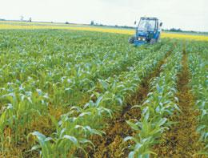
Sub-Saharan Africa
United States can learn from Africa….
Apartheid
United States can help Africa by….
Helping countries develop.

Slide 9
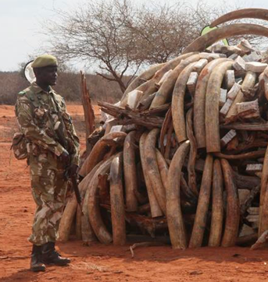
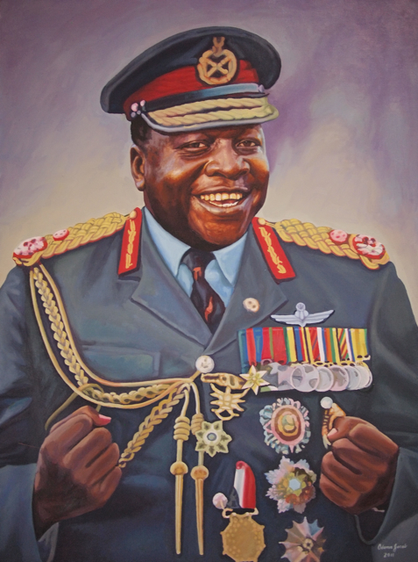
Why does Africa not have a developed (rich) country?

