Slide 1
Myanmar
Burma VJ (Video Journalist) - Link 2 min
Warm Up
What’s happening in Myanmar?
Write down your emotions as you watch the video clip.

Slide 2
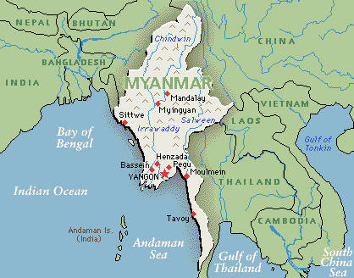
Where is this country?

Slide 3
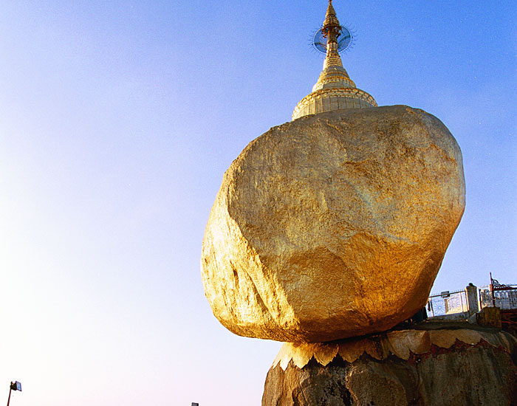
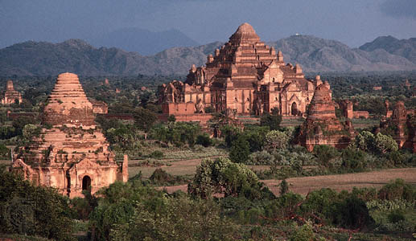
Rich Culture

Slide 4
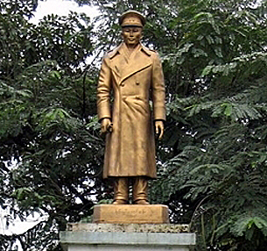
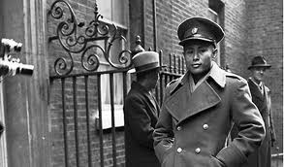
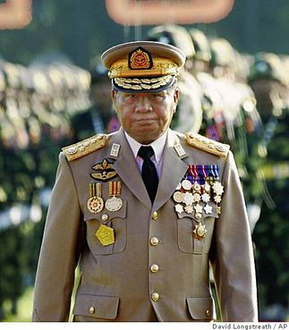
Gained Independence 1948
Aung Saan

Slide 5
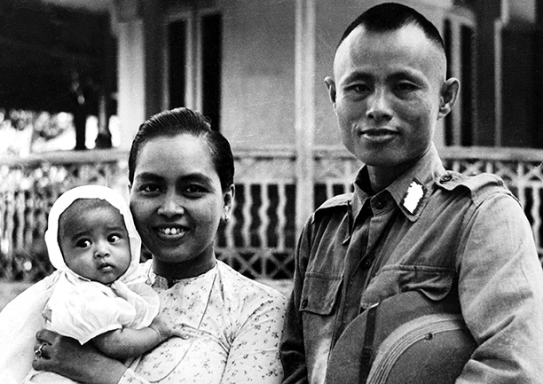
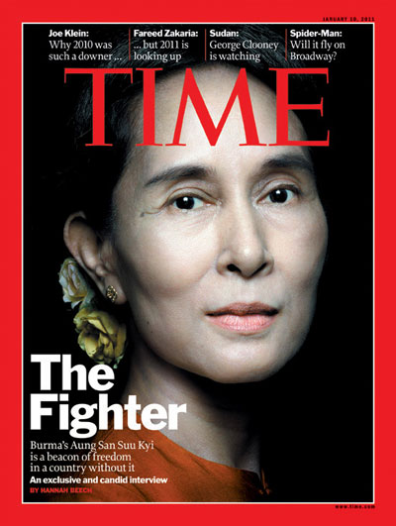
Aung Saan Suu Kyi

Slide 6
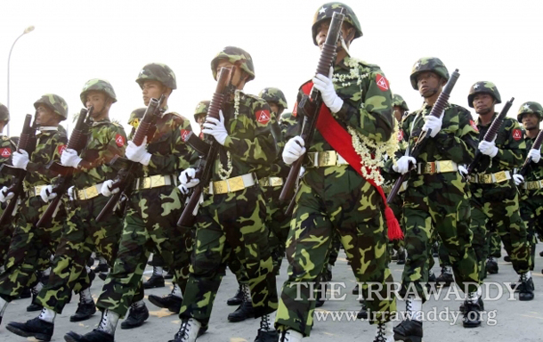
VS.

Slide 7
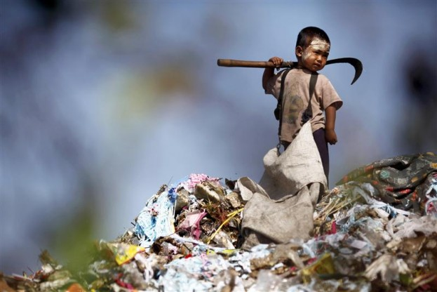
What/who is keeping the people of Myanmar from improving their lives?

