Slide 1
Humans of New York

Slide 2
“I spent about ten years as a music agent. Along the way, I became very interested in how my clients handled success. Some of them were tremendously successful but quite unhappy. Others seemed quite content with their success. The subject interested me so much that I went back to school to study the science of happiness, and now I teach the subject at NYU. Happiness doesn’t necessarily mean you have a smile on your face. It’s more of a mixing board with several different dials: positive emotion, engagement, relationships, meaning, and achievement. Everyone’s mixing board is set differently. There’s no one way to be happy and there’s no wrong way to be happy. I may draw my happiness from relationships, while somebody else may need to be constantly engaged in the pursuit of a goal.

Slide 3
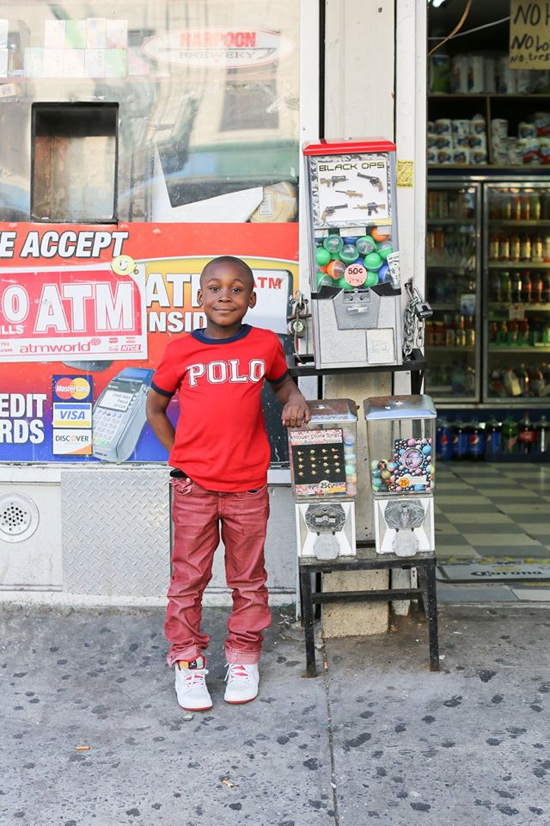
“I’ve got lots of ideas for inventions so I’m going to be a millionaire.” “What sort of inventions?” “Flying shoes. A Hoverboard. A freeze ray. A robot of Michael Jordan. A robot of me. And a big robot that’s two million feet tall that I can live in. That’s it for now.”
"I went to Coney Island and went on a ride that went round and round and upside down and I wasn't scared."
"I want to be an astronaut." "What's the hardest part about being an astronaut?" "Pressing the right buttons at the right time."

Slide 4
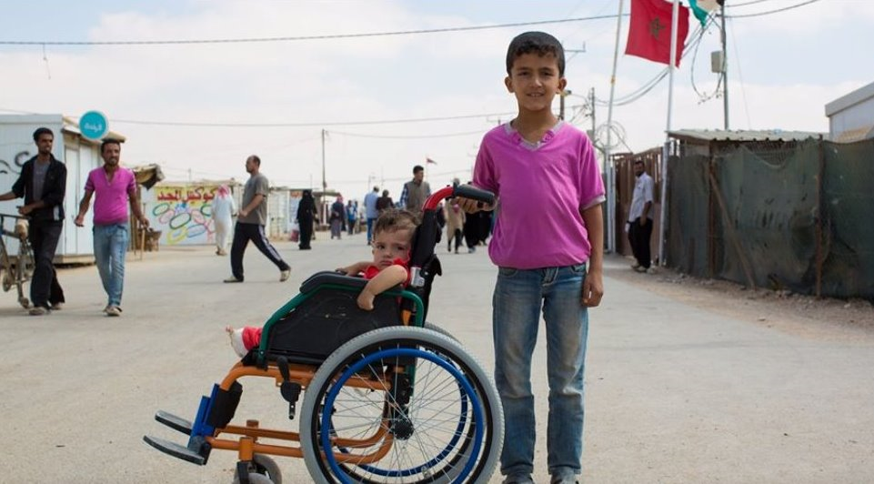
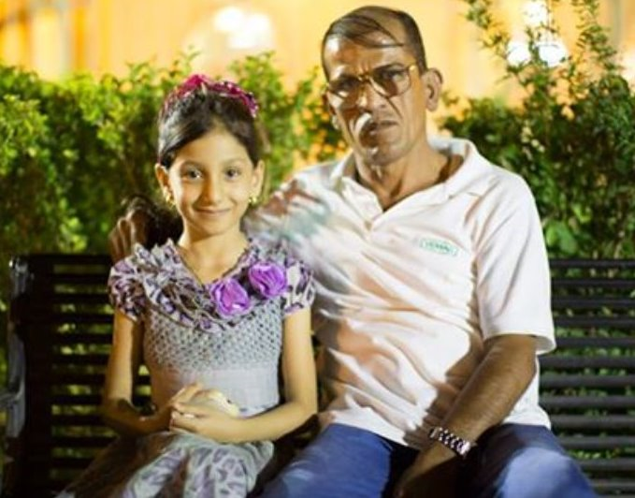
“What are your hopes for them?”
“We left our hopes back in Syria.”
(Zaatari Refugee Camp, Jordan)
“She always dreams about the bombs.”
(Erbil, Iraq)
“I want to be a pilot so I can fly everywhere.”
(Dhana, Jordan)

Slide 5
Analyze the Stories
How are the US stories different from those of South West Asia (The Middle East)?
How do US children view the world vs. how SW Asian children view the world?
What story do the pictures tell that the text may have left out?

Slide 6
Perspective: The way a person sees something.
A person’s perspective is created or changes based on where they are from, their personal life experiences/influences, their belief systems/opinions, etc.
Why do you think the stories are different?
What is influencing their perspectives?

Slide 7
Influences on Perspective
Each partner/group has a different person’s story. Read each story and answer the following questions on a separate sheet of paper
Summarize the Main Idea of each story. What is its lasting impact?
What can you infer about the country or region the person is in/writing about?
What does the picture tell you/explain that the text leaves out?
How is the person’s/persons’ experience going to shape their views on current issues? Pick one or two issues to write about.
Immigration/refugees, terrorism/extremism, Syrian war, ISIS, Israel/Palestinian conflict, US relations, religion…

