Slide 1
Globalization Vocabulary
Callanan Middle School

Slide 2
Directions
On the following slides you will be shown challenging vocabulary words and pictures that will help you understand the word’s meaning.
Only write down what is underlined.
When CALLED upon you can guess the words meaning. If shout out you will not be able to share your answer.

Slide 3
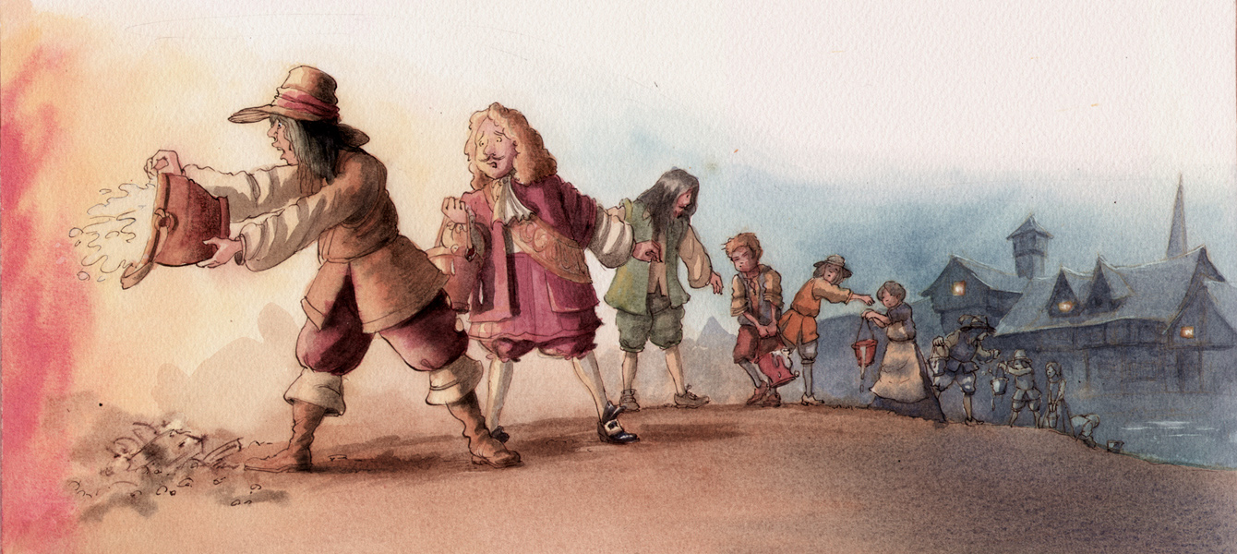
Interdependence

Slide 4
Interdependence
concept of relying on each other to work/function.

Slide 5
Globalization

Slide 6
Globalization
The interdependence of business, trade, and economics between countries.

Slide 7
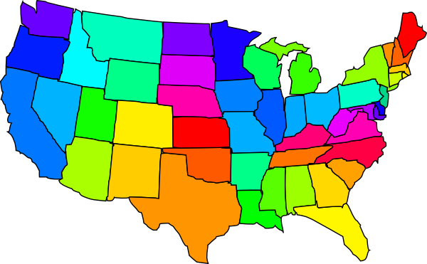
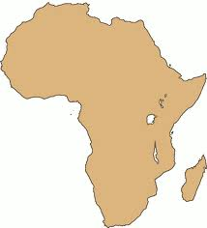
Domestic

Slide 8
Domestic
at home or within a country.

Slide 9
Foreign

Slide 10
Foreign
Away from home or outside the country.

Slide 11
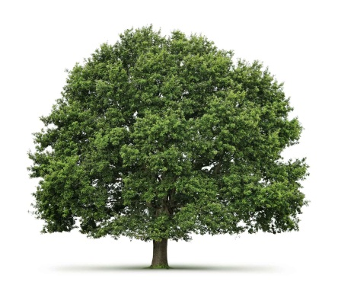
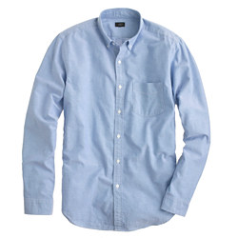
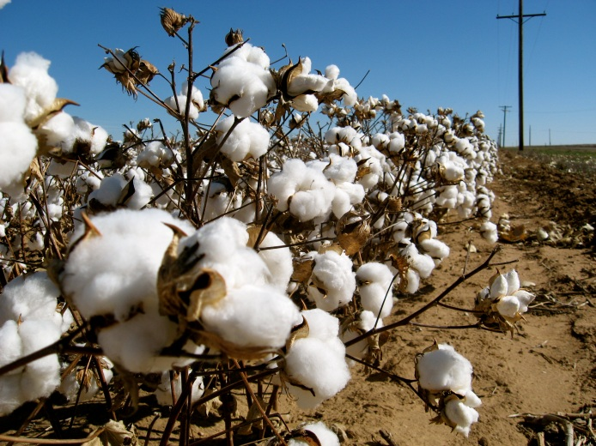
Raw Goods

Slide 12
Raw Goods
Are things that are changed into finished product.

Slide 13
Finished Goods

Slide 14
Finished Goods
Are items that are made up of raw goods that people use.
Wood Pencil
Raw Finished

