Slide 1
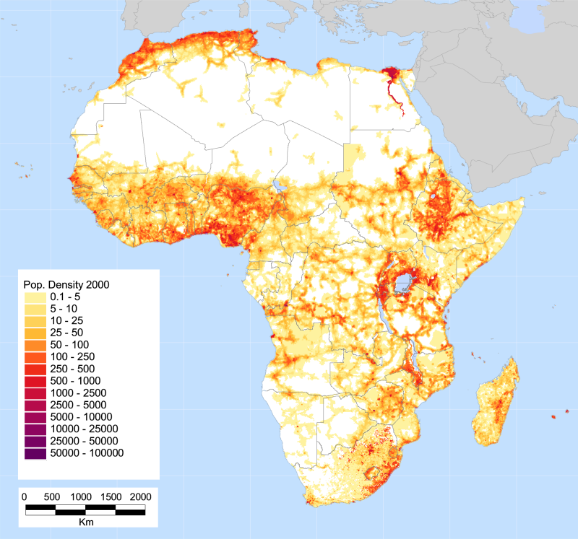
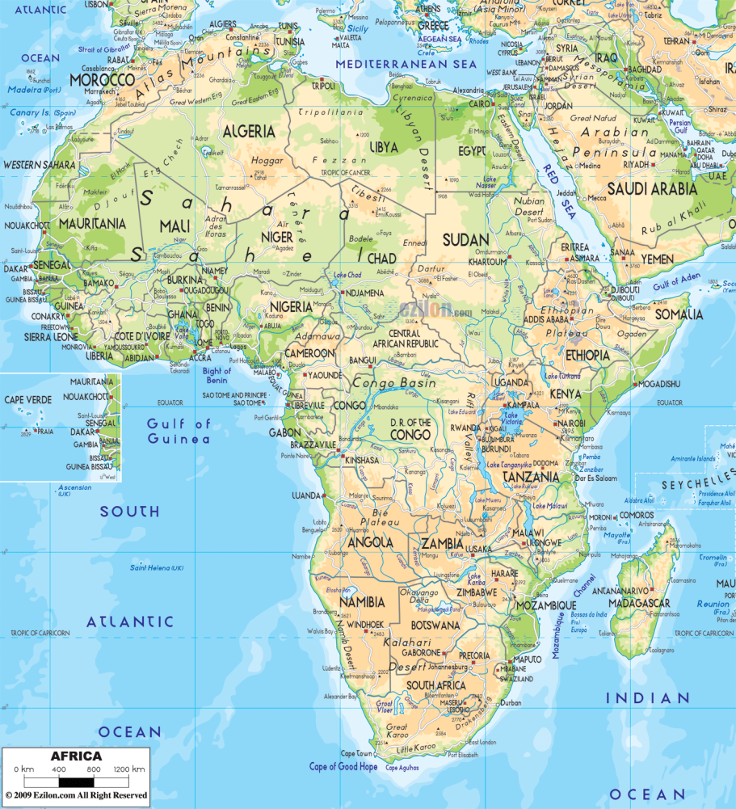
The map on the left shows population density, the map on the right is a physical map. What conclusions can you draw about population based on physical features?

