Slide 1
The Five Themes of Geography
A Framework for Studying the World

Slide 2
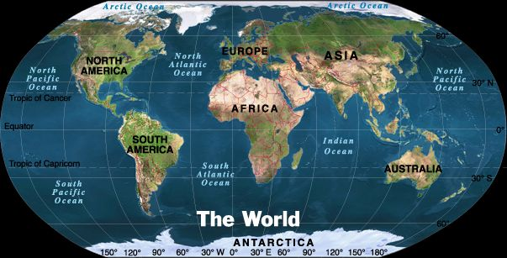
Theme 1: Location
Two Types of Location
Absolute
Relative
Where is It?
Why is It There?

Slide 3
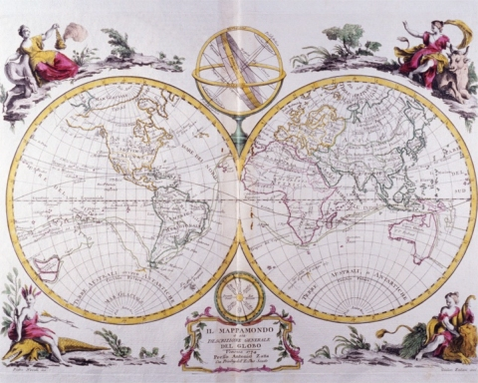
Absolute Location
A specific place on the Earth’s surface
Uses a grid system
Latitude and longitude
A global address

Slide 4
IOWA
Absolute Location
Des Moines, IA
  41° 36' N Latitude
  93° 36' W longitude
Cedar Rapids, IA
  42° 00' N Latitude
  91° 38' W Longitude

Slide 5
Relative Location
Where a place is in relation to another place
Uses directional words to describe
  Cardinal and intermediate directions

Slide 6
IOWA
Iowa is bordered by Minnesota on the north, Missouri on the south, Nebraska on the west, and Illinois on the east
Iowa is one of the Midwestern States

Slide 7
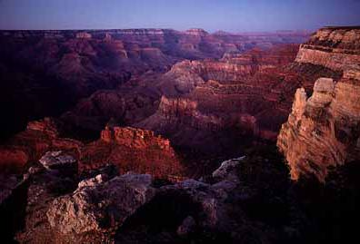
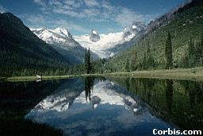
Theme 2: Place
Physical Characteristics
Land Features
Mountains, plains, and plateaus
Climate
Bodies of Water

Slide 8
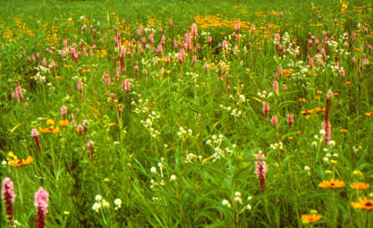
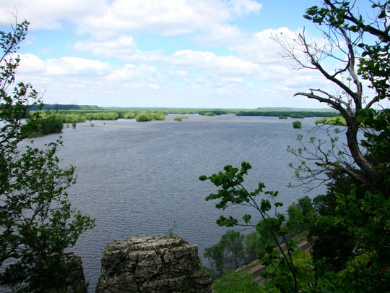
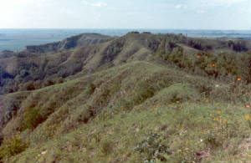
Iowa: Physical Characteristics

Slide 9
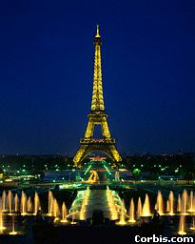
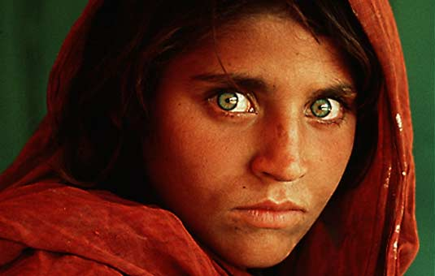
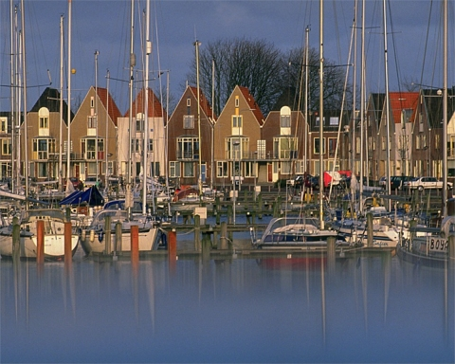
Theme 2: Place
Human Characteristics
People
Culture
Language
Religion
Buildings and Landmarks
Cities

Slide 10
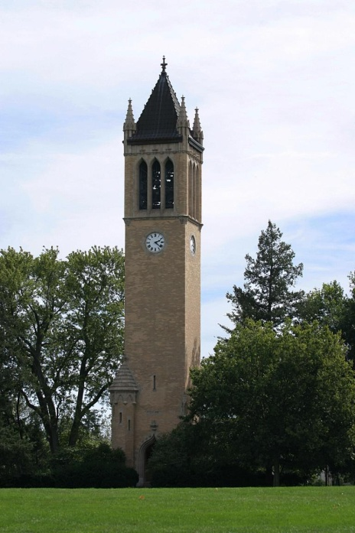
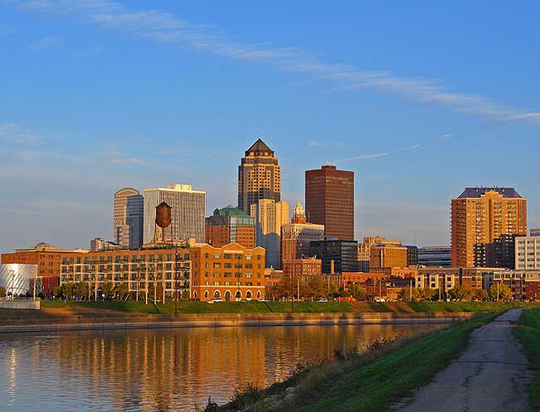
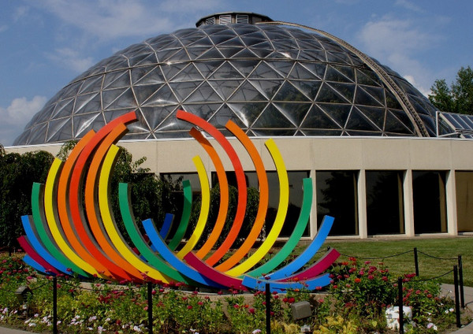
Iowa:
Human Characteristics

Slide 11
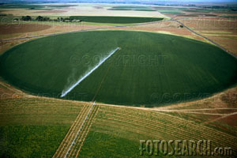
Theme 3: Human Environment Interaction
How People Interact With Their Environment
People . . .
Adapt to Their Environment
Modify Their Environment
Depend on Their Environment
http://www.fotosearch.com/comp/corbis/DGT119/BAG0017.jpg

Slide 12
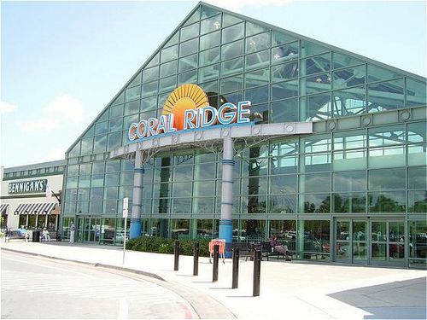
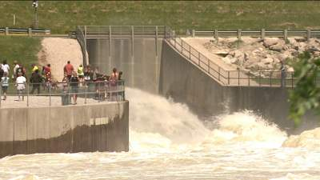
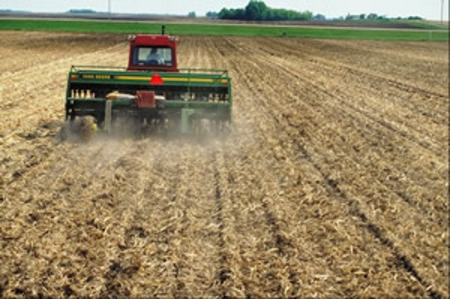
Iowa: Human Environment Interaction

Slide 13
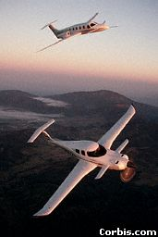
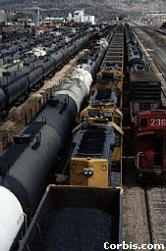
Theme 4: Movement
The Mobility of
People
Goods
Ideas
How Places are linked to one another and the world

Slide 14
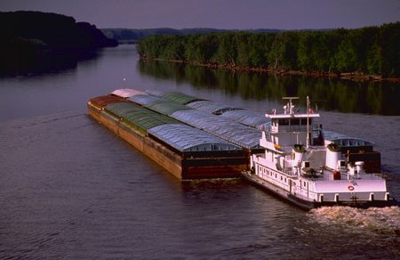
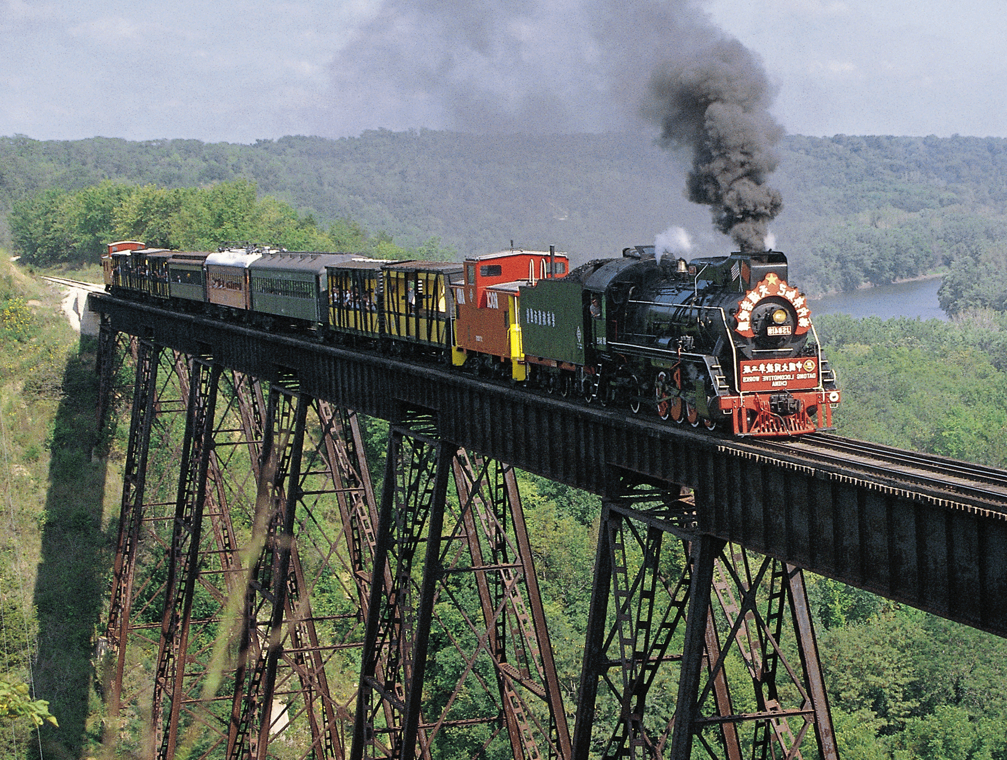
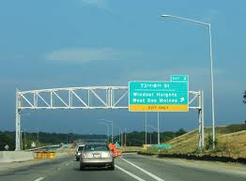
Iowa : Movement

Slide 15
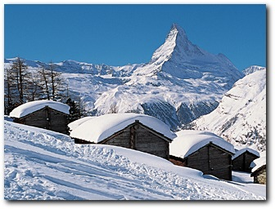
Theme 5: Regions
What Places Have in Common
Political Regions
Landform Regions
Agricultural Regions
Cultural Regions

Slide 16
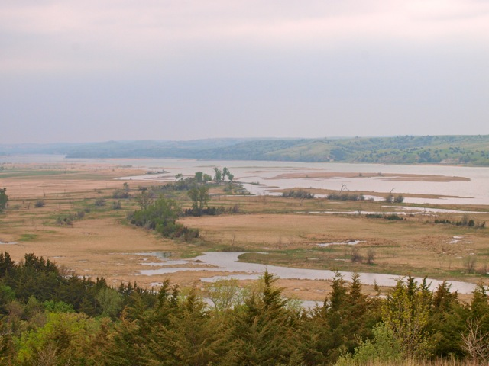
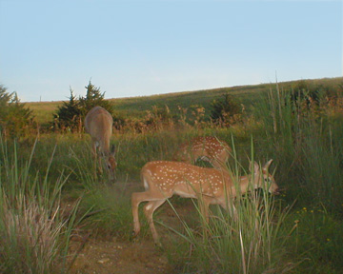
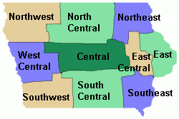
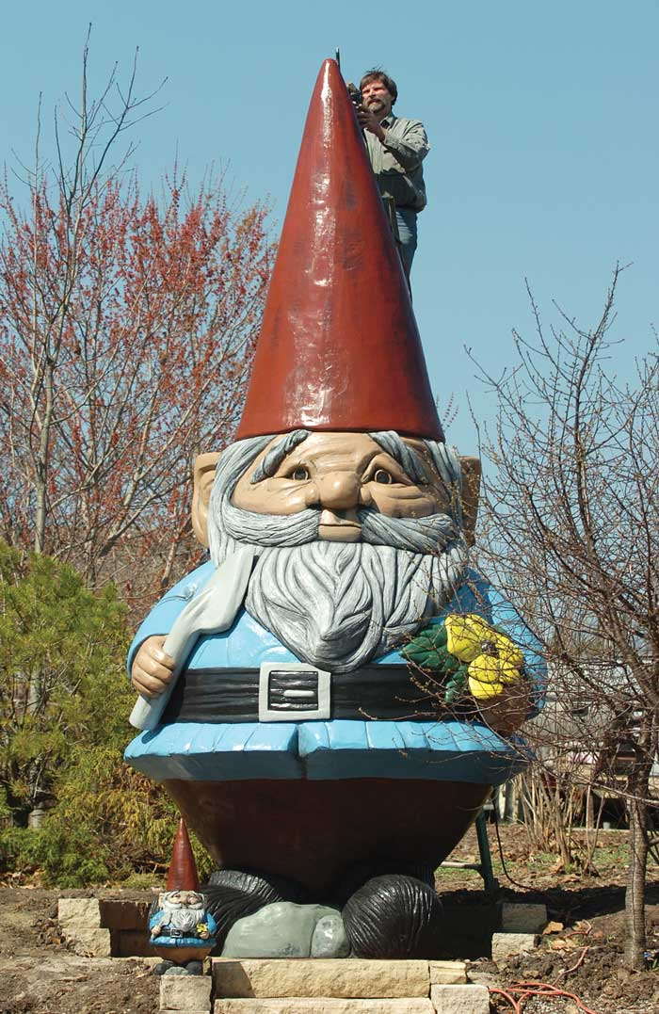
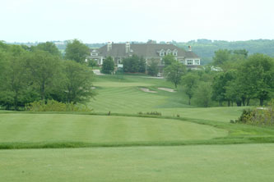
Iowa: Regions

