Slide 1
South/central Asia
Mr. Patterson

Slide 2
South/Central Asia
In your notebook you need to write down everything that is underlined.

Slide 3
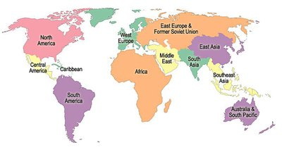
Southwest Asia
Where is this region?

Slide 4
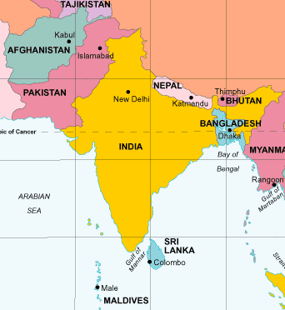
Southwest Asia
We will be studying these countries over the next six weeks.
Why is this region an exciting place to study?

Slide 5
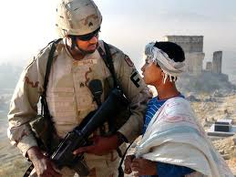
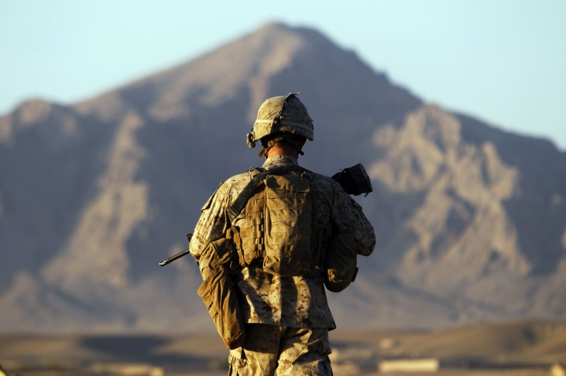
South/Central Asia
The U. S. has troops in this country.

Slide 6
South/Central Asia
The U.S. killed Bin Laden here.

Slide 7
South/Central Asia
The U.S. give this country more than $60 billion since 1948.

Slide 8
South/Central Asia
The U.S. give this country $126 million in 2010 alone
Projected to give $11 billion more in the next 5 years

Slide 9
South/Central Asia
The U.S. give this country $19 billion in the last 10 years.

Slide 10
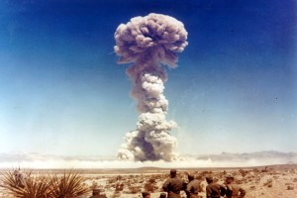
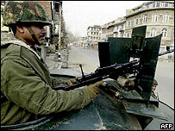
South/Central Asia
These countries don’t like each other….and they have nukes.

Slide 11
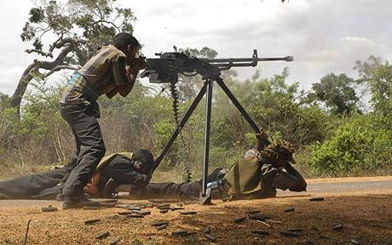
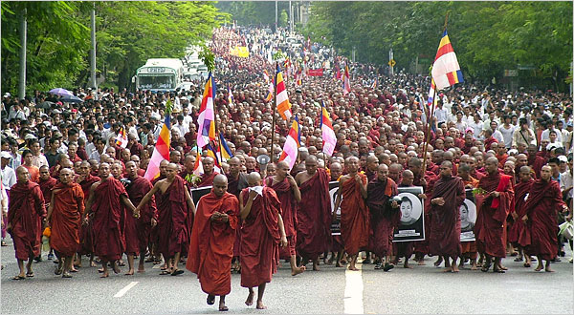
South/Central Asia
These countries have had a civil war/coup since you were born.

Slide 12
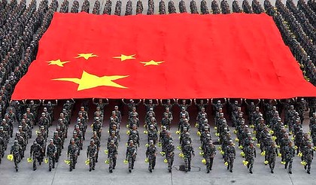
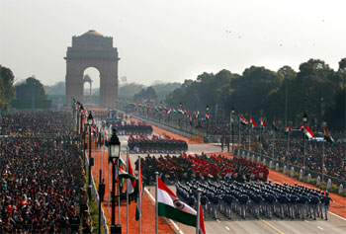
South/Central Asia
This region is only getting stronger. In your lifetime these two countries could/will become more powerful than the U.S.

Slide 13
South/Central Asia Introduction
6 minutes
http://www.learn360.com/ShowVideo.aspx?SearchText=south+asia&lid=13863540&player=13&ID=317769&autostart=1
Login: 1737callan
Password: haea11

Slide 14
South/Central Asia
Introducing Continent – 6 min
Write down the words to the right.
Skip four lines in between each word.
When you hear the video mention the words write down what it says.
Indian Ocean
Bay of Bengal
Indus River
Ganges River
Hindu Kush Mountains
Himalaya Mountains

Slide 15
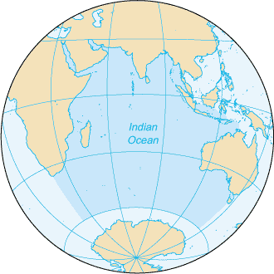
Indian Ocean
is the third largest of the world's ocean
covering approximately 20% of the water on the Earth’s surface.
Connects India to Africa, the Middle East, and Australia

Slide 16
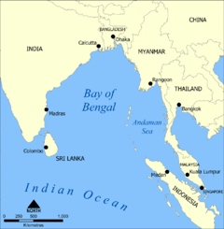
Bay of Bengal
the largest bay in the world.
Most major rivers of India flow into the Bay of Bengal.

Slide 17
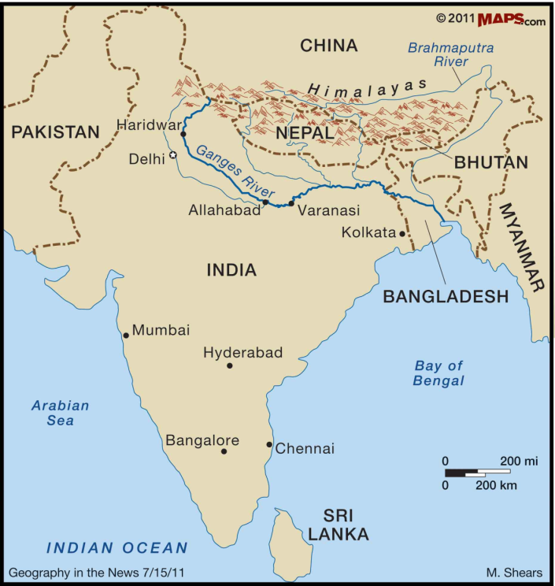
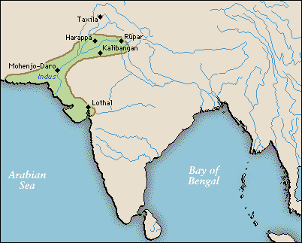
Indus/Ganges Rivers
Have defined life in Asia, just at the Nile has with Egypt.
Source of water, transportation, and diffusion of ideas.

Slide 18
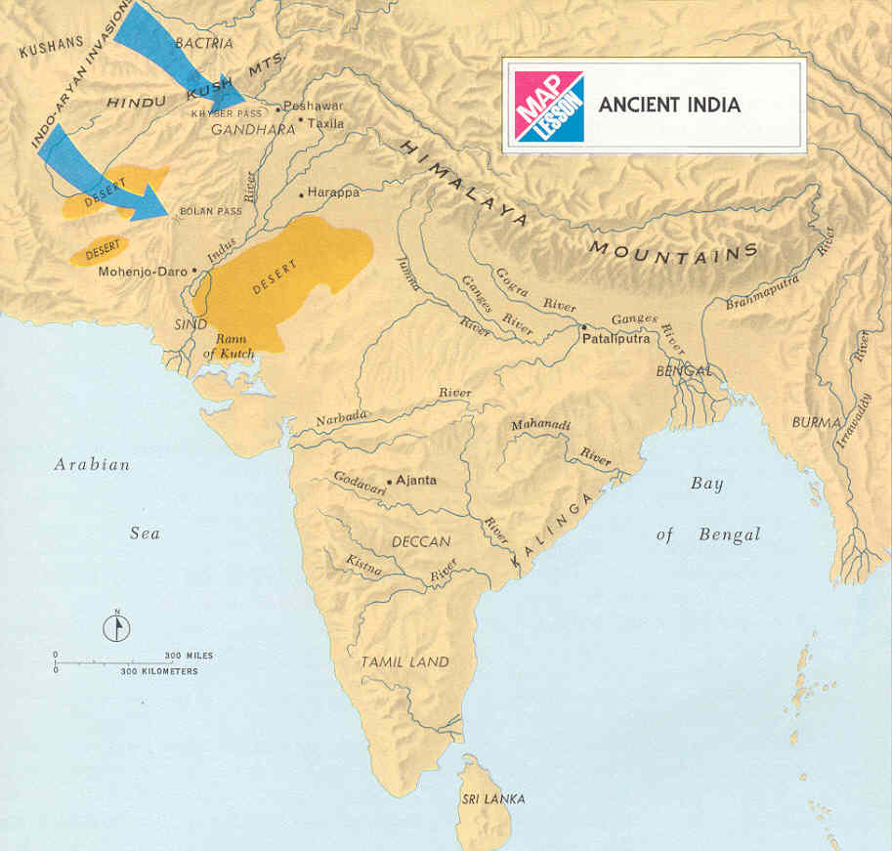
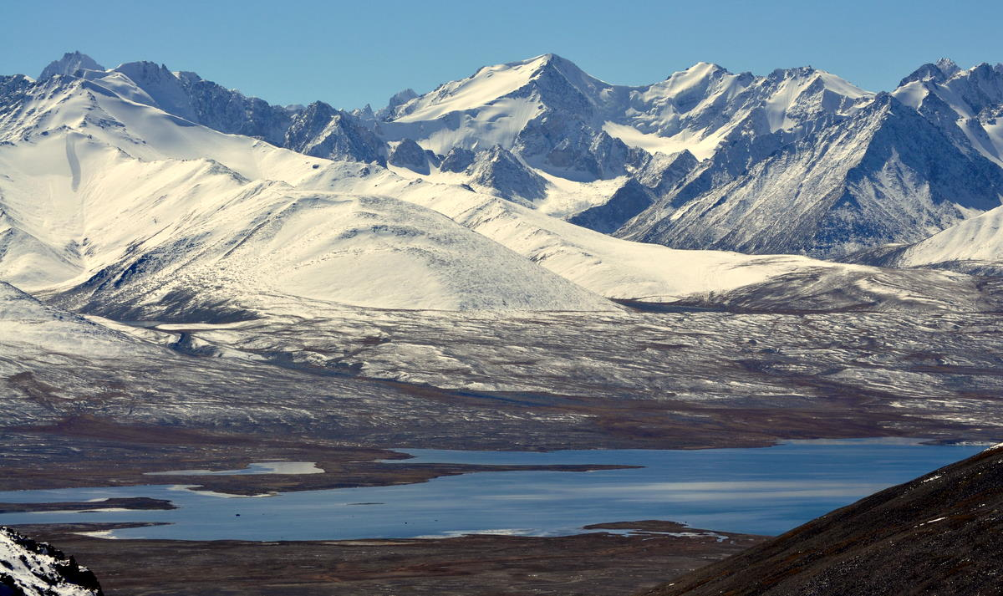
Hindu Kush Mountains
Hindu Kush Mountains
Mountain range that dominates the geography of Afghanistan

Slide 19
Himalaya Mountains
is home to some of the planet's highest peaks, including the highest, Mount Everest.
are among the youngest mountain ranges.

Slide 20
Climate
What kind of climate does South/Central Asia have?
Purple Asia book
pg. 32

Slide 21
Sources
Source: http://www.guardian.co.uk/commentisfree/cifamerica/poll/2011/aug/16/india-us-aid-poll
http://www.pbs.org/newshour/bb/military/jan-june11/afghanistan1_06-08.html
https://www.youtube.com/watch?v=cekU_MvrkEs
https://www.youtube.com/watch?v=x-LFOkGfyZM

