Slide 1
Buddhism

Slide 2
"Awakened One" (Buddha): Prince Siddhartha Gautama, who would one day be known as the Buddha, began his life as a prince in a kingdom in ancient India.
Prince Gautama (Buddha) was born about 553 BCE. He had parents who loved him, many servants to wait on him, the finest clothes, and a different palace for each season of the year. Yet, he found his world full of suffering. It upset him that painful old age, sickness, and death were all part of life in this world.

Slide 3
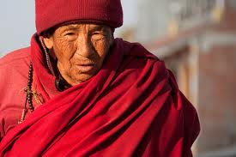
One day, he met a monk. He was amazed that this monk could find calm and peace in a world filled with such sufferings. That day he made a very difficult decision. He decided to leave his wealth, his comfort, his wife, and his newborn son, to become a monk.

Slide 4
For the next six years he traveled throughout India. But the answers he found were not enough. One day, while sitting under a fig tree, an understanding came to him. This understanding was a way to end suffering. That was the day Prince Siddhartha Gautama began to earn a new title, the Buddha, which means "Awakened One".

Slide 5
Four Noble Truths: His journey to find the meaning of life had concluded. The Buddha realized that life is ruled by Four Noble Truths:
Life is filled with suffering
Suffering is caused by people's wants.
Suffering can be ended if people stop wanting things, like more pleasure or more power.
To stop wanting things, people must follow 8 basic laws, called the Eightfold Path.

Slide 6
Eightfold Path: In brief, these are the laws of the Eightfold Path:
To know the truth
To intend to resist evil
To not say anything to hurt others
To respect life, property, and morality
To work at a job that does not injure others
To try to free one's mind from evil
To be in control of one's feelings and thoughts
To practice appropriate forms of concentration

Slide 7
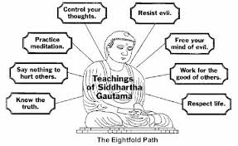
The Middle Way: The Eightfold Path was designed to guide people without making life too strict or too easy. The Middle Way is the name Buddhists call lives guided by the laws of the Eightfold Path.

Slide 8
Buddha spent the rest of his life traveling around India and sharing his message with everyone. He had many followers, who lived according to his Four Noble Truths. Some of his followers became Buddhist monks. They gave up all they owned and depended on other followers and kind hearted people to give them food. Their message was one of love.
After the Buddha's death in 483 BCE, Buddhism spread rapidly throughout Southern and Eastern Asia.

Slide 9
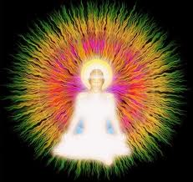
Nirvana: Nirvana is the supreme state free from suffering and individual existence. It is a state Buddhists refer to as "Enlightenment". It is the ultimate goal of all Buddhists. The attainment of nirvana breaks the otherwise endless rebirth cycle of reincarnation. Buddhists also consider nirvana as freedom from all worldly concerns such as greed, hate, and ignorance. No one can describe in words what nirvana is. It can only be experienced directly.

Slide 10
Soul: Buddhists believe that they are temporary vessels in this world and that until they attain enlightenment or Buddhahood, they do not know their own self or soul. They believe that this world is an illusion and that as a result, one can not know one’s true nature.

Slide 11
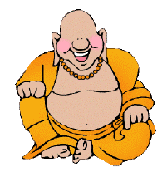
The Laughing Buddha: Have you ever seen a ceramic or carved representation (a statue) of the Buddha, perhaps in a Chinese restaurant, or for sale in a store, or in your home or garden? Have you ever wondered why the Buddha is laughing?
The laughing Buddha reminds us that to be happy we need to have a loving heart. A big heart gives you tolerance. It helps you to greet each day with joy and all people with gladness. It helps you to tolerate a great many things with a big happy smile that reaches your eyes and your heart.
Buddha says that the best way to solve a problem we might have with someone else is to have a warm and loving heart. By not being resentful, by not bearing grudges, only then are we able to smile like the Buddha - only then can we be truly happy.

Slide 12
The Goal - To Become The Greatest Person in the World: Buddhism teaches that being the greatest is an absolute achievement free of comparison. What does that mean? It means that to be the greatest is not an achievement that can be attained through competition. You can't win greatness - but you can achieve it. That means everyone can be the greatest.
Here's an example: For a healthy ant to successfully carry one grain of rice is a great achievement. For a healthy horse to successfully carry one grain of rice is not all that terrific. The ant has put his best effort into his job. It has fulfilled its purpose as an ant. When this truth is achieved, the ant is no longer just an ant. The ant has moved into the realm of Truth - it has become the greatest ant in the world.

Slide 13
Buddhism teaches that a person is successful not because he or she is better than someone else, and not because they received a higher grade on a test or won a Gold Medal at the Olympics, or beat out other ants to see who could carry the biggest and heaviest grain of rice. True achievement does not come from competition or comparison. A person (or an ant, or a horse) is successful because he or she has given their best within their means. For this reason, every single person can become the greatest person in the world, all at the same time.

Slide 14
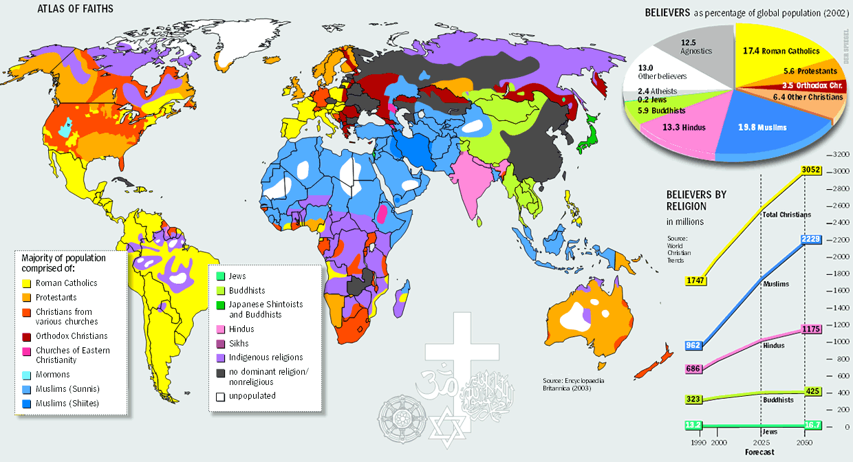
The Growth of Buddhism: Buddhism values love, wisdom, goodness, calm, and self-control. Buddhists believe that The Buddha and his teachings should be honored, that people should try to end suffering, that they should follow the Eightfold Path.
Today, Buddhism is a major world religion. There are over 350 million Buddhists in the world.

