Slide 1
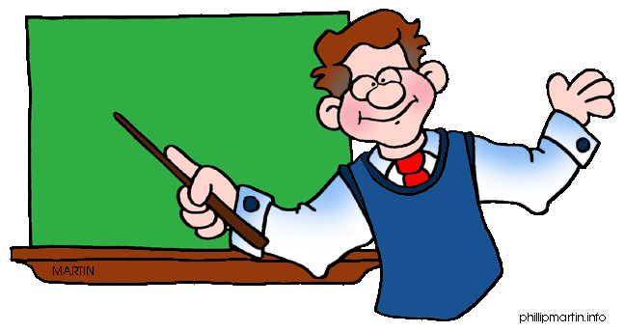
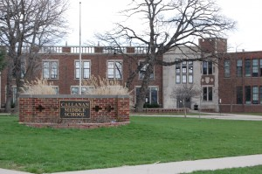
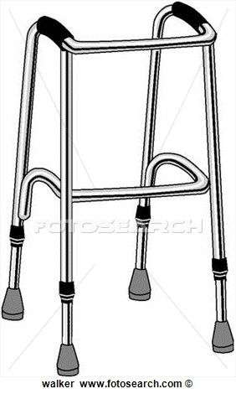
Who is Mr. Sissel?
Mr. Sissel is a global studies teacher at Callanan.
Global Studies

Slide 2
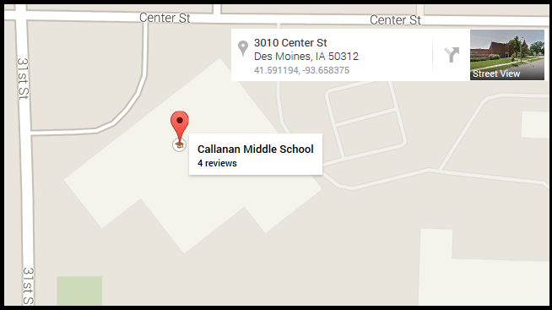
Absolute Location
an exact position, there is only one possible spot.

Slide 3
Relative Location
Describing the position of something based on what is around it.
“To the right of the tree.”
“To the left of the basketball hoop.”
“Behind the red car.”

Slide 4
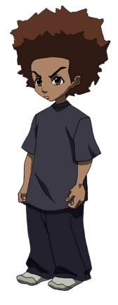
Equator
A line that cuts the Earth into exactly two even parts horizontally, at the “waist.”

Slide 5
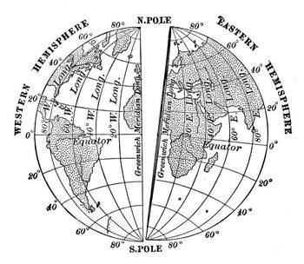
Prime Meridian
A line that cuts the Earth into exactly two even parts vertically, from “head to toe.”

