Slide 1
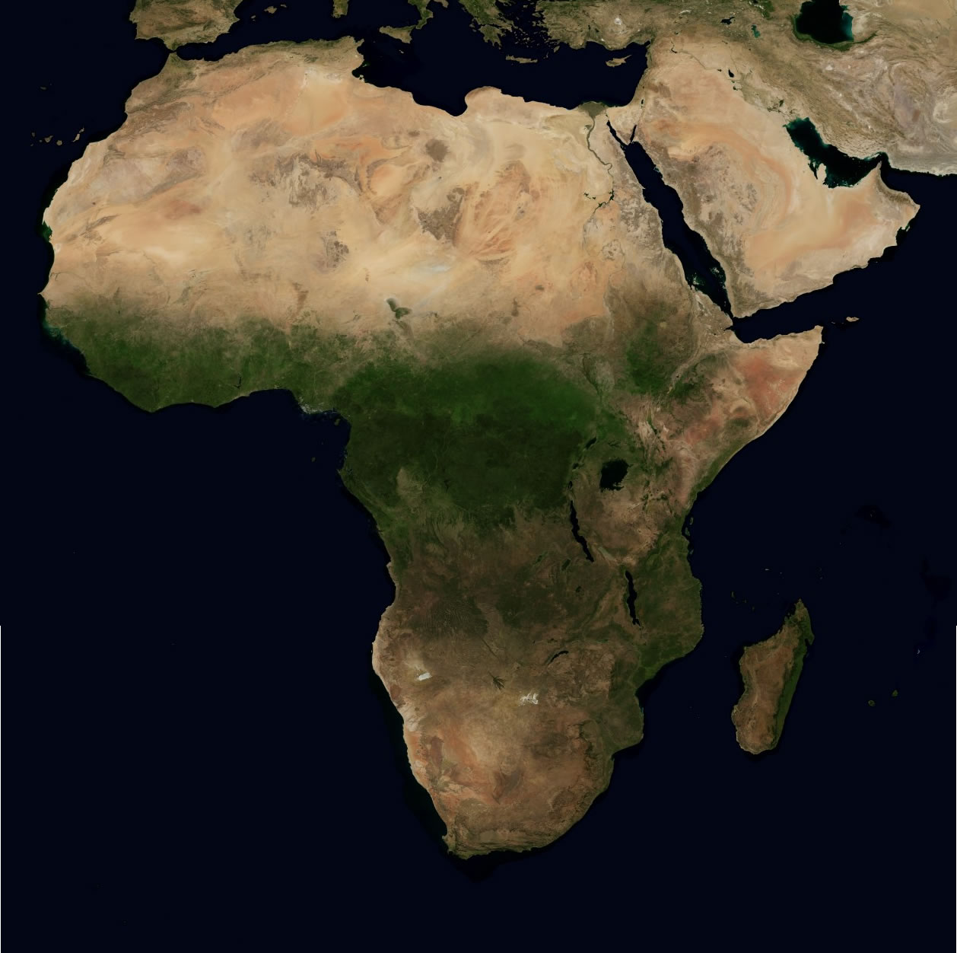
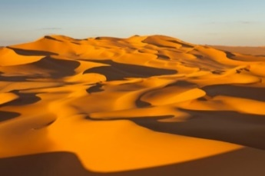


Sub-Saharan Africa
Sub-Saharan African is below the Sahara Desert. Most people that live there are Christian.

Slide 2
North Africa
North Africa is dominated by the Sahara Desert. Most people that live there are Muslim.

Slide 3




Primary Source
a document or physical object which was written or created during the time under study.
Kathryn!!!!

Slide 4
Secondary Source
a document or physical object which was written or after the time under study.
Kathryn!!!!

Slide 5



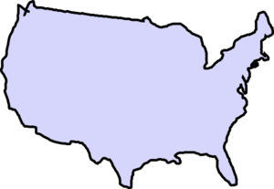


Colonize
to settle in an area and take control of its government (usually for natural resources).

Slide 6
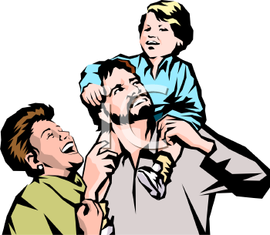
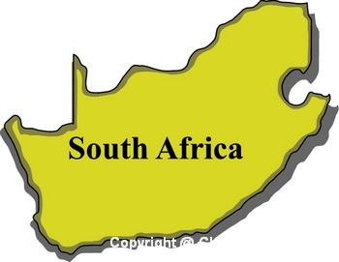
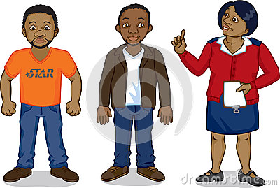
Apartheid
A series of racist laws that prevented people of color from becoming powerful and wealthy.

Slide 7
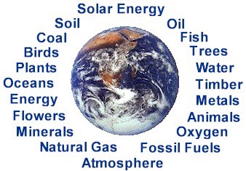
Natural Resources
A supply of materials produced by the Earth that are valuable to human society.
=

Slide 8



Cultural Diffusion
the spread of customs and ideas from one culture to another.

Slide 9


Nationalism
Is a feeling of pride in one’s country or group.

Slide 10

Symbol
A shape, sign, or item that is used/connected/represents something else.
Recycling

Slide 12
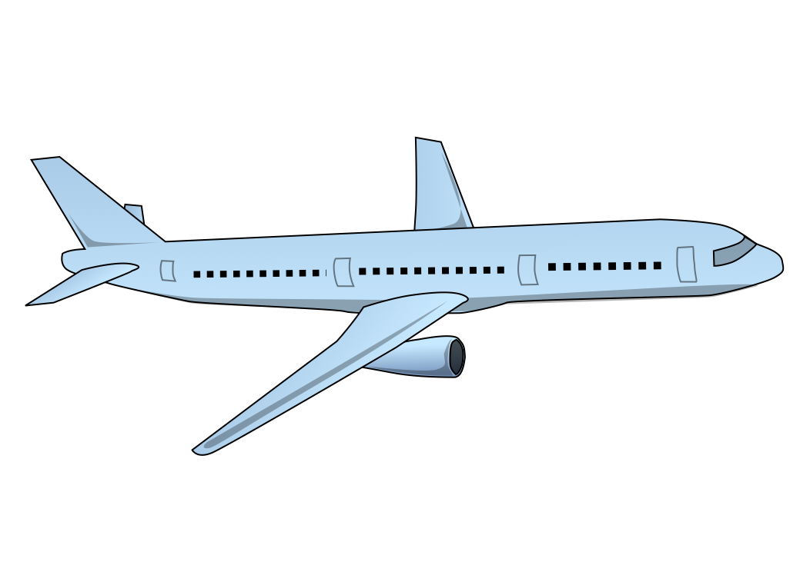



Physical Map
show what a region looks like by showing things such as deserts, plains, and mountains.

Slide 13



Political Maps
Show continents, countries, and divisions within countries.

Slide 14
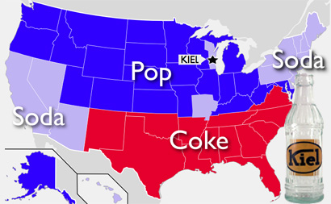
Thematic Map
Are issue maps, showing things like: land use, language, and population in an area.

