Slide 1
Sub. Africa Vocab
Patterson

Slide 2
Vocabulary
On each of the following slides there is a picture and a vocabulary word. When called upon, your job is to guess what the word or phrase means based upon the picture.

Slide 3
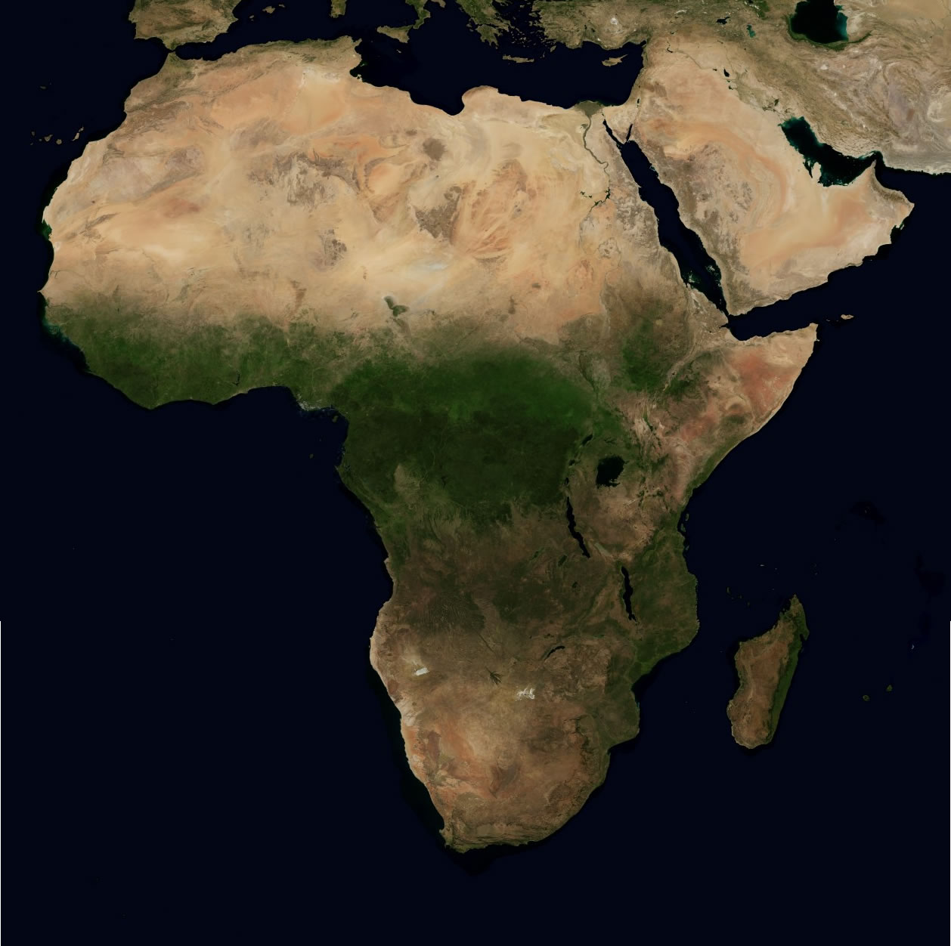
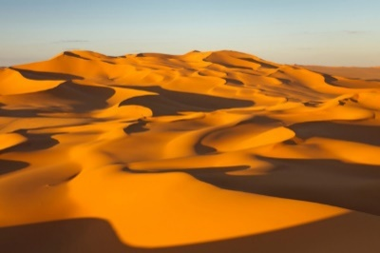

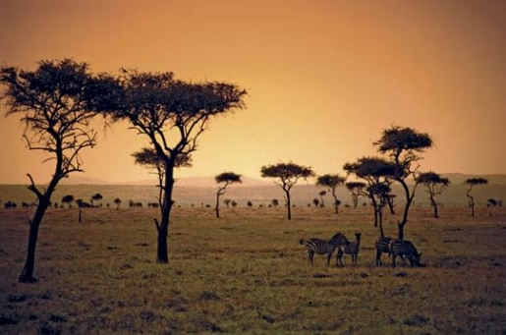

Sub-Saharan Africa

Slide 4
Sub-Saharan Africa
Sub-Saharan African is below the Sahara Desert. Most people that live there are Christian.

Slide 5
North Africa

Slide 6
North Africa
North Africa is dominated by the Sahara Desert. Most people that live there are Muslim.

Slide 7


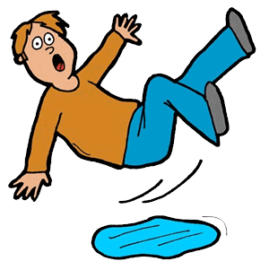

Primary Source
Kathryn!!!!

Slide 8
Primary Resource
a document or physical object which was written or created during the time under study.

Slide 9
Secondary Source
Kathryn!!!!

Slide 10
Secondary Resource
a document or physical object which was written or after the time under study.

Slide 11




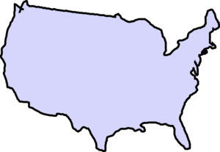
Colonize

Slide 12
Colonize
to settle in an area and take control of its government (usually for natural resources).

Slide 13
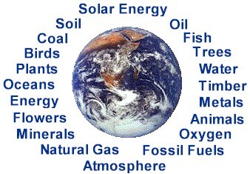
Natural Resources
=

Slide 14
Natural Resources
A supply of materials produced by the Earth that are valuable to human society.

Slide 15


Cultural Diffusion

Slide 16
Cultural Diffusion
the spread of customs and ideas from one culture to another.

Slide 17
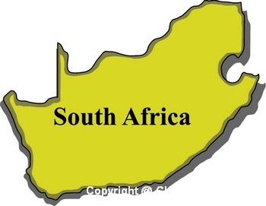
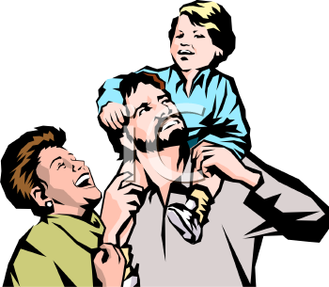
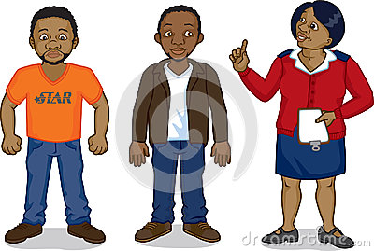
Apartheid

Slide 18
Apartheid
A series of racist laws that prevented people of color from becoming powerful and wealthy.

Slide 19


Nationalism

Slide 20

Nationalism
a feeling of pride in one’s homeland; a group’s identity as members of a nation.

Slide 21


Symbol
?
?

Slide 22
Symbol
A shape, sign, or item that is used/connected/represents something else.
Recycling

Slide 24
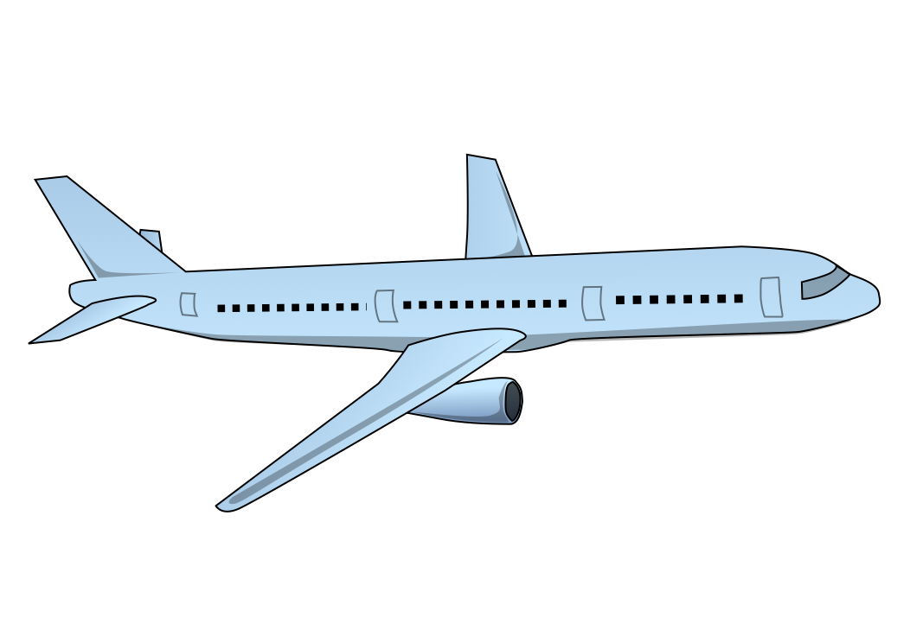


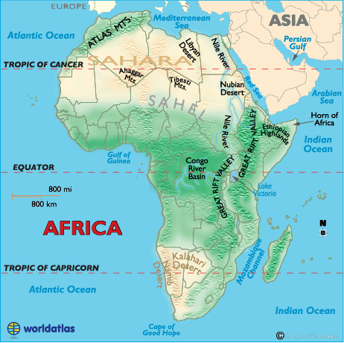

Physical Map

Slide 25
Physical Maps
show what a region looks like by showing things such as deserts, plains, and mountains.

Slide 26

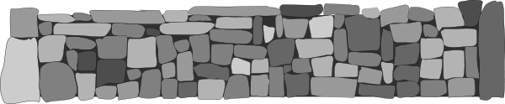
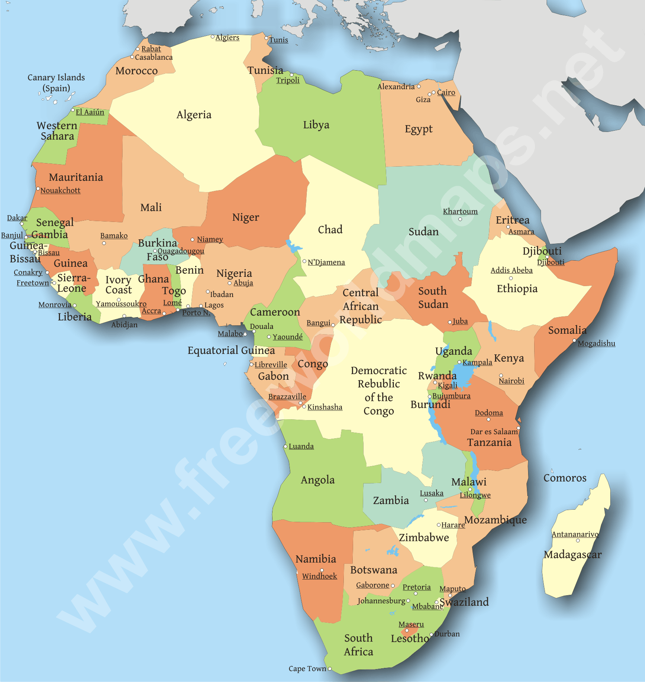

Political Map

Slide 27
Political Maps
show continents, countries, and divisions within countries.

Slide 28
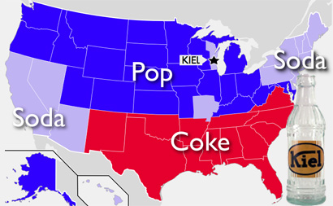
Thematic Map
Potential Topics
Oil Location
Birth Rates
Crime Rate
Land Use
Education Rates
Etc….

Slide 29
Thematic Map
are special issue maps, showing things like: land use, language, and population.

Slide 30
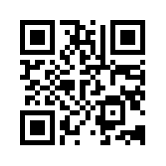
Word Wall
Study Help!!!
Computer
https://quizlet.com/_u0we0
Phone
1. Open Up Quizlet App
2. Search for Pattea42
3. Click on Sub-Saharan Africa

Slide 31
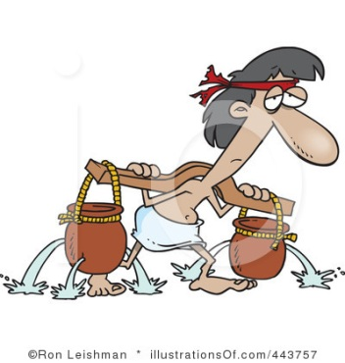

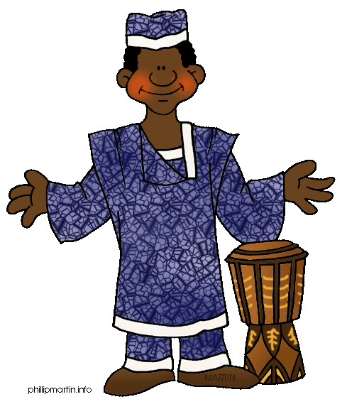
Slave Trade

Slide 32
Slave Trade
The transporting of humans as slaves, with a focus on Africa to the Americas.

Slide 33
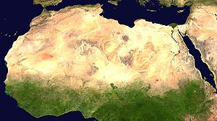
Sahel

Slide 34
Sahel (Shore)
area between the Sahara desert and the rest of Africa

Slide 35
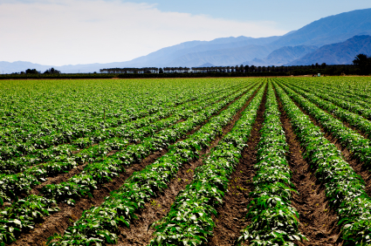
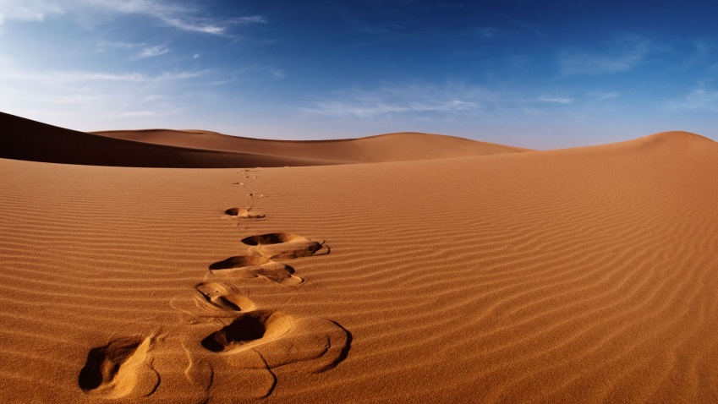
Desertification

Slide 36
Desertification
the process by which farmland becomes too dry or damaged to support life.

Slide 37
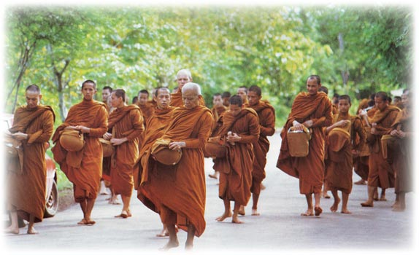


Culture

Slide 38
Culture
A group of people’s way of life, who share customs and beliefs.

